Slide 1
Radio Frecuency Quadrupole (RFQ)
Lukács Kolos
PK79MU

Slide 2
Lecture Plan
Short introduction to linear accelerators
The „missing link” of particle accelerators
Brief history of RFQs invention
Inside the Cavities
Appiclations
Better to know how they work

Slide 3
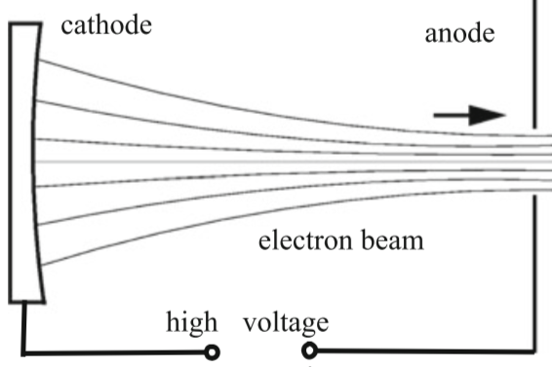
Linear particle accelerators
Static or RF electro-magnetic field used for acceleration
The beam goes through the components only once
Just fixed target experiements
D
Statical
Notes:
We call them linear accelerator becouse the beam is going through once.

Slide 4
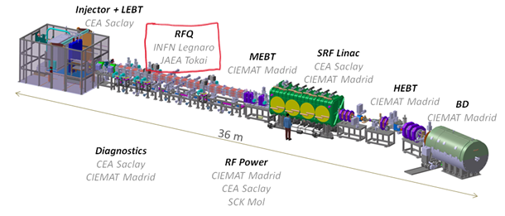
Linear accelerator complexes

Slide 5
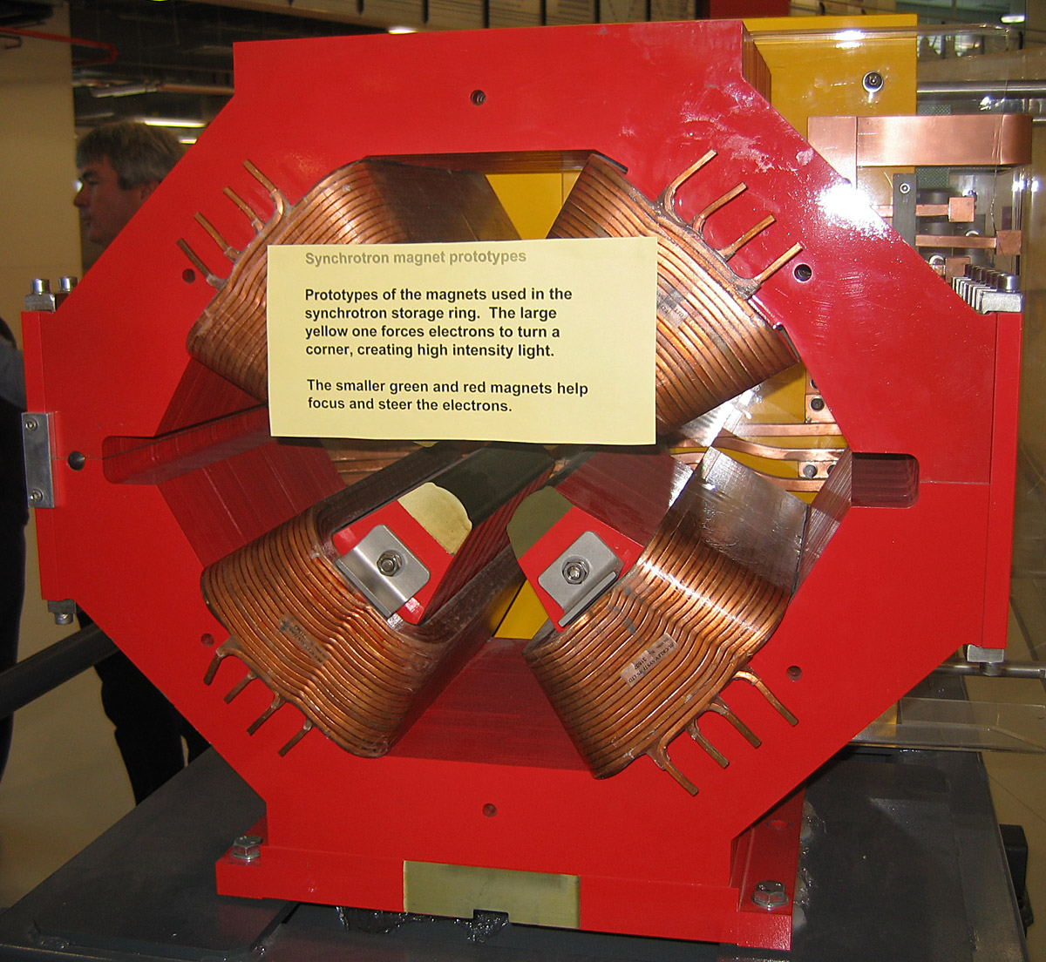
Before RFQ
Classical solution: extend the extraction voltage from the ion source, the beam went straight to a DTL
The beam bunching and focusing happens with seperate installations
There was a need for a more compact device
Focusing magnet

Slide 6
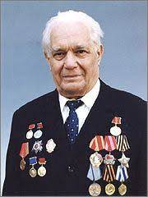
The birth of the idea
In 1970 they have proposed the idea of the
Radio frequency quadrupole
First expererimental test in 1974 with 50 % efficiency
(I. M. Kapchinsky)
???
Vladimir Teplyakov
1925-2008
Notes:
1974: 148.5MHz RFQ accelerated 100-keV protons to 620 keV with an efficiency of 50%

Slide 7
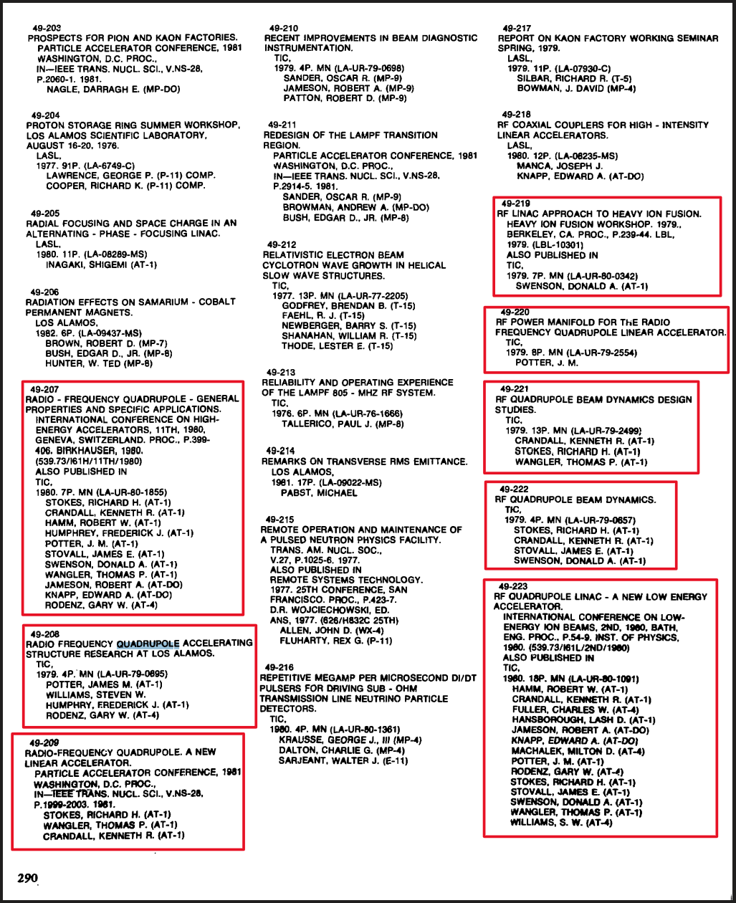
Reveal to the World
1977 : The world is informed about the new idea
1980 : PoP ( pfoor of experiment with 90% efficiency
Notes:
1980: 425 MHz RFQ accelerates a 100-keV proton beam to 640 keV with an efficiency of 90%,

Slide 8
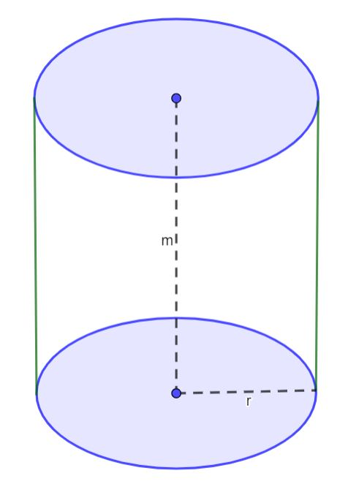
Principle of operation
Boundary conditions in cavity:

Slide 9
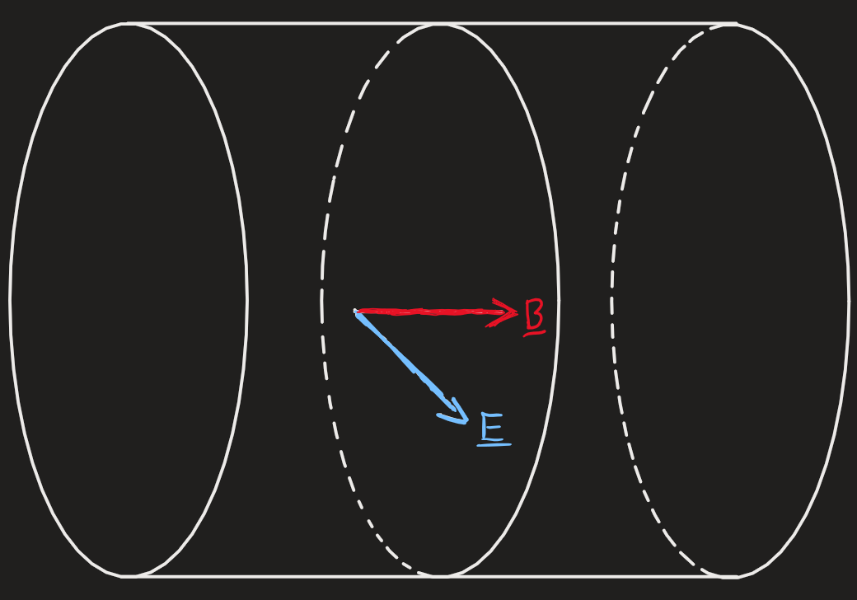
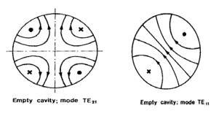
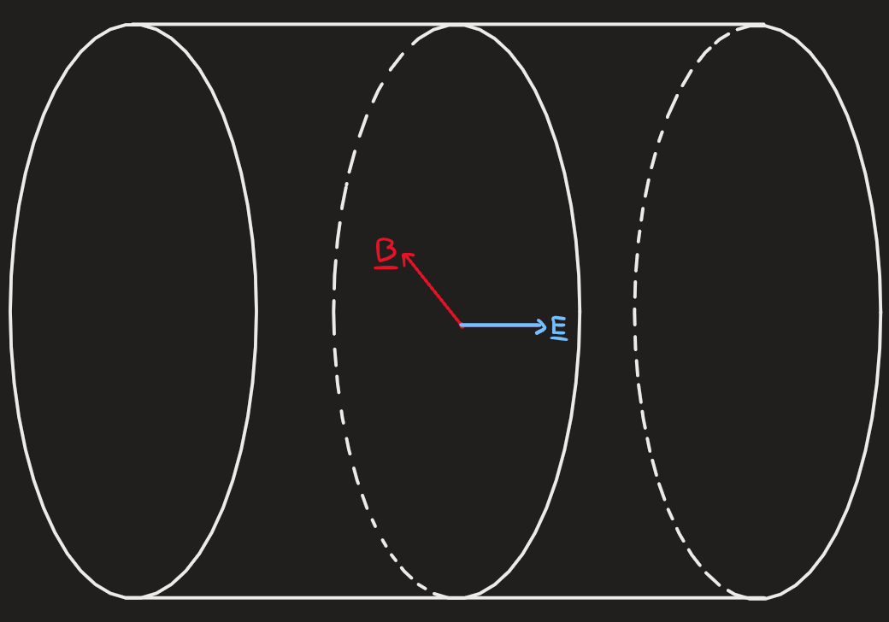
TE/TM modes
TE mode
TM mode
Notes:
Cavity fig: quadropole mode and diple mode

Slide 10
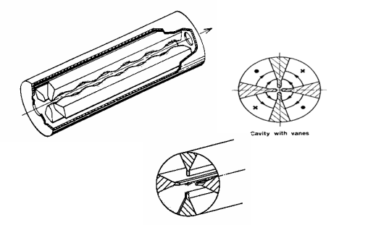
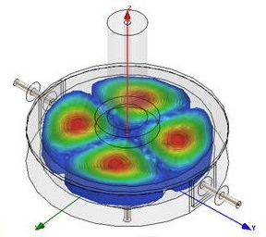
RFQ cylindciralc cavity, 4 electrodes
Notes:
A RFQ is composed of a cavity loaded with four electrodes and therefore forced to resonate in the TE210 mode. A sketch is shown in Fig. 2.

Slide 11
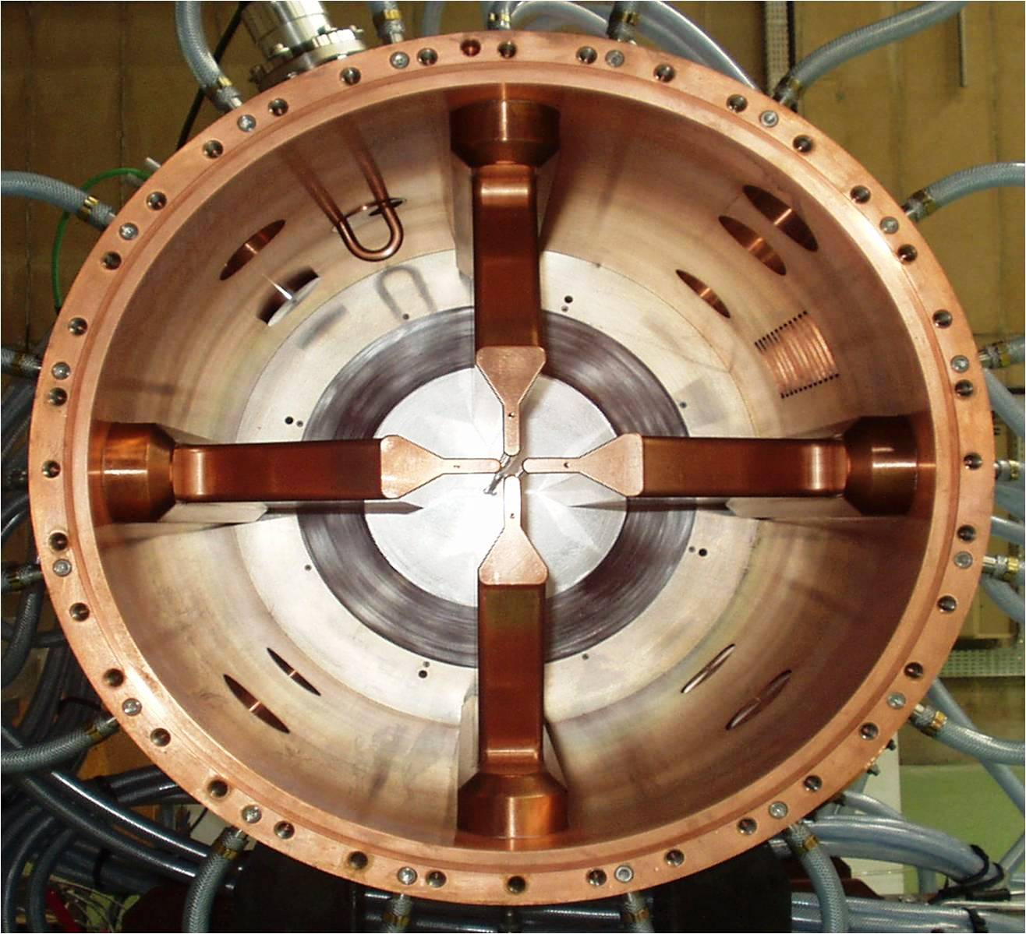
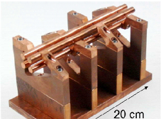
Main configurations for TE210 mode
Notes:
Up: 4 vane sturcture
Donw:4 rod sturcture

Slide 12
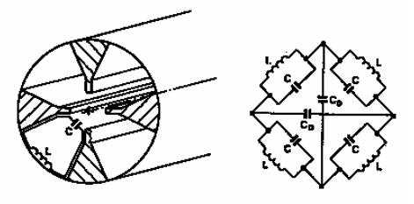
Four-vane structure
Notes:
each vane is a resonator with the capacitance concentrated between the vane tips and the inductance in the inter-vane spacec. Frecuency inversely propotional to the cylinder dimensions. 200MHz bottom

Slide 13
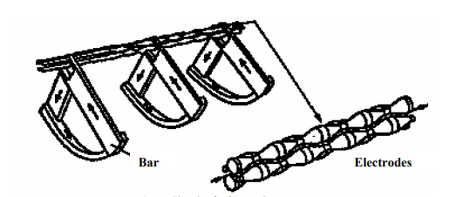
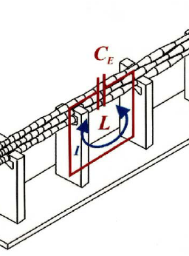
Four-rod structure
Notes:
Becouse each ceel is a resonatro the frecuency is indepentent from the cavity dimensions, altouht its less efficient due to strong current in the holding bars

Slide 14
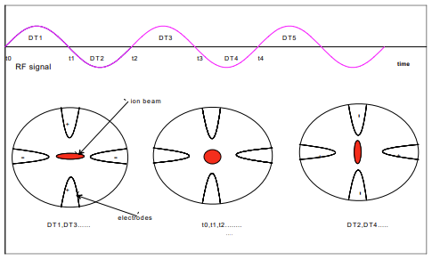
Focusing
Asume a positively charged ion
Alternating transverse fieald
Period lenght = β λ
λ is the wavelenght of the RF
Β is the speed of the particle (v/c)

Slide 15
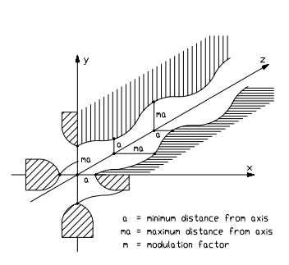
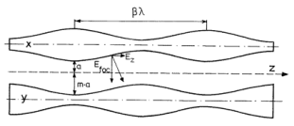
Accelerating

Slide 16
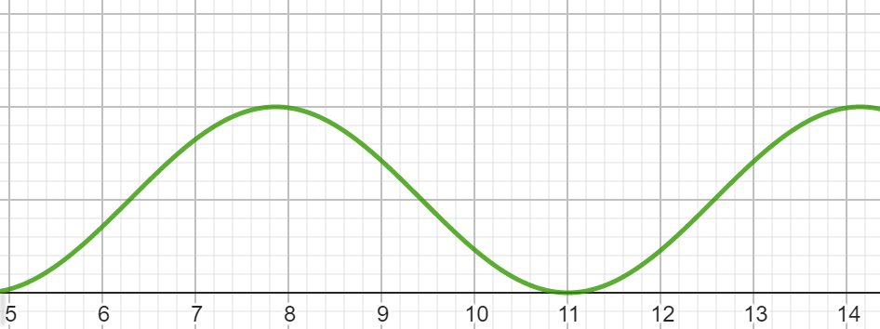
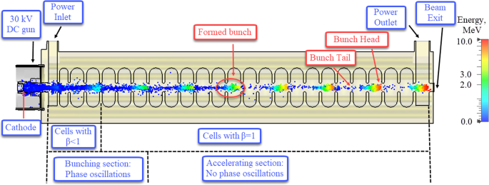
Bunching

Slide 17
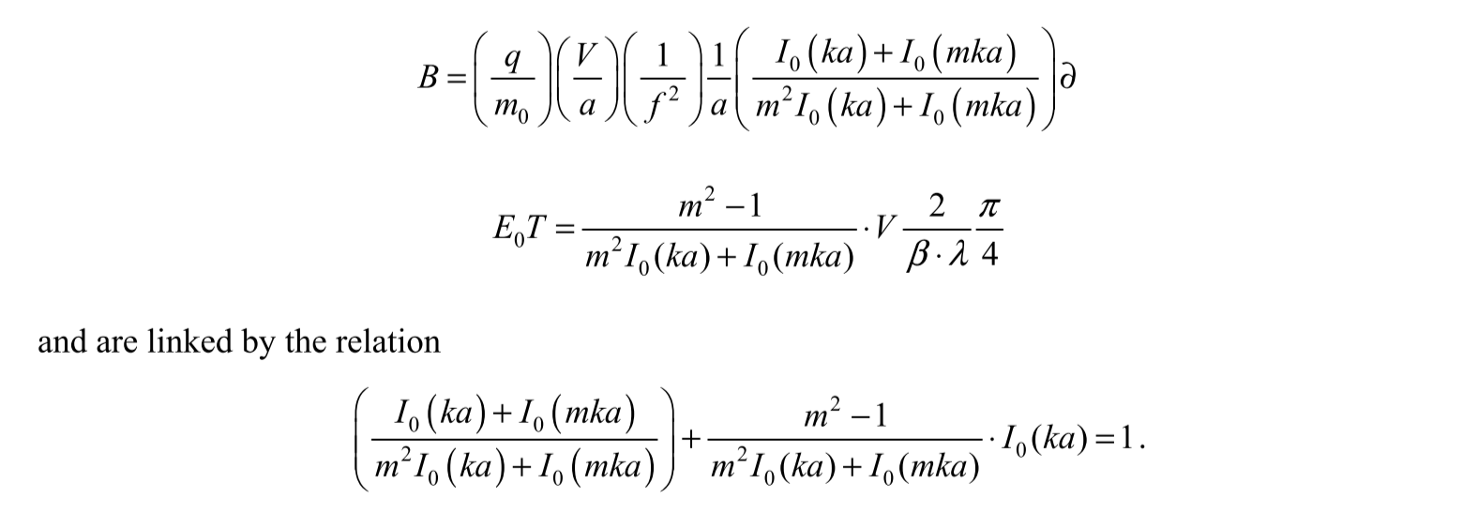
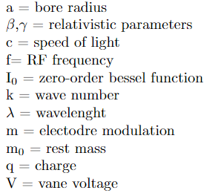
Attached parameters
Focusing strenght:
Accelerating efficiency:
Notes:
B is the focusing strenght, E_0T is the accelerator efficiency
All the time the transverse parameters are set as to keep a constant transverse phase advance per cell, by compensating the variation of the RF defocusing
term and the space charge term during the process of bunching and acceleration.

Slide 18
Transverse phase advance
Approximation to a 3D ellipsoidal bunch
Quadrupole focusing
Space charge defocusing
RF defocusing

Slide 19
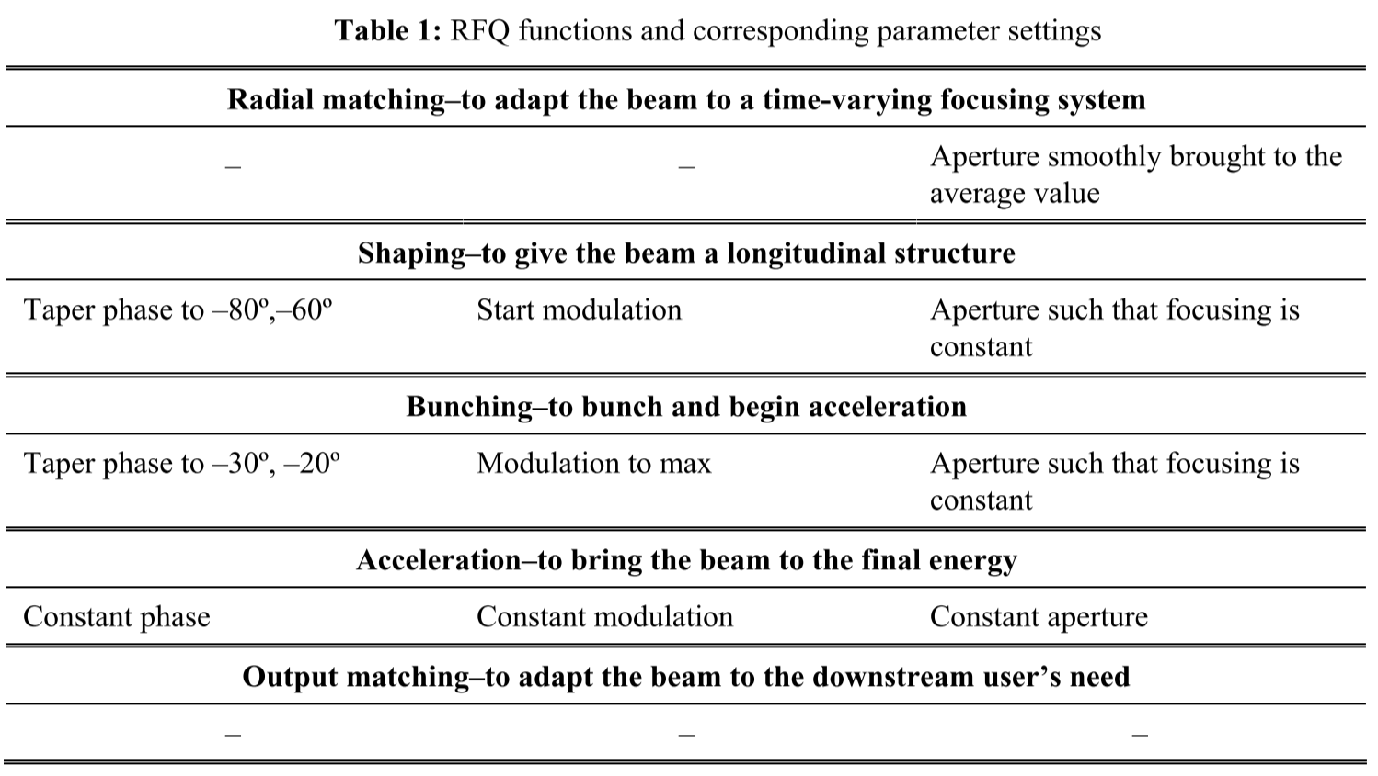
Summary of RFQ functions
RFQ-s are very felxible, they can be easily customized for any accelerator system
Notes:
The main difference when designing RFQs comes from the space charge effects. For high intensity beam, when the space charge term dominates the emittance term in the equation of motion, it is important to start acceleration almost at the same time of shaping and bunching in order to compensate for the increased space charge defocusing during longitudinal compression. A RFQ designed for a high intensity beam will result in a longer structure than one designed for the
corresponding low intensity beam and, generally, will produce a higher output longitudinal emittance

Slide 20
Applications
As a pre-injetor at:
BNL,
DESY,
CERN,
IHEP,
KEK
Heavy-ion RFQs at(atomic,nuclear physics research):
LBL,
INS,
ITEP,
GSI,
Saclay,
IAPF

Slide 21
Thank your for your attention!
References:
A.M. Lombardi: The Radio Frequency Quardupole
A.Schemp : Radio-freqcuency quadrupole LINACS

