Slide 1
Scintillation and it’s uses
Experimental particle and nuclear physics seminar
ELTE
Tamás Török, ELTE Physics BSc 3. year 24. nov. 2022

Slide 2
Topics of discussion
What are scintillators?
Types of scintillators
Range of use
Detectors
Pros/cons
Reading recommendation

Slide 3
SO what are they actually?
„Stuff” that exhibits scintillation when excited
First ever used in 1903 by Sir William Crookes
Curran and Baker – PMT (1944)

Slide 4
Different types of scintillators
Gaseous
Organic – crystals or liquids
Plastic
Glasses
Inorganic

Slide 5
Fields of uses
Medical
Detecting radiation/radioactive contamination
Particle detectors
Nuclear cameras
X-ray security

Slide 6
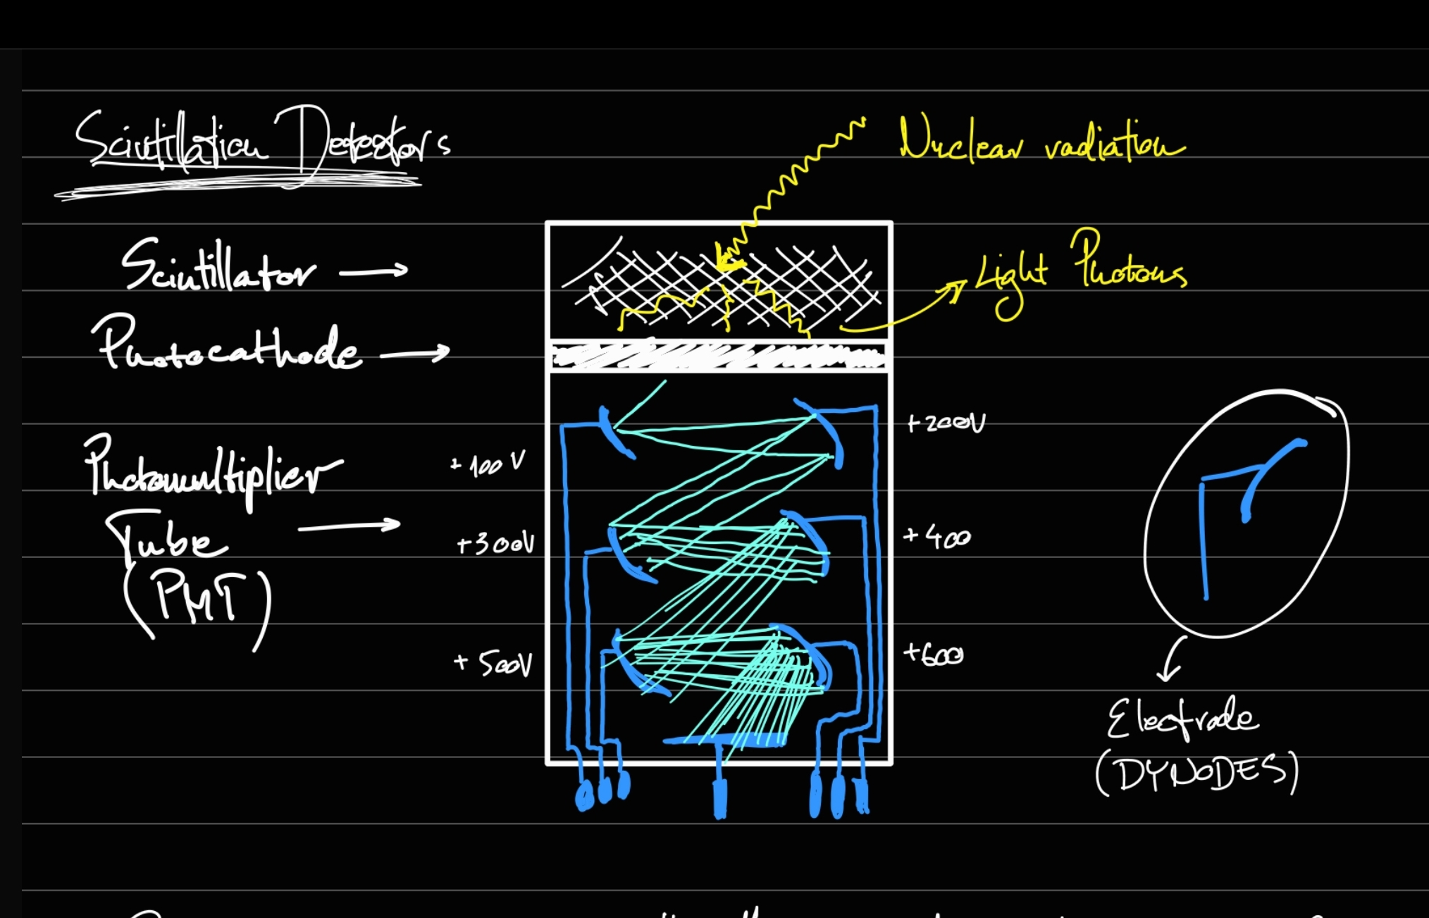
Scintillation detectors
General mechaniscm
Building blocks

Slide 7
Current uses in experiments: Scintillating fibre tracker
LHCb detectors tracker system got updated with a single homogeneous detector composed of scintillating fibres (diameter of 0.25mm)
The Scintillating Fibre Tracker (SciFi Tracker) is composed out of four layers with vertical and rotated fibre orientations.
Each layer consists of 10 or 12 fibre modules.
The goal is to cope with higher instanteneous luminosities and a data readout at 40 MHz
340 m² of surface area is covered by applying the new technology, giving spatial resolution for charged particles (better than 100 $μm$ in the bending direction of the LHCb spectrometer)

Slide 8
The fibre
Made of polystyrene with added dye and wavelenght shifter and two claddings with lower reflection index.
Fibre mats are composed out of six layers of this fibre. This is the active element of the detector.
The epoxy glue that is used to hold them together has TiO₂ in it. The reason for that is to reduce the optical cross-talk between the fibres.
The 2.4 m long fibre mats provide light yield greater or equal to 16 photo-electrons, a 99% hit efficiency and position resolution of 70 $μm$

Slide 9
Reading recommendation
https://en.wikipedia.org/wiki/Scintillator
https://en.wikipedia.org/wiki/Scintillation_(physics)
http://wigner.elte.hu/koltai/labor/parts/modern10.pdf
https://arxiv.org/abs/1710.08325

Slide 10
Thank you for your attention!

