Slide 1
How hit becomes data
Srikanta Tripathy
Lecture on Spring semester 2021

Slide 2
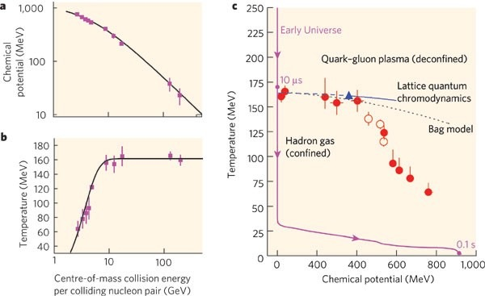
Objectives !!
Requirements:
Particle accelerator
Chemical potential:energy required to add/remove a particle from a system

Slide 3
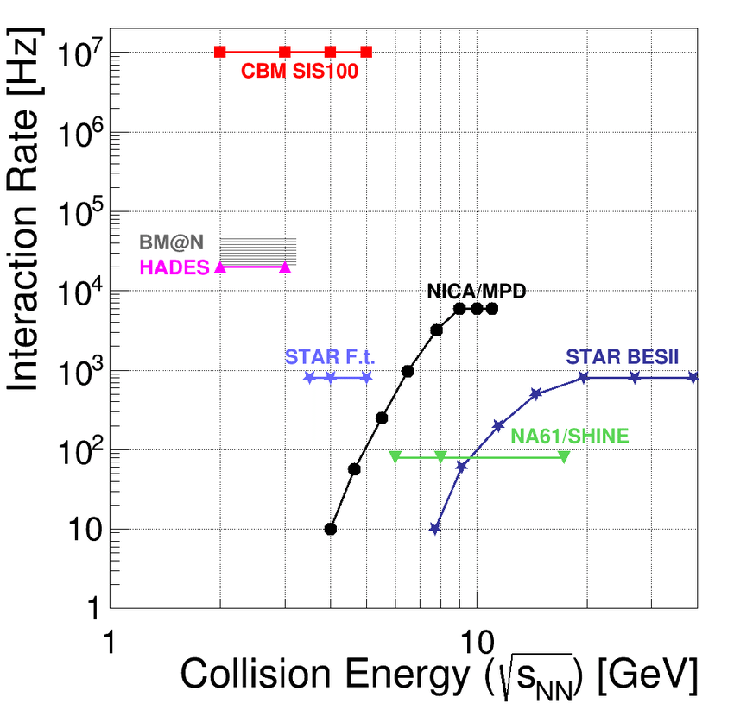
Energy ranges covered
Collider experiments allow for very high √sNN
fixed target experiments allow for very high interaction rates at lower √sNN

Slide 4
Proton Source
There are several ways to generate proton:
Duoplasmatron :
a cathode filament emits electrons into a vacuum chamber, and a passing gas get ionized
Electron Cyclotron resonance source:
if one synchronize, alternating electric field of microwaves (at ECR frequency), with the gyration period of the free electrons inside a gas volume, it increases electrons kinetic energy. Subsequent collisions with gas volume can cause ionization [for KE_el > IE_atom]
polarized source - Optically pumped polarization:
spin-transfer collisions between a primary proton (or atomic hydrogen beam of a few keV energy) and optically pumped alkali – metal vapors.

Slide 5
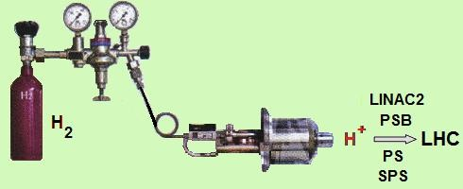
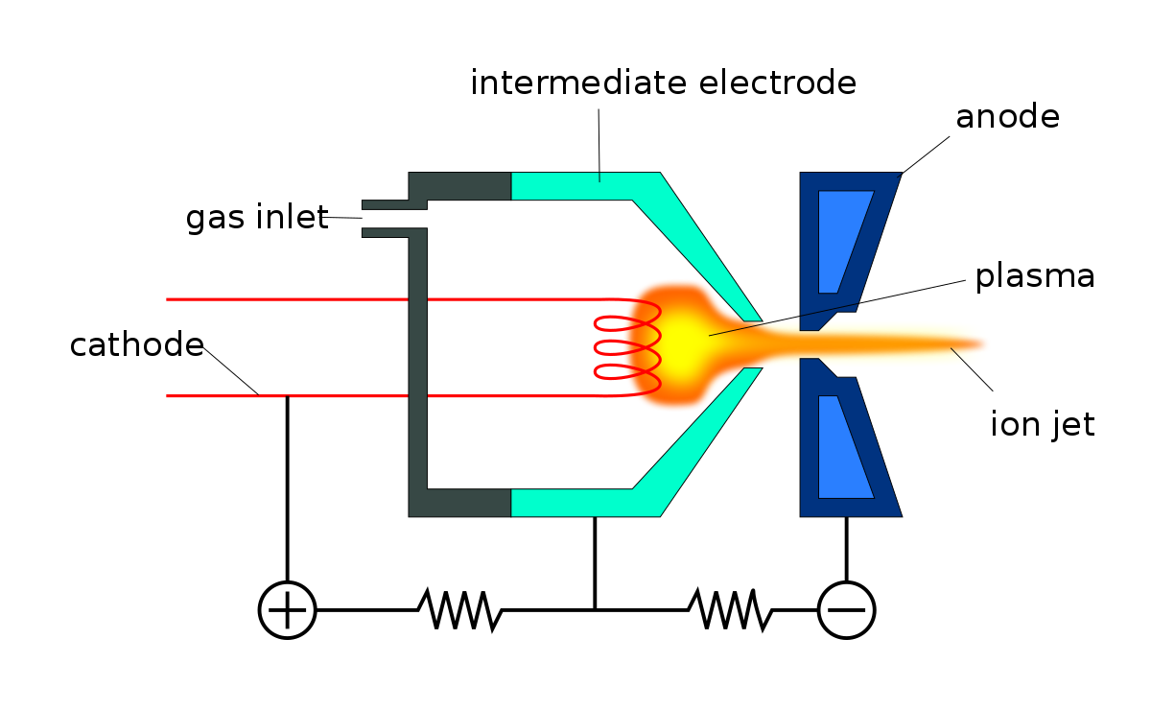
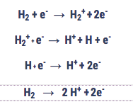
Proton Source : Duoplasmatron
Inject hydrogen gas into the metal cylinder (Duoplasmatron)
surround it with an electrical field to break down the gas into its constituent protons and electrons.
This process yields about 70 percent protons.

Slide 6
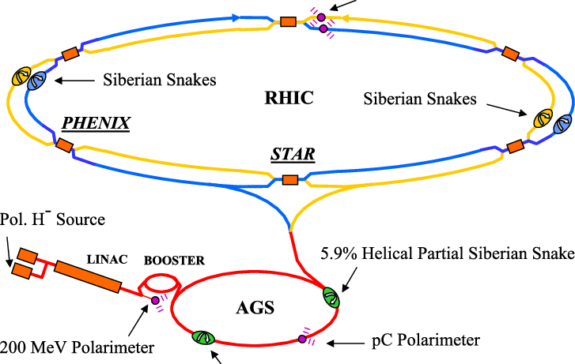
Proton Source :
Optically-Pumped Polarized (H-) Ion Source
producing10^12 polarized protons per pulse.
A single source pulse is captured into a single bunch,to reach the nominal RHIC bunch intensity of 2 × 10¹¹ polarized protons.
In the AGS 6% helical dipole partial Siberian snake (rotates the spin by 11^{◦)} is sufficient to avoid depolarization from imperfection resonances.

Slide 7
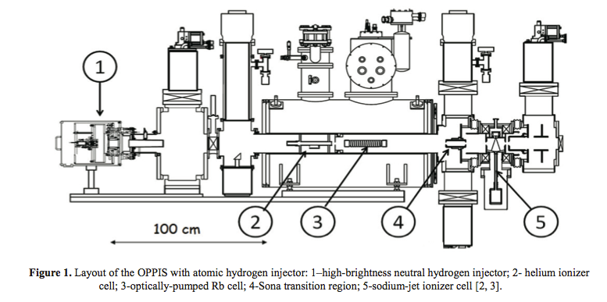
Proton Source :
Optically-Pumped Polarized (H-) Ion Source
primary proton beam is focused and neutralized in the hydrogen cell, => producing 6.0-6.5 keV atomic H0 beam.
atomic H0 beam injected into the superconducting solenoid, => where a Helium ionizer cell and an optically-pumped Rubidium cell are situated (in 25-30 kG solenoid field).
injected H0 atomic beam is ionized in the He-cell (70% efficiency) to form a proton beam.
https://aip.scitation.org/doi/pdf/10.1063/1.5053343

Slide 8
Proton Source :
Optically-Pumped Polarized (H-) Ion Source
proton beam decelerated to 2.0-2.5 keV (for energy separation from primary beam) and then enters the polarized Rb vapor cell,
here protons capture the polarized electrons from Rb atoms => producing electron-spin polarized atomic hydrogen beam.
The electron polarization is transferred to protons => when the hydrogen beam is passing the zero longitudinal magnetic field region (between the superconducting solenoid and ionizer cell solenoid).
https://aip.scitation.org/doi/pdf/10.1063/1.5053343

Slide 9
Ion Source
There are several ways to ionize atoms
With a low density plasma under vacuum (very common) :
Works great for any gas and also condensable like metals, provided the metal can evaporate at high temperature
On a surface (specific technique) :
Works great with the first group: Alcaline
Directly from solid (specific technique):
Via sputtering (uncommon technique used for negative ion production)

Slide 10
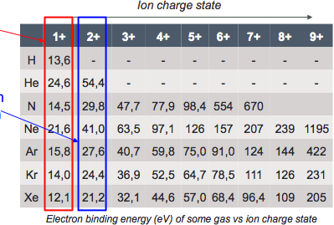
Ion Source
Electrons are bound to the atom nucleus with and energy depending on the atom number (Z) and the quantum numbers (n/l/m).
=>the deeper the electron shell (lower n), the higher the binding energy
=>(for a given sub shell) the higher Z, the higher binding energy
The first ionization energy (or ionization potential) is the minimum energy that must be brought to the atom to expel a first electron
The second ionization energy is the minimum energy required to remove a second electron from the highest occupied subshell

Slide 11
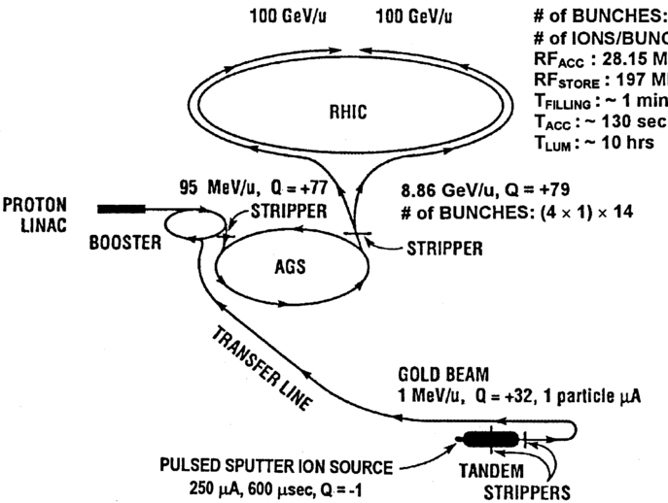
cesium sputter ion source
A cesium sputter ion source injecting into a tandem Van de Graaff provides the gold ions for RHIC.
The ion source is operated in the pulsed beam mode and produces a 500 \mus long pulse of Au- with a peak intensity of 290 \muA at the entrance of the tandem.
After acceleration in the tandem and post-stripping, this results in a beam of Au+32 with an intensity of 80 \muA and an energy of 182 MeV.

Slide 12
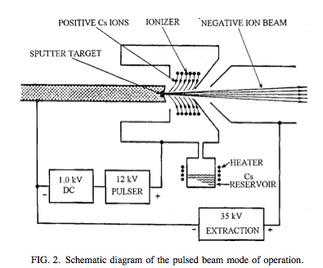
cesium sputter ion source
The pulser power supply provides a positive voltage to the cesium ionizer relative to the sputter target cathode.
The positive cesium ions are accelerated to the cathode and sputter some of the cathode material as negative ions, which are then accelerated.
Because the pulser voltage is tied to the cathode, the energy of the negative ions leaving the ion source remains constant.

Slide 13
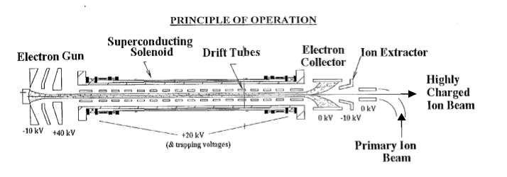
electron beam ion source (EBIS)
At one end an electron beam is produced, and then compressed to high density as it enters a strong solenoidal magnetic field.
The beam passes through the solenoid, is decelerated, and then stopped in the electron collector (EBIS trap region is series of cylindrical electrodes in the main solenoid).

Slide 14
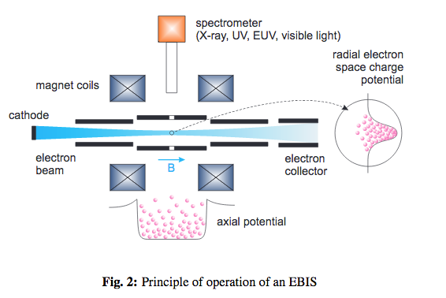
electron beam ion source (EBIS)
Electrostatic barriers for ions are produced on the ends of the trap region => by applying positive voltages on the end electrodes.
Ions are confined radially by the space charge of the electron beam. The trap is seeded either by injecting neutral gas or by axial injection => trapping (of singly) charged ions
As the ions are held in the trap, they are step-wise ionized, until the desired charge state is reached, at which time the voltage on one end electrode is reduced and the ions are extracted.

Slide 15
electron beam ion source (EBIS)
essential feature of EBIS:
it produces a narrow charge state distribution, with the charge state in the peak increasing => as the product of electron beam current density and ion confinement time increases.
It is therefore straightforward to achieve any desired charge state; this is especially the case for an EBIS for RHIC where the needed charge states are very modest.
it produces a fixed amount of positive charges per pulse.
The number of trapped charges can increase only to the point where the space charge of the electron beam is neutralized. The maximum yield of positive charges therefore roughly equals the electron beam charge in the trap (trap capacity)

Slide 16
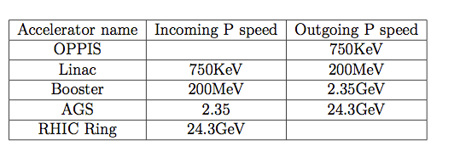
Stages of acceleration

Slide 17
Bunch making
When the beam has reached the required energy,
=>an ideally timed proton with exactly the right energy =>will not be accelerated.
=>protons with slightly different energies arriving earlier or later will be accelerated or decelerated so that they stay close to the desired energy.
In this way, the particle beam is sorted into packs of protons called "bunches".

Slide 18
Collision
https://www.youtube.com/watch?v=0PIOHLxEC98

Slide 19
Cooling system
RHIC performs at a temperature maximum of 4 trillion degrees Celsius or 250,000 times hotter than the centre of the sun .
To counter this, liquid helium is being pumped into RHIC’s 1,740 superconducting magnets to cool them about absolute zero temperature (-273 degree). This helps magnets to operate with zero energy loss.
Detector cooling system:
ECU cooling unit: which regulates air flow and air temperature
Interlocks: Any condition that can potentially harmful for STAR.
FEE cards of TPC pad planes are water cooled to ±0.7 deg C (to keep the wire gain constant and maintain the dE/dx calibration). FTPC FEE cards are air cooled.

Slide 20
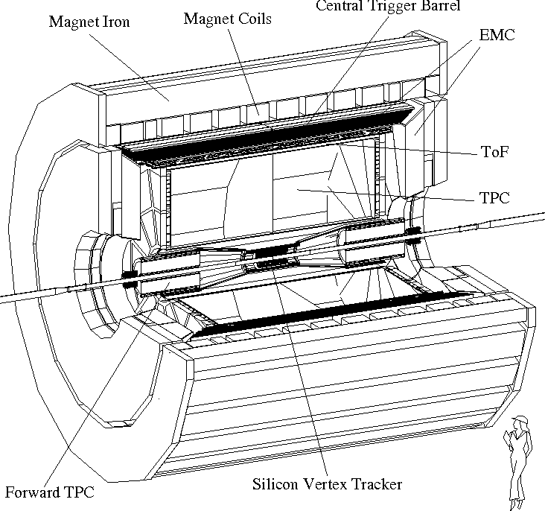
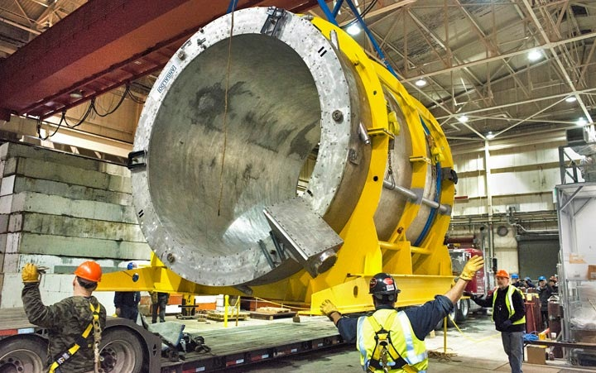
Magnet system
iron dominated, conventional (room temperature) solenoid magnet
To resolve tracks > 200 micron, TPC requires uniform field over the operating range 0.25 -0.5 T [earth: 25 to 65 \mu T]
The magnet is roughly cylindrical in geometry and consists of 30 flux return bars (back legs), four end rings and two poletips. The 6.85 m long flux return bars are trapezoidal in cross section and weigh 18 tons each.

Slide 21
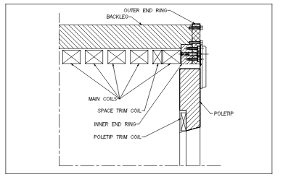
Magnet system
Three types of magnet coils: Main, Space Trim and Poletip Trim.
Main and Space Trim: These coils are built up from two layer pancakes wound two-in-hand (bifilar) fashion containing 13 turns. These coils are all connected in series electrically, however all the water circuits (88) are in parallel.
Each poletip includes a trim coil to help attain magnetic field uniformity. These coils contain six layers and are wound three-in-hand (trifilar) fashion giving 118 turns per coil. Each two layers contains three separate water circuits giving a total of nine circuits per coil.

Slide 22
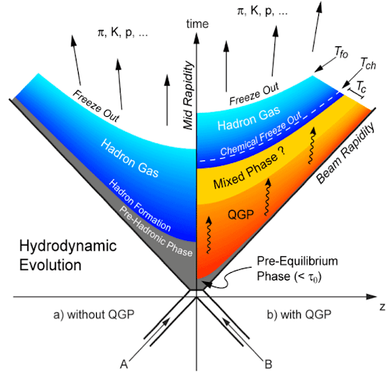
Space-time collision picture
Hadronisation temperature : Tcrit ~ 155 MeV
Chemical freeze out temperature (inelastic interactions among the produced particles stop, i.e. no more particle production occurs): Tchem < Tcrit
Kinetic freeze out temperature (elastic interaction stops, i.e. momentum of particle no more changes): Tkin < Tchem

Slide 23
Hit information processing
Colliding beams at RHIC are not continuous but are bunched, with the bunch crossing rate of ~10 MHz and every time the bunches cross at STAR at 107 ns.
TPC cannot operate fast enough (~200 kHz) to record every RHIC collision.
Trigger System uses data from much faster detectors (ZDC, BBC, VPD) to select just those collisions where an interaction of interest occurred and passes to slow detectors (TPC, SVT, FTPC, EMC).
For every bunch crossing,Trigger analyzes data from fast Trigger-only detectors (and from the fast, low resolution, output of some of the slower detectors).
When a collision of interest is detected the Trigger initiates the digitization and readout procedures in the slow detectors.
It also notifies the Data Acquisition system (DAQ) so that DAQ can gather the data from each detector, build the event, and store it.

Slide 24
Hit information processing
To maximize the acceptance of this diverse group of detectors the Trigger System needs:
to select collisions whose primary vertex is close to the center of the TPC.
to select collisions with small impact parameters, as well as those with very large impact parameters.
to select collisions that produced rare events: jets, high transverse momentum particles, topological signatures of rare decays in the calorimeters, as well as dimuons in the MTD
All of these trigger goals are accomplished using custom designed programmable electronics.

Slide 25
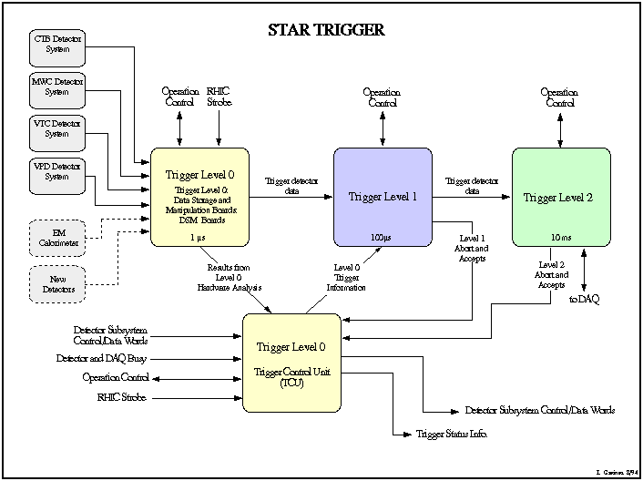
Hit information processing
Data AcQuisition System (DAQ) in STAR starts with STAR’s trigger system, which is divided in four stages.
Level 0 trigger operates using trigger detectors. If the data that passed Level 0, it is digitized and recorded.
Then a subset of data is analyzed by the Level 1 trigger. Level 2 trigger takes over after Level 1 passes the pre-set trigger condition. For displaying the reconstructed event in real time, some of the data is passed to Level 3 trigger, which is in fact online reconstruction software.
If the event is passed from trigger system, it is written to the disks of High Performance Storage System (HPSS)

Slide 26
Hit information processing
The reconstruction pass is managed by reconstruction framework, root4star.
This converts the DAQ file to DST(Data Summary Tables) and other products [a rough estimation of size between DST and Micro-DST is about five].
To have a immediate online QA (quality assurance & quality control), a small sample of the events are analysed online during data taking.
As the data flow runs to to mass storage, a small fraction of the data passes through Fast Offline (for event reconstruction).
Example:
U+U & Au+Au central event size for DAQ files is 1.02 MB .
After reconstruction, U+U central event size is 6.38 MB.
U+U have
~ 600 × 10⁸ events
~ 382.8 PB

Slide 27
Computing
RCF (RHIC Computing Facility) at BNL (Brookhaven National Laboratory) server is a Tier 0 centre for STAR experiment.
Currently RCF has 350 computing nodes, 1500 CPUs and 500TB of disk space dedicated to STAR experiment only.
Fetching of data for analysis purposes, STAR uses the SUMS (STAR Unified Meta Scheduler) tool.
This gets data (in xrootd format) from the existing servers and perform jobs as mentioned in the xml file.

Slide 28
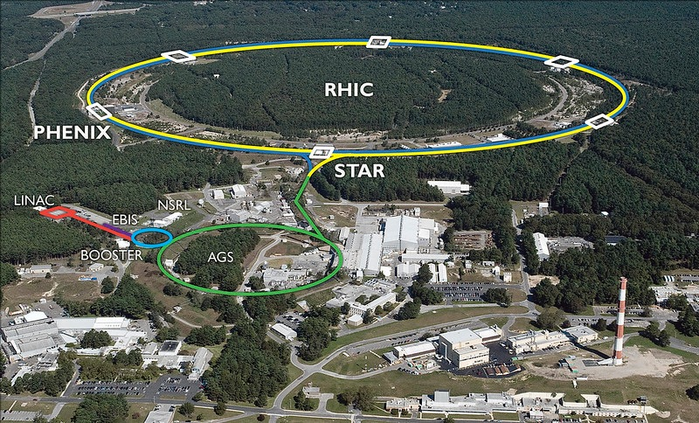
RHIC experiment
About 743 physicists from 14 countries and 68 institutions
ELTE too !
first heavy-ion colliders
only spin-polarized proton collider
superconducting magnets down to the operating temperature of -268.6°C (4.5K)
Collides U238, Au197, Cu63, Zr96, Ru96, d and p

Slide 29
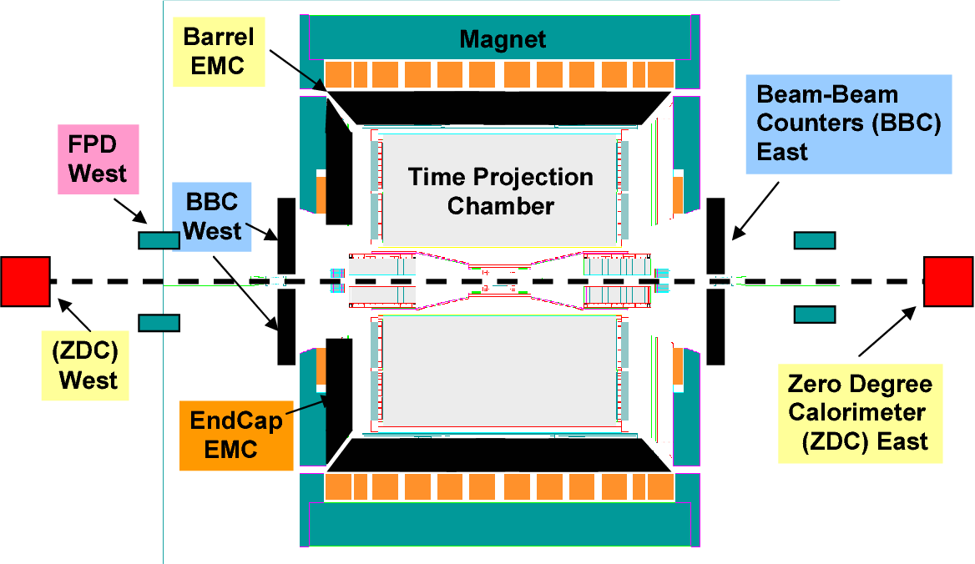
STAR experimental set up
About 743 physicists from 14 countries and 68 institutions
ELTE too !
STAR detector subsystem:
Trigger: BBC/VPD/ZDC
Tracker:eTOF/iTPC/TOF/TPC
Calorimeter: BEMC/EEMC/FMS
Muon system: MTD

Slide 30
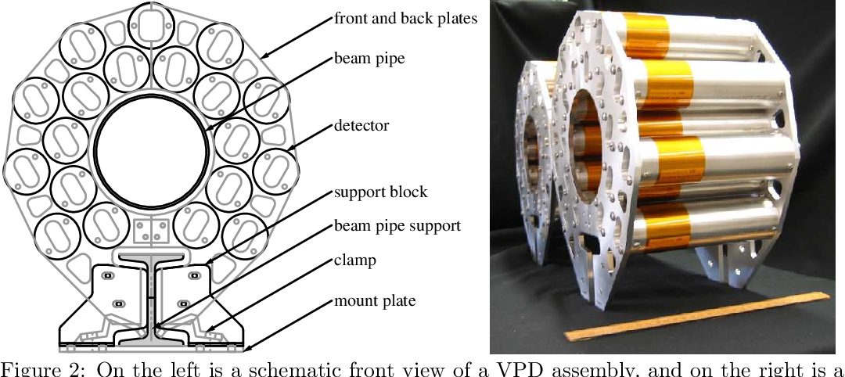
Event Identification - VPD
Use:
Trigger for the minimum-bias events using VPD, is defined as a coincidence signal in the east and west VPD detectors.
Located:
is about 5.7 m from interaction point and have pseudo-rapidity range 4.24 < |η| < 5.1.
Design:
Consists of 19 lead converters plus plastic scintillators with photo- multiplier tube readout.
https://arxiv.org/pdf/1403.6855.pdf

Slide 31
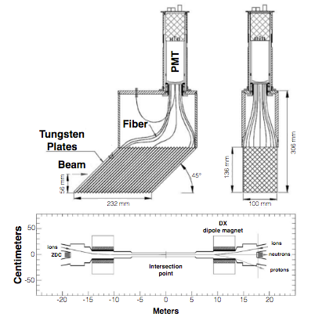
Event Identification - ZDC
Use:
for minimal bias events, we use ZDC coincidence of both beam directions.
Located:
installed about 18 meters away from the intersection point along the beam line, behind the dipole magnets.
Design:
ZDC modules consist of tungsten plates, fibers and photon multiplier tubes; Magnets will bend all charged particles and leave the neutrons and other neutral particles hit on the ZDC modules.

Slide 32
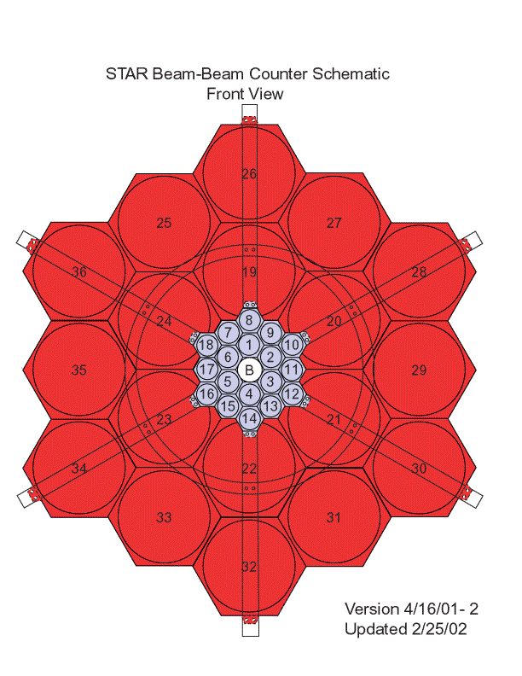
pp trigger- BBC
Use:
during p+p runs to provide triggers, to monitor the overall luminosity, to measure the relative luminosity for different proton spin orientations.
Located:
pair of BBC’s wrapped around the beampipe, one on either side of the TPC
Design:
Each counter consists of two rings of hexagonal scintillator tiles: an outer ring composed of large tiles and an inner ring composed of small tiles.Internally, each ring is itself divided into two separate sub-rings of 6 and 12 tiles each (total 18)

Slide 33
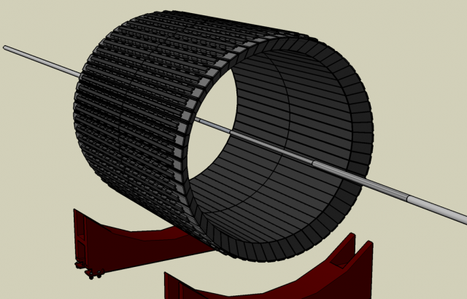
rare trigger- Calorimeter
Use:
allow STAR to trigger on and study rare and high p_{T} processes such as jets, leading hadrons, direct photons, and heavy quarks
Location:
BEMC located inside the aluminum coil of the STAR solenoid
Design:
BEMC includes 120 calorimeter modules, each subtending 6 degree in \del phi and 1 unit in \eta. The modules are segmented into 40 towers, each tower subtending 0.05 in \del phi and in \del eta, thus a total of 4800 towers.

Slide 34
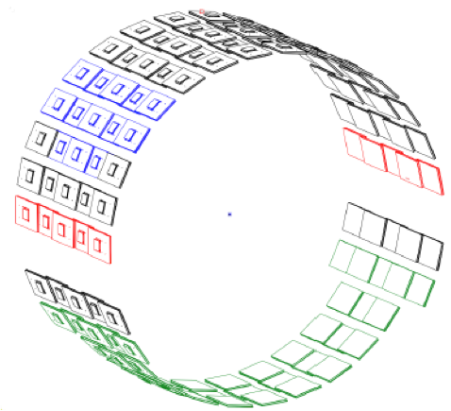
muon System - MTD
Use:
Unique capability to identify muons at mid-rapidity at RHIC
Location:
installed at a radius of about 403 cm
Design:
based on the Multi-gap ResistivePlate Chamber technology
118 modules, 1416 readout strips, 2832 readout channels
45% acceptance for |\eta| < 0.5

Slide 35
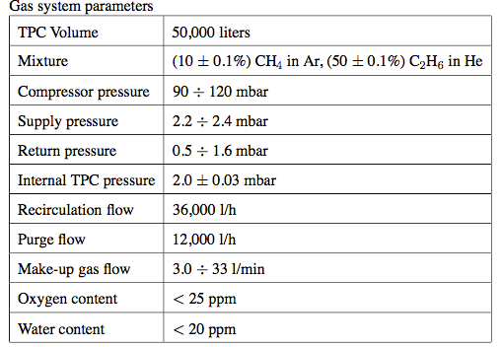
Tracker: gas system -TPC
Supplies either of two mixtures, P10 (Ar 90% + CH₄ 10%) or C₂H₆ 50% + He 50%,
Gas circulation rate is 36,000 l/hr (one volume change every 1.4 hours)
The purity and composition of the TPC mixture is monitored using O₂, CH₄ (C₂H₆) and H₂O analyzers.

Slide 36
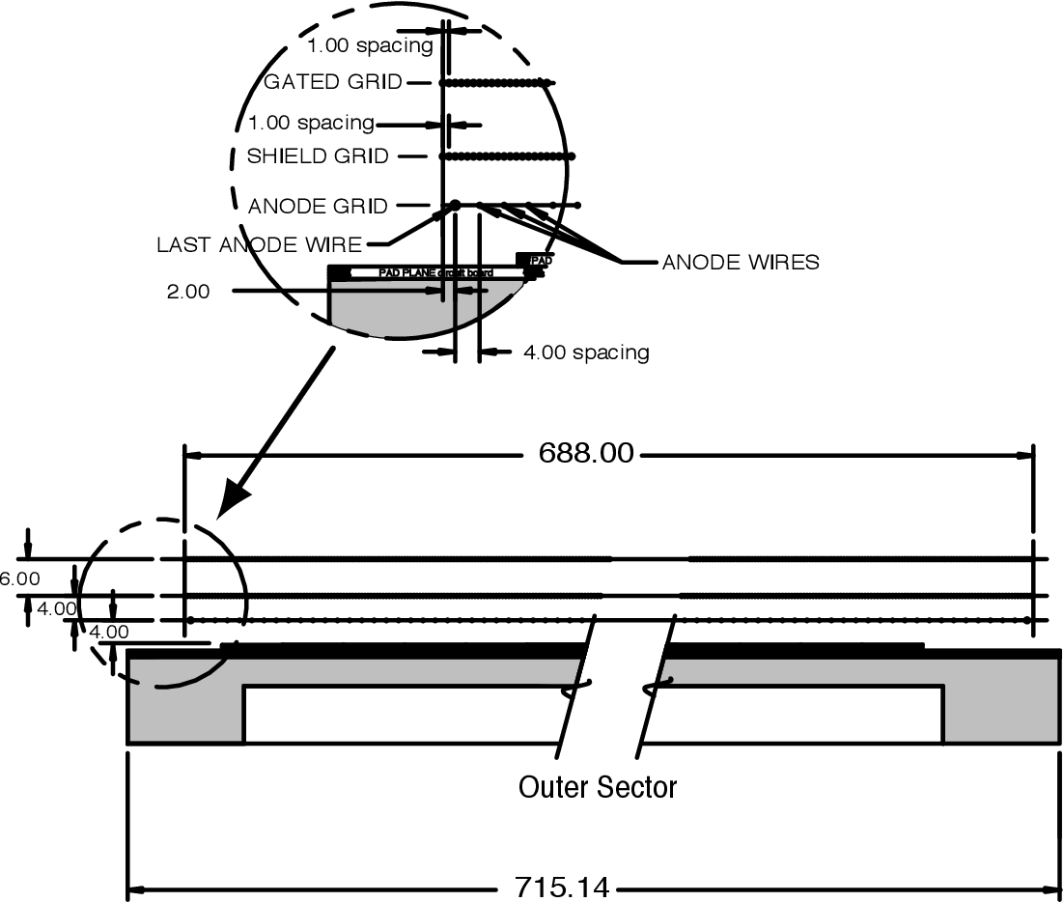
Tracker: readout chamber -TPC
The readout chambers have 3 wire planes:
The gated grid is normally closed, minimizing buildup of positively charged ions in the drift volume. When a trigger is received, the voltages are switched and it becomes transparent
The ground plane, anode wires (and TPC pad plane) form a multi-wire proportional chamber. Electrons drift to the wire where they initiate an avalanche, leaving a cloud of positively charged ions remaining around the wire. The 136,608 pads on the TPC pad plane image this charge; this image charge goes to the electronics.
an outer sub-sector pad plane

Slide 37
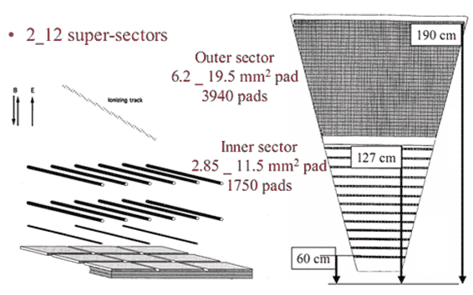
Pad readouts -TPC
Electrons from ionized gas drift toward the nearest endcap, where the signals are read out
TPC readout is divided into 24 sector (12 on each side of end-cap).
Each inner sector have 13 pad rows, whereas outer sector have 32 pad rows; so a track can give a maximum 45 hits.

Slide 38
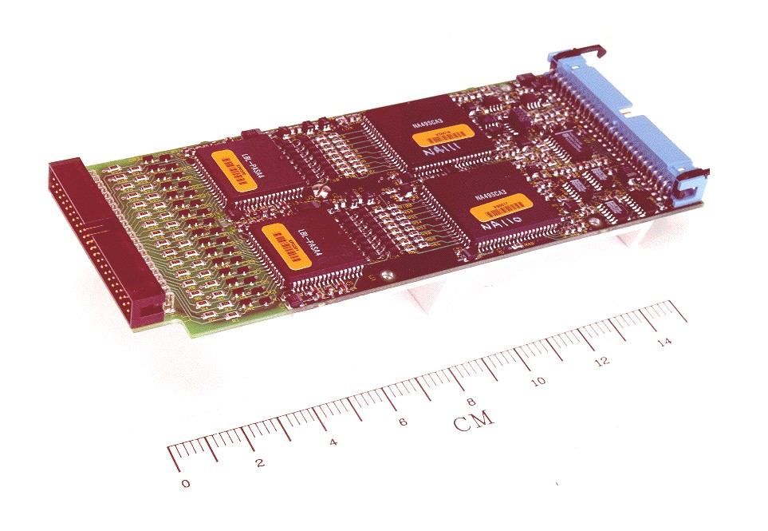
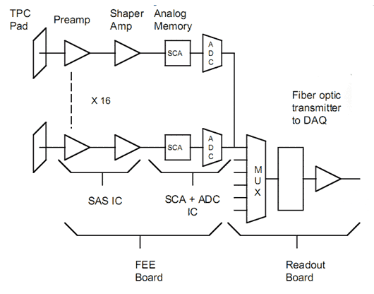
Electronic readouts -TPC
FEE, custom design IC:
512 time bins
Readout 140k Channes
i.e. 70M pixels
Readout board:
Carry ~ 100 Channels to DAQ

Slide 39
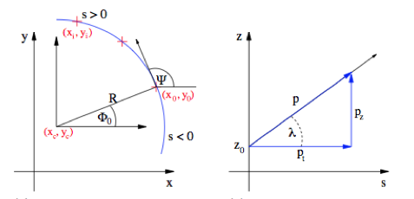
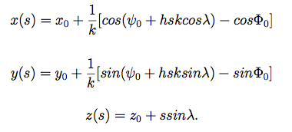
Track reconstruction - TPC
TPC sits over an uniform magnetic filed, so a charged track can be de- scribed by helix.
Here s is path along helix,
λ is the dip angle,
Φ = ψ + π/2, k is curvature (1/R),
ψ(s) is azimuthal angle of the track direction at the origin of the helix
h is the rotation of the helix, projected in the xy plane, ±1

Slide 40
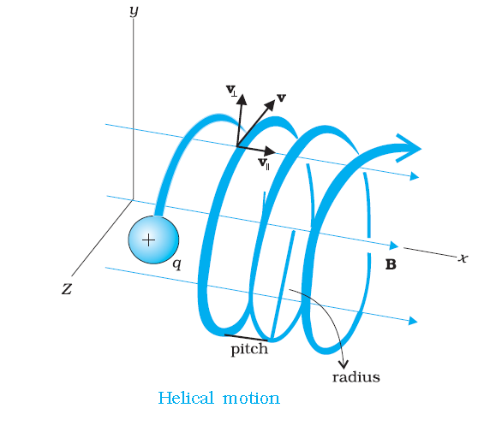
Momentum reconstruction -TPC
Transverse momentum of a track is determined by fitting a circle through x, y co-ordinates of a vertex and the points along the track.
pT =0.3×B×r×q
where B is the magnetic field,
q is the charge of the particle and
r is the radius of curvature of helix

Slide 41
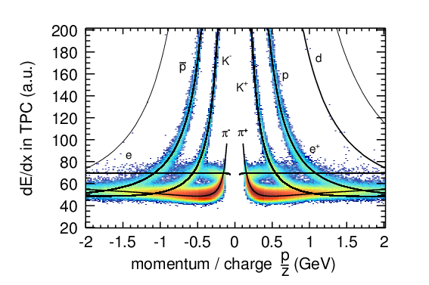
Particle identification - TPC
theoretical description :
Bethe-Bloch formula
TPC detector of STAR:
modified Bethe-Bloch formula or Bichsel formula
Where
p - full momentum,
ai- fit parameters.

Slide 42
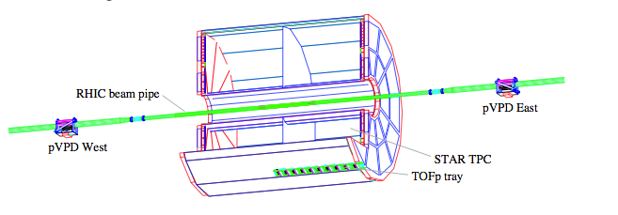
Trackers - TOF
pVPD (the “start” detector); TOFp tray (the “stop” detector)
pseudo-rapidity acceptance of |η| < 0.9 with full azimuth
120 trays equally distributed in numbers of 60 on east and west sides.
pVPD provide start time information to TOF, and also z-component of collision vertex

Slide 43
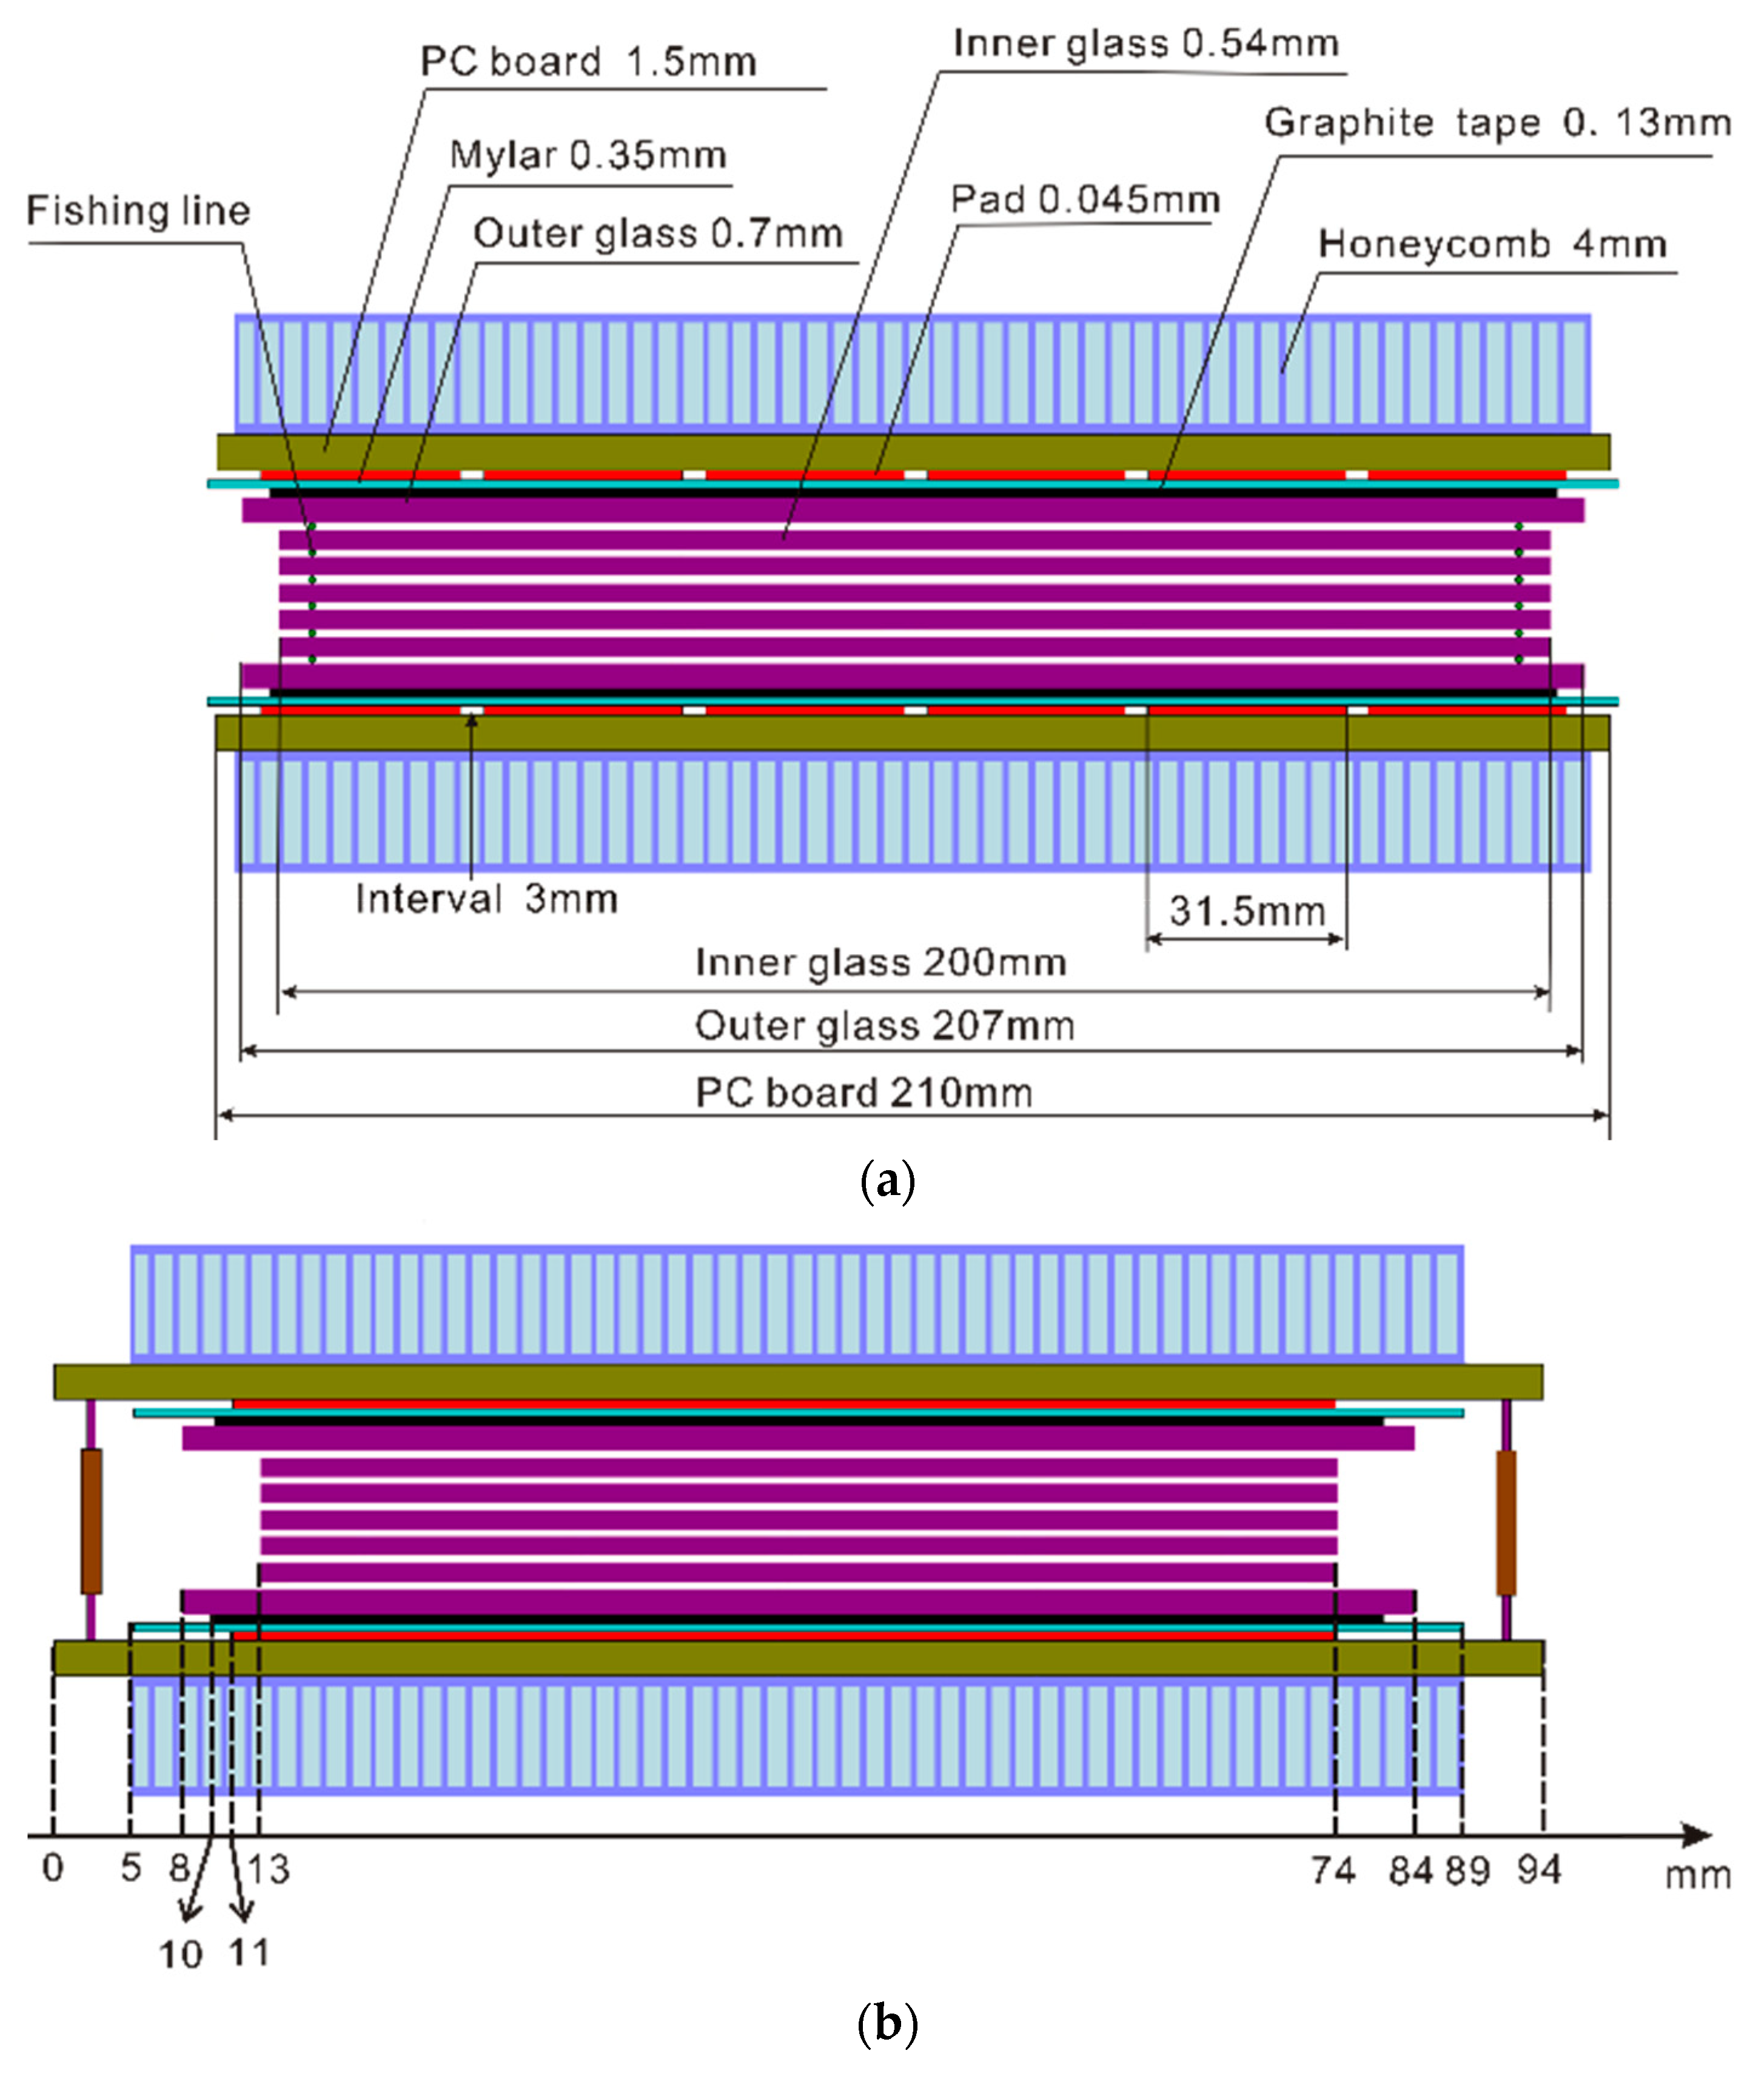
Trackers - TOF
2012 upgrade to MRPC technology.Each tray of TOF has 32 MRPC modules covering 6 degrees in azimuthal direction around TPC.
MRPC is basically a stack of resistive plates with a gas gap between two adjacent plates.
High voltage is applied on both sides of the outer plates, which produces a strong electric field in the vicinity of the sub gaps between the plates.
The plates being resistive to an avalanche of signal, the signal induced on the collecting plate is the sum of signals from all the gaps.

Slide 44
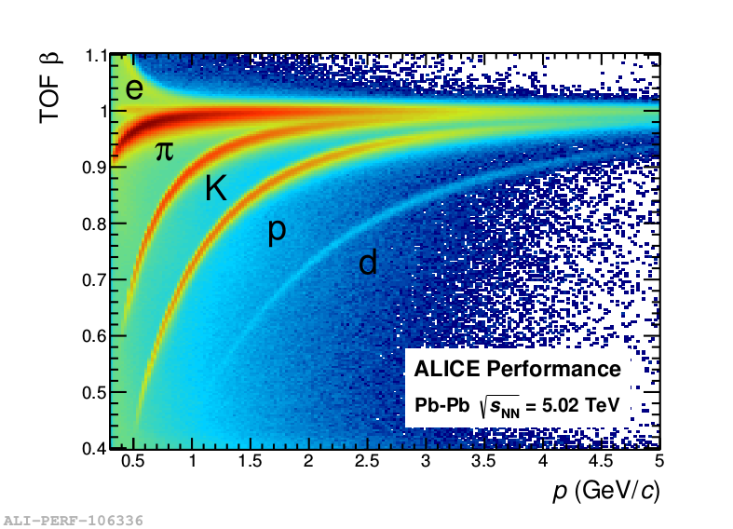
Particle identification -TOF
Where m2 = measured mass-square,
p = momentum
\beta = velocity of particle

Slide 45
LHC experiment
About 743 physicists from 14 countries and 68 institutions
world's largest and highest-energy particle collider
The electromagnets in the LHC are chilled to ‑271.3°C (1.9K)
Number of collisions per second ~1 billion
Collide Pb208,Xe129 and p

Slide 46
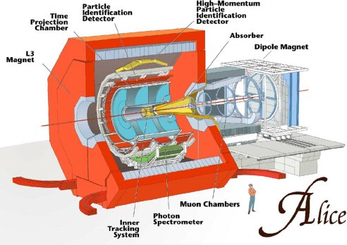
ALICE experimental set up
About 1936 physicists from 39 countries and 175 institutions
ALICE detector subsystem:
Trigger: ZDC/V0/T0
Tracker:ITS/TPC/TOF/HMPID/TRD
Calorimeter: PHOS/EMCAL
Muon system: MCH/MTR
Others: PMD/FMD

Slide 47
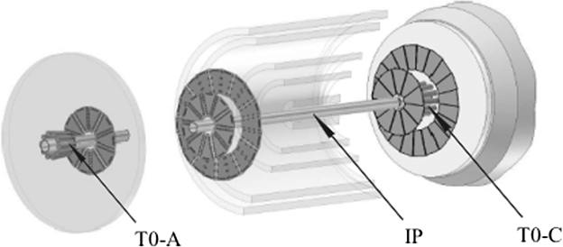
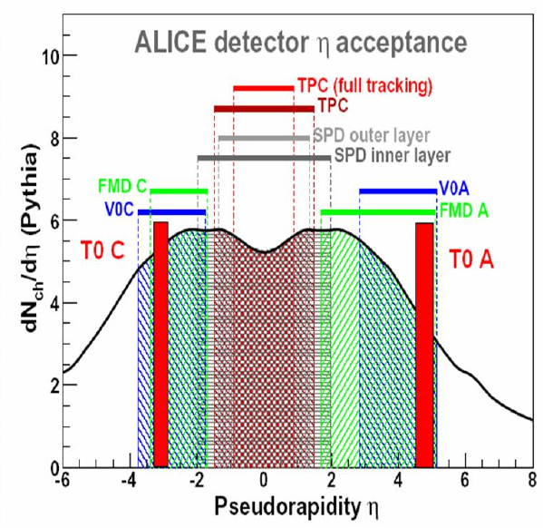
Trigger: T0
T0 system made of two arrays of Cherenkov radiators, opposite to IP.
pseudorapidity range of −3.3 < η < −2.9 and 4.5 < η < 5.
time resolution ~ 50 ps
The triggering efficiency varies from about 50% for pp collisions up to 100% for A–A collisions.
Objectives:
to supply fast timing signals which will be used in the L0 trigger for ALICE, to provide a wake-up call for TRD and to deliver collision time reference for Time-of-Flight (TOF) detector.

Slide 48
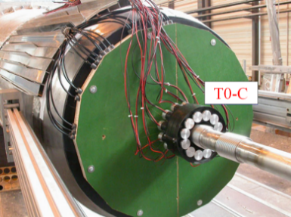
Trigger: T0
only ALICE sub-detector capable of delivering high-precision start signal for the TOF detector.
T0 signal must correspond to the real time of the collision (plus a fixed time delay) and be independent of the position of the vertex.
required precision of the T0 signal must be better, or at least equal, to that of the TOF detector, which is about 50 ps (sigma).
function of generating T0 start will not be doubled by any other detector in ALICE, so the quality of T0 time resolution will directly influence the quality of TOF identification.

Slide 49
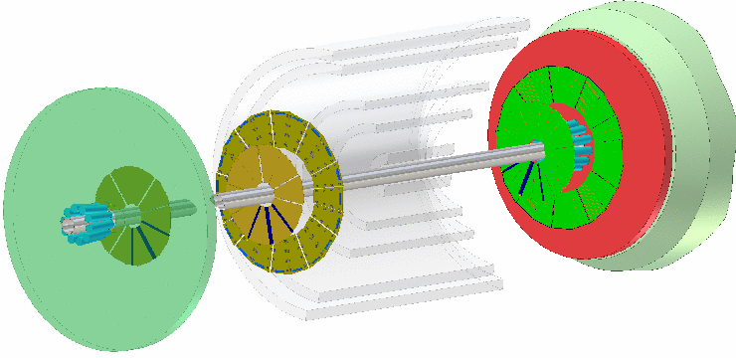
Trigger: V0
V0 system, made of two rings of plastic scintillators at asymmetric positions, one on each side of the interaction point.
−3.4 < η < −1.7 and 1.7 < η < 5.0.
timing performance ~ 0.6 ns
Objectives:
trigger source, to monitor LHC beam conditions, to reject beam-induced backgrounds and to measure basic physics quantities(luminosity, particle multiplicity, centrality and event plane direction)

Slide 50
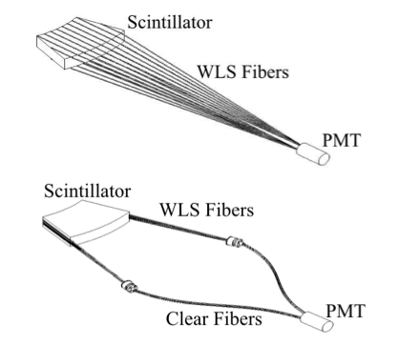
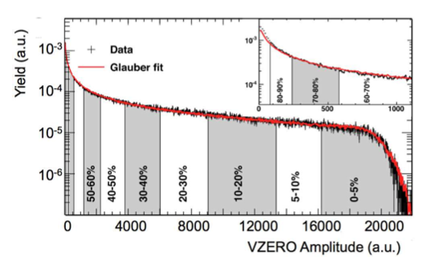
Trigger: V0
signal provided by each PMT sent to an electronics circuit, which delivers two signals. first one (amplified by a factor of about 10) is sent to a threshold discriminator for the generation of the V0 triggers. The second one, not amplified, is used for the measurement of the charge given by the counter. The two treatments are carried out far from PMTs, namely 25 m away.
The Front End Electronics provides signals for triggering the ALICE experiment at the level L0 and digitizes the physical signals delivered by the individual scintillating counters. The system generates four trigger types and several sets of information.

Slide 51
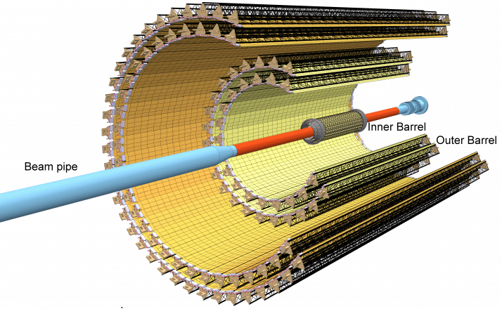
Tracker:ITS
consists of six cylindrical layers of silicon detectors.
2 layers of SPD (Silicon Pixel Detector),2 layers of SDD (Silicon Drift Detector),2 layers of SSD (Silicon Strip Detector).
readout electronics can record events ~ of 50 kHz and a few100 kHz for minimum bias Pb–Pb and pp collisions
Objectives:
with a precision of a tenth of millimeter, identify decay short-living (heavy) particles, which cover a very small distance before decaying

Slide 52
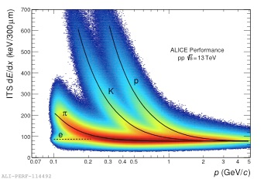
Tracker:ITS
The SPD tracklets selected within a window are combined to extract the vertex position. This method is used to monitor the interaction position quasi-online at the early stage of the tracking procedure and to measure important first-physics observables, e.g.: the charged particle multiplicity density at midrapidity.
A second method - that reaches a better resolution - is applied at the end of the tracking procedure; it is based on the straight line approximation of the reconstructed tracks in the vicinity of the vertex.

Slide 53
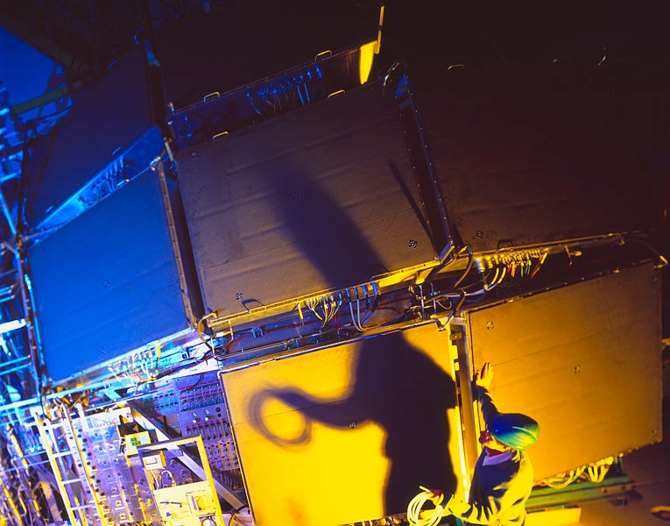
Tracker: HMPID
Objectives:
world's largest caesium iodide RICH (ring-imaging Cherenkov) detector
determine the speed of particles beyond the momentum range available through ITS/TPC/TOF

Slide 54
Tracker: HMPID
Cherenkov radiation is generated in a radiator material, when a highly energetic charged particle exceeds the speed of light inside the same material. This is analogous to the sonic boom produced by a jet traveling faster than the speed of sound.
Cherenkov radiation is emitted along a cone having particle trajectory as axis and an opening angle (\theta) proportional to velocity (\beta)
Photon detector produces images of the Cherenkov radiation in form of ring. Cherenkov angle can be written as:

Slide 55
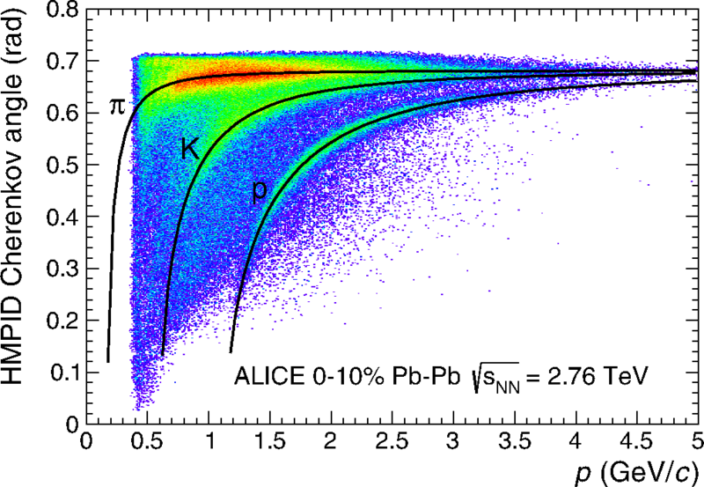
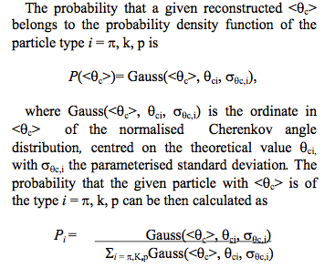
Tracker: HMPID

Slide 56
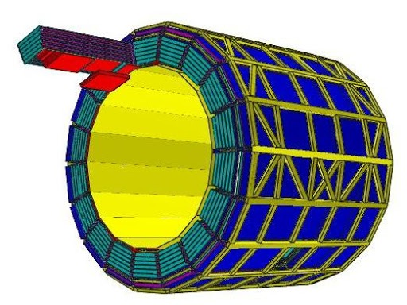
Tracker: TRD
Transition radiation (TR) is a form of electromagnetic radiation => emitted when a charged particle passes through inhomogeneous media, such as a boundary between two different media.
Electrons and positrons can be discriminated from other charged particles using the emission of transition radiation (X-rays emitted when the particles cross many layers of thin materials).

Slide 57
An individual detector module consists of a radiator and a drift chamber operated with Xe/CO2 mixture (85%/15%).
The particles pass through the radiator, where electrons emit transition radiation (TR) and then enter the conversion and drift region of the readout chamber.The secondary electrons are amplified in the multi-wire proportional counter.
The induced signal on the pads is read out every 100 ns to record the time evolution of the signal.
The ratios of charges recorded on adjacent pads for each time sample => allow position determination along the track segments in one chamber (called tracklet). From the inclination of the tracklet one can infer the momentum.

Slide 58
Tracker: TRD
The TRD provides particle identification on a track-by-track basis.
Truncated mean signal
(the combined signal of specific ionization and transition radiation)
One-dimensional likelihood
Two-dimensional likelihood
Neural network

Slide 59
Photon detection: PMD
The photon multiplicity detector consists of a matrix of scintillator pads placed in light-tight boxes and mounted behind the lead converter plates.
Scintilator pad with wavelength shifting
Total honey comb cell 221184; 48 modules; 800 pads covering area of 3m2
Objectives:
Particle shower detector which measures the multiplicity and spatial distribution of photons produced in the collisions.

Slide 60
Photon detection: PMD
photon produces an electromagnetic shower on passing through the converter.
These shower particles produce signals in several cells of the sensitive volume of the detector. Charged hadrons usually affect only one cell and produce a signal resembling those of Minimum Ionizing Particles (MIPs).
In order to have better hadron rejection capability, another plane of the detector of identical dimension as of the preshower part is placed before the lead plate, which acts as a veto for charged particles.

Slide 61
CMS experimental set up
About 4000 physicists from 40 countries and 200 institutions
ELTE too !
CMS detector subsystem:
Trigger:L1
Tracker:pixel/silicon strip
Calorimeter: ECAL/HCAL
Muon system: RPC/MDT/CSC

Slide 62
Tracker: pixel
size of a shoebox, contains 65 million pixels, closest detector to the beam pipe, with cylindrical layers at 4cm, 7cm and 11cm and disks at either end
the rate of particles received around 10 million particles per square centimetre per second
each pixel generating around 50 micro watts (the total power output is ~ energy produced by a hot plate). So as not to overheat the detector, the pixels are mounted on cooling tubes.

Slide 63
Tracker: pixel
Each layer is spilt into segments each a little silicon sensor (100µm by 150µm) [~ two hairs widths].
When a charged particle passes through it gives enough energy for electrons to be ejected from the silicon atoms, creating electron-hole pairs.
Each pixel uses an electric current to collect these charges on the surface as a small electric signal.
A electronic silicon chip, one for each tile is attached, using an almost microscopic spot of solder using the so-called bump bonding technique, which amplifies the signal.

Slide 64
EM Calorimeter: ECAL
Lead tungstate crystal with a touch of oxygen (in this crystalline form) is highly transparent and scintillates when electrons and photons pass through it.
This means it produces light in proportion to the particle’s energy. These high-density crystals produce light (in fast, short, well-defined photon bursts) that allow for a precise, fast and fairly compact detector.
Photodetectors glued onto the back of each of the crystals to detect the scintillation light and convert it to an electrical signal that is amplified and sent for analysis.

Slide 65
Hadron Calorimeter: HCAL
uses alternating layers of “absorber” and fluorescent “scintillator” materials that produce a rapid light pulse when the particle passes through
Special optic fibres collect up this light and feed it into readout boxes where photodetectors amplify the signal.
When the amount of light in a given region is summed up over many layers of tiles in depth, called a “tower”, this total amount of light is a measure of a particle’s energy.

Slide 66
Muon System
one of the clearest "signatures" of the Higgs Boson is its decay into four muons.
1400 muon chambers [250 drift tubes (DTs), 540 cathode strip chambers (CSCs), 610 resistive plate chambers (RPCs)] track the particles’ positions and provide a trigger.
DTs and RPCs are arranged in concentric cylinders around the beam line (“the barrel region”) whilst CSCs and RPCs, make up the “endcaps” disks that cover the ends of the barrel.

Slide 67
Muon System - DT
drift tube (DT) system, Each 4-cm-wide tube contains a stretched wire within a gas volume.
When a muon or any charged particle passes through the volume it knocks electrons off the atoms of the gas. These follow the electric field ending up at the positively-charged wire.
By registering where along the wire electrons hit as well as by calculating the muon's original distance away from the wire, DTs give two coordinates for the muon’s position.

Slide 68
Muon System - CSC
CSCs consist of arrays of positively-charged “anode” wires crossed with negatively-charged copper “cathode” strips within a gas volume.
When muons pass through, they knock electrons off the gas atoms, which flock to the anode wires creating an avalanche of electrons. Positive ions move away from the wire and towards the copper cathode, also inducing a charge pulse in the strips, at right angles to the wire direction.
Because the strips and the wires are perpendicular, we get two position coordinates for each passing particle.

Slide 69
Muon System - RPC
RPCs consist of two parallel plates, a positively-charged anode and a negatively-charged cathode, both made of a very high resistivity plastic material and separated by a gas volume.
When a muon passes through the chamber, electrons are knocked out of gas atoms. These electrons in turn hit other atoms causing an avalanche of electrons.
The electrodes are transparent to the signal (the electrons), which are instead picked up by external metallic strips after a small but precise time delay.
The pattern of hit strips gives a quick measure of the muon momentum, which is then used by the trigger to make immediate decisions about whether the data are worth keeping.

Slide 70
Take Hostel !
 | RHIC | LHC
Energy range | p+p; 62GeV - 510 GeV ions: 7 GeV - 200 GeV fixed target also | p+p: 900 GeV - 13 TeV pb+pb: 2.76 TeV -5.02 TeV
Colliding System | U238, Au197, Cu63, Zr96, Ru96, d , He, p | Pb208, Xe129,p
Physics | QGP, phase transition, spin structure | QGP, Higgs, precession measurement, search for supersymmetric particles, missing antimatter
budget | ~€1 billion | ~€8 billion

Slide 71
Take Hostel !
Source | Duoplasmatron/ECR/Optically pump/Sputtering
Trigger | various type of event selection | V0/T0/Lx/BBC/ZDC/VPD
Tracker | measure momentum of charged particle based on dE/dX, neutral particle on pre-shower,Cherenkov radiation, Transition radiation | TPC/TOF/ITC/HMPID/TRD/Pixel/
Calorimeter | measures energy deposition based on electro-magnetic showers/nuclear showers | BEMC/EEMC/ECAL/HCAL
Muon System | measurement of muon momentum | DT/CSC/RPC/MTD

