Slide 1
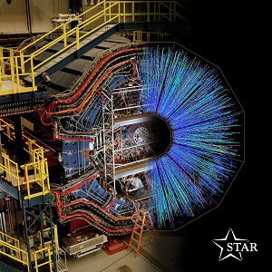
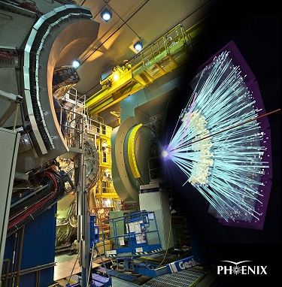
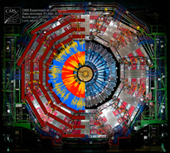
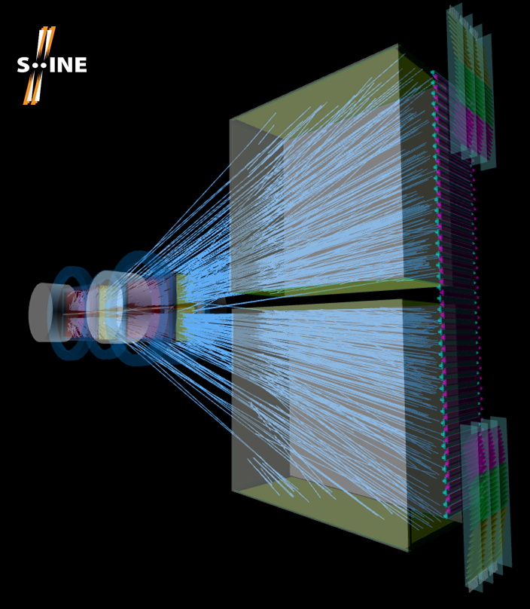
Accelerators and detectors
Máté Csanád (Eötvös U)

Slide 2
Contents
Accelerators in general
Details of SPS, RHIC, LHC
Detectors in general
Some examples: PHENIX, STAR, CMS, NA61

Slide 3
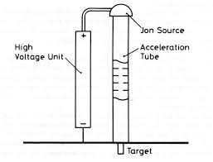
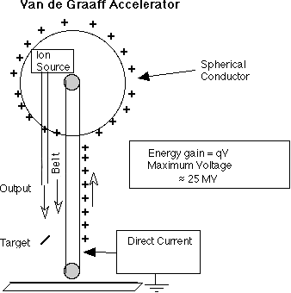
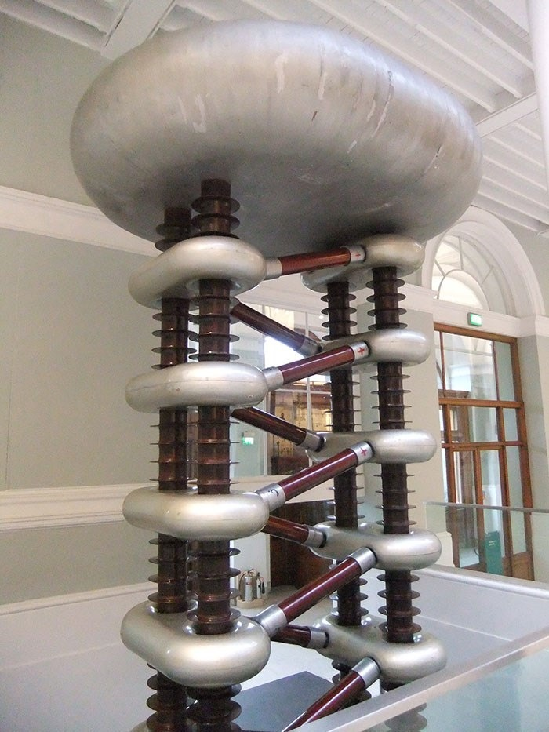
Electrostatic particle accelerators
Basic electrostatic
Cockroft-Walton
Van de Graaf
Limitation: length and/or insulation breakdown

Slide 4
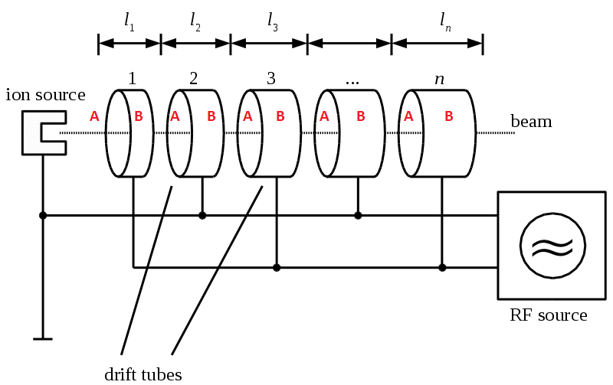
Linear accelerators
Alternating current to always accelerate towards the next tube
Multiple types: Wideroe, Alvarez, Tesla, RFQ

Slide 5
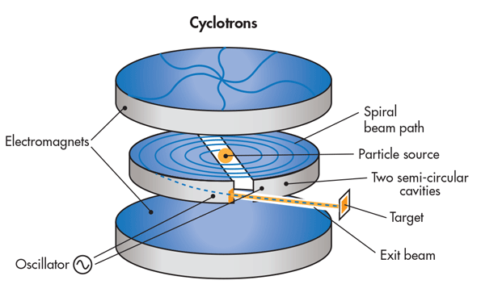
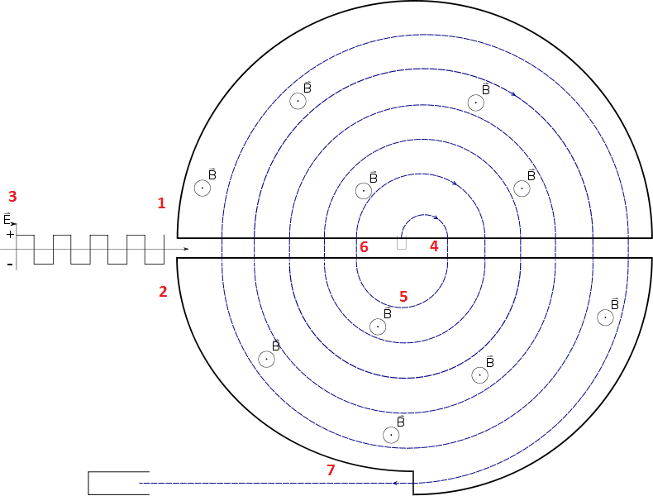
Cyclotrons
Circular design, larger acceleration possible
Spiral: increasing radius as particle energy increases
Beam exiting towards target

Slide 6
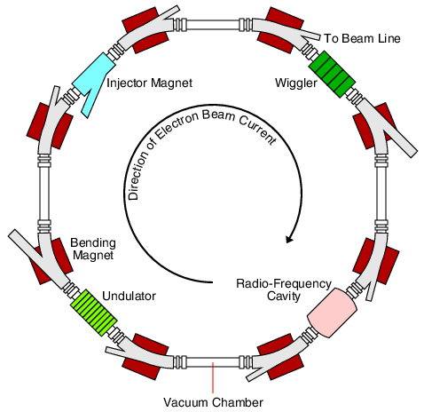
Synchrontrons
Basic principle: maintain constant radius
Synchronize magnetic field to particle energy
Three tasks:
Accelerating
Bending
Focusing

Slide 7
Relativistic kinematics
Lorentz-multiplication of four-vectors: $a^{μ}b_{μ}=a^{μ}g_{μν}b^{ν}$,
Metric tensor: $g_{μν}=diag (1,−1,−1,−1)$
Space-time four-vectors: $x^{μ}=(t,x,y,z)$
Length: proper-time, Lorentz-scalar, $τ^{2}=x^{μ}x_{μ}=t^{2}−x^{2}−y^{2}−z^{2}$
Momentum four-vector: $p^{μ}=\left(E,p_{x},p_{y},p_{z}\right)$, $p^{μ}p_{μ}=m^{2}=E^{2}−{\left|p\right|}^{2}$
Velocity: $β=\frac{v}{c}=\frac{pc}{E}$; Rest energy: $E_{0}=mc^{2}$; Lorentz-factor: $γ=\frac{1}{\sqrt{1−{\left|β\right|}^{2}}}$
Full energy: $E=γmc^{2}$, $p=mvγ$ (let us use $c=1$ from here)
Lorentz-boost: multiplication with $γ\left(\begin{matrix}1 & −β \\ −β & 1\end{matrix}\right)$, in the direction of $β$
$E^{′}=γ\left(E−βp\right)$, $p^{′}=γ(p−βE)$; similarly for space-time
Scalar: invariant under Lorentz-boost ($τ$, $m$ yes; $E, t$: no)

Slide 8
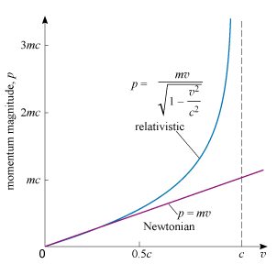
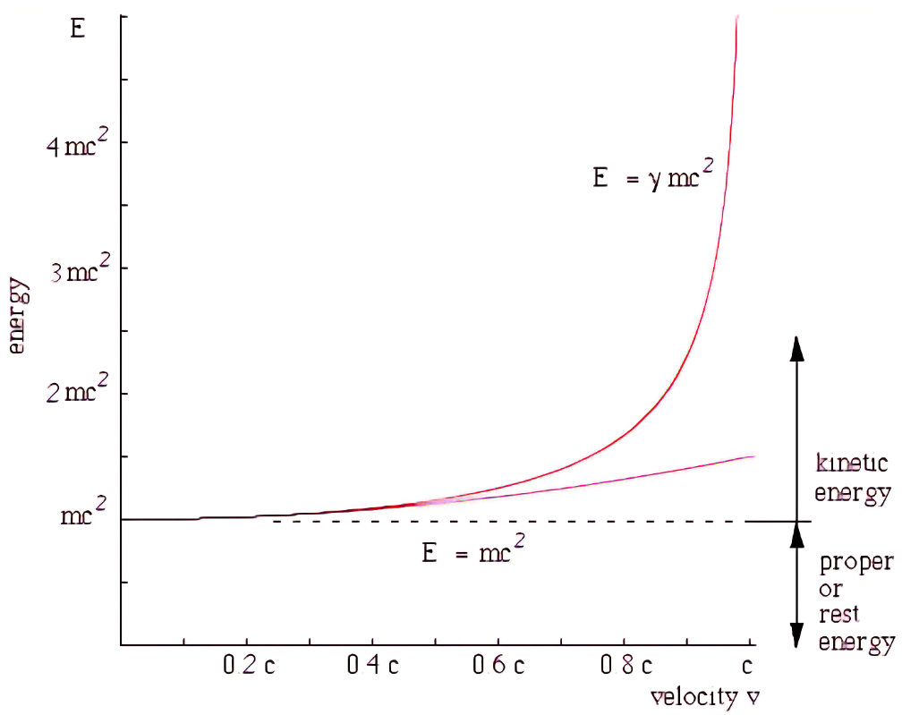
Kinetic energy
Classical: $E_{kin}=\frac{1}{2}mv^{2}=\frac{p^{2}}{2m}$; relativistic: $E_{kin}=E−E_{0}=\left(γ−1\right)mc^{2}$
Series expansion: $E_{kin}=\frac{p^{2}}{2m}−\frac{p^{4}}{8m^{3}c^{2}}+\frac{p^{6}}{16m^{5}c^{4}}−\frac{5p^{8}}{128m^{7}c^{6}}+…$

Slide 9
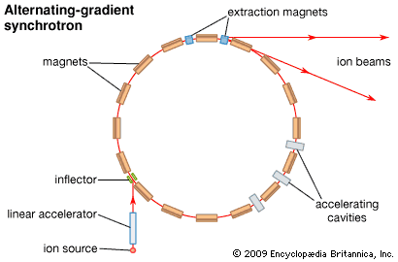
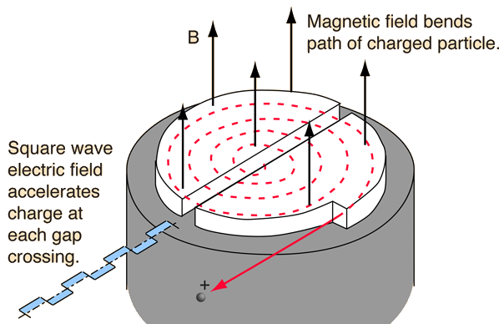
Particle accelerators
$$\vec{E}$$
Fwd acceleration: electric field, $F=qE$
Circular orbit: magnetic field, $F=qv×B$
Radius: $p=qRB$; $R=p/qB$
1 eT = 0.3 (GeV/c)/m $→$ 1 T field, 0.3 GeV/c particle, 1 m radius
Cyclotron: acceleration between semicircles
Synchrotron: fixed orbit
$$\vec{B}$$
cyclotron

Slide 10
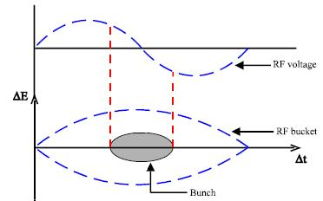
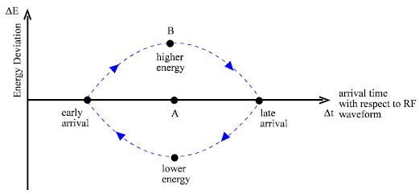
Buckets and Bunches
Acceleration with RF cavities
Particles must always see an accelerating voltage
$f_{RF}=N×f_{revol}$
Storage ring (”accelerator”): $N$ buckets
Bunch: where the voltage is accelerating in the bucket
Synchronous particle (A)
Others: oscillate (B) sometimes late, sometimes early

Slide 11
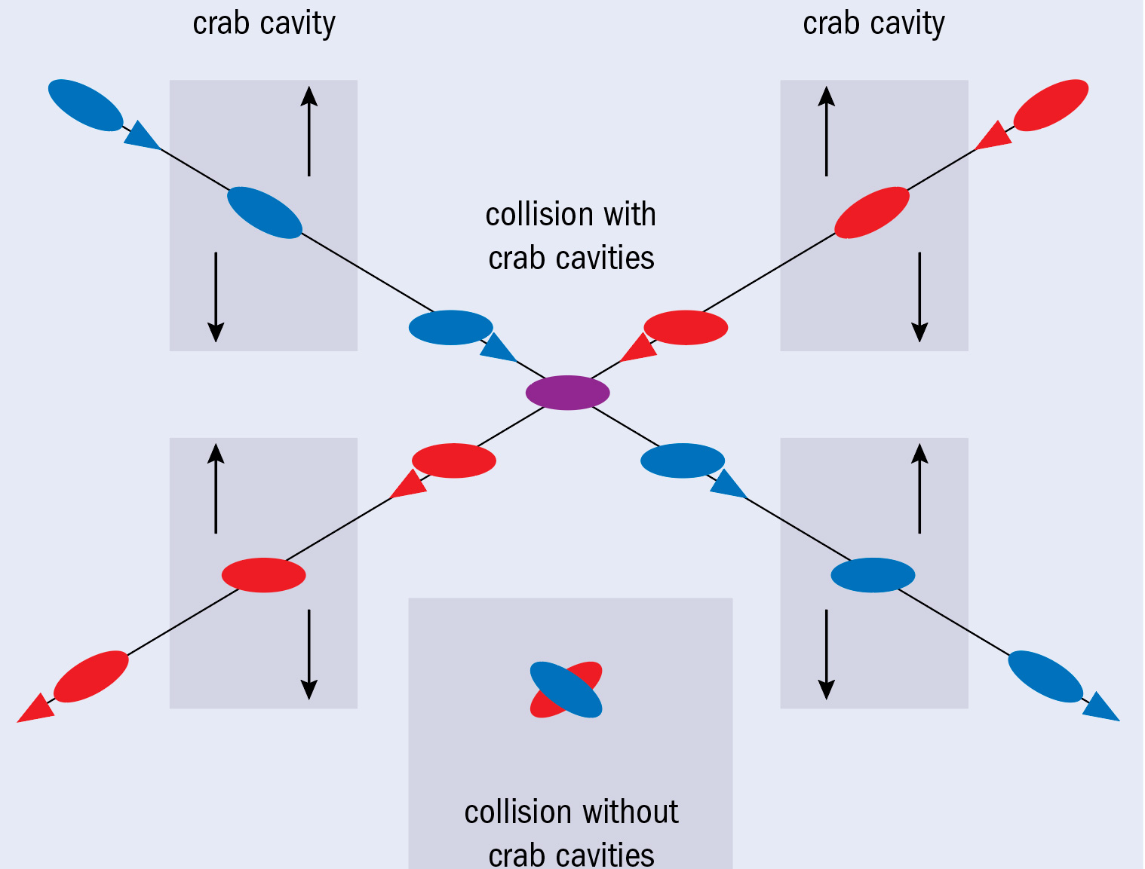
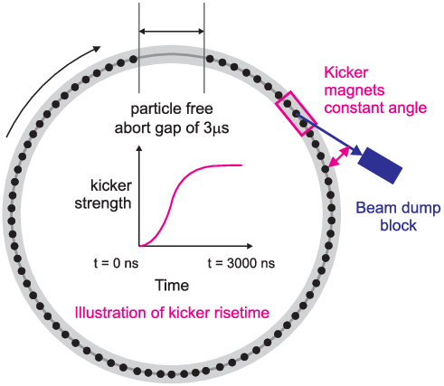
Bunch crossings and collisions
Two rings with opposite directed beams
Crossing at some angle
Crab cavity: rotation
Bunch spacing: determined by pre-accelerators
Not all bunches are filled: filling scheme
Bunch crossing: possible collisions
Missing bunches: pre-accelerator and injection kicker gap
Important: abort gap for dumping the beam
Max number of events usually too high
Filtering: minimum bias sampling

Slide 12
Contents
Accelerators in general
Details of SPS, RHIC, LHC
Detectors in general
Some examples: PHENIX, STAR, CMS, NA61

Slide 13
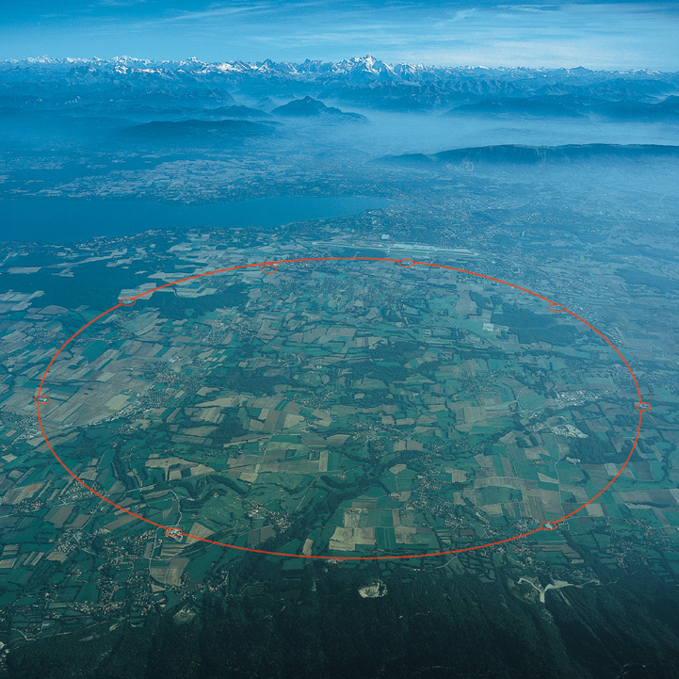
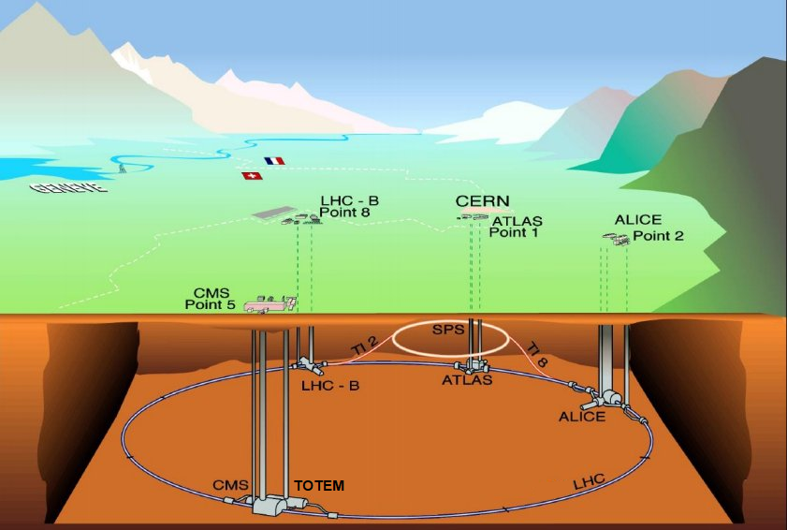
Facilities: Large Hadron Collider (+SPS)
LHC collisions: p+p, p+Pb and Pb+Pb; also Xe+Xe, soon probably O+O
Energies: from 2.76 TeV/nucleon to 13 TeV (p+p only)
Experiments: ALICE, ATLAS, CMS, LHCb, LHCf, MoEDAL, TOTEM
Phase diagram related studies: SPS (NA61/SHINE, previously NA49)
Energy: $s={\left(p_{1}+p_{2}\right)}^{2}=E_{center−of−mass}^{2}$; usually quoted: $\sqrt{s_{NN}}=\frac{\sqrt{s}}{A}$ (E per nucl. pairs)

Slide 14
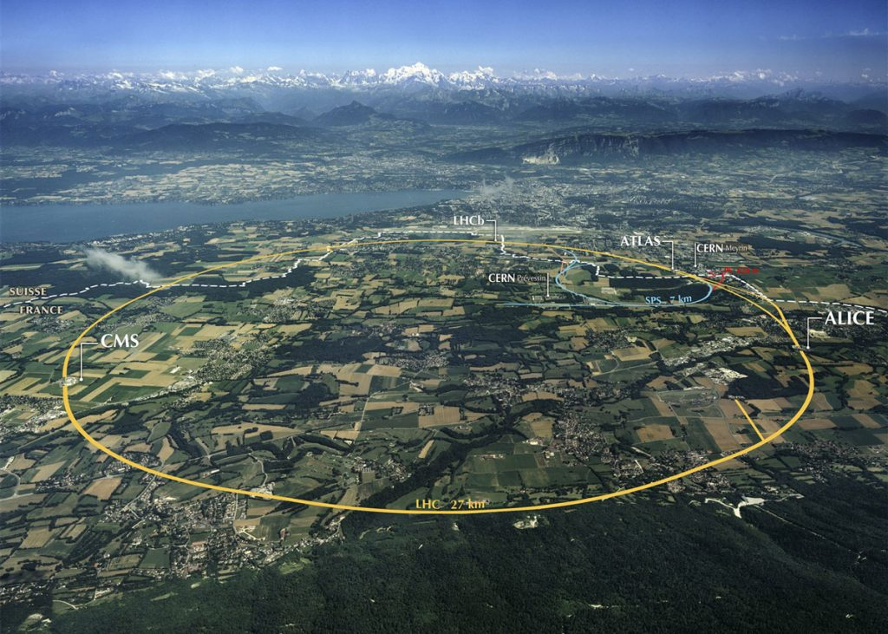
CERN, LHC and SUrroundings
Mont Blanc
Geneve
Lake Geneva
Swiss-French border
CERN

Slide 15
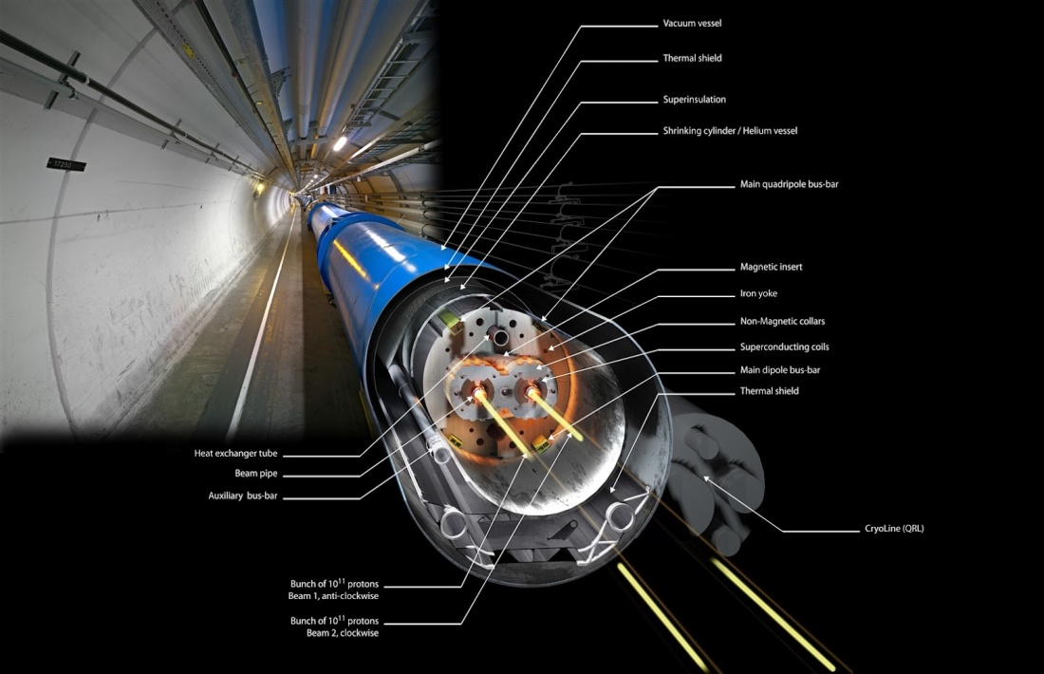
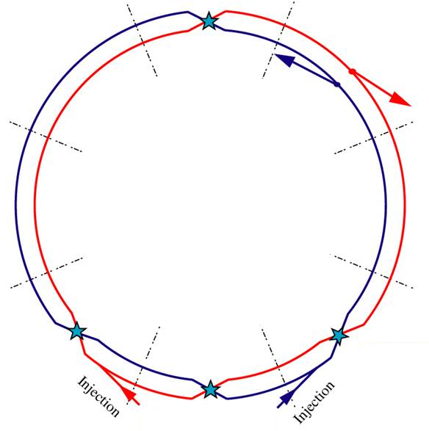
LHC in Numbers
2x27 km, 150-200 m deep
Collisions: 4 intersections
~3000 bunches, 25 ns spacing
99.9999991% speed of light
10 000 rounds/sec
600 million collisions/sec
10 000 superconducting magnets
10 000 tons of liquid N₂: 80 K
120 tons of liquid He: 2 K
120 MW electricity consumption (c.f. a large city)
6 μg H⁺ in 10 years
25 000 terabyte data yearly

Slide 16
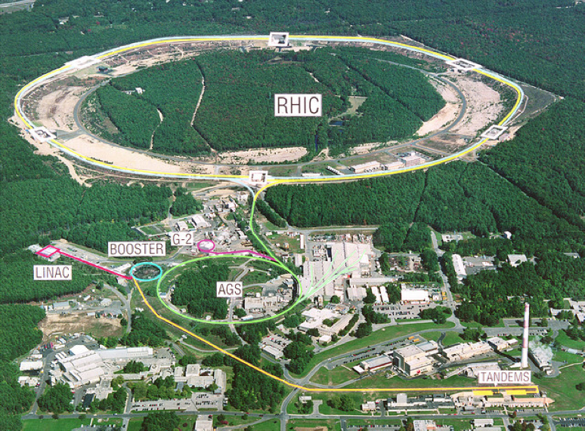
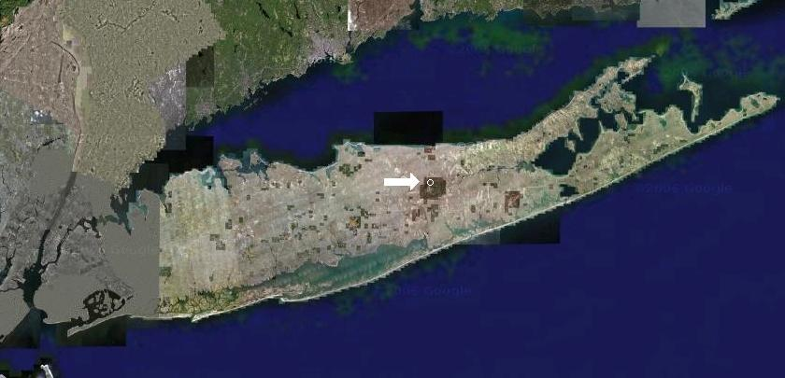
The Relativistic Heavy Ion Collider
At the Brookhaven National Laboratory, Long Island, New York, USA
Collisions of $\vec{\text{p}}$, d, ³He, Al, Cu, Zr, Ru, Au, U (each has separate reason)
Accelerator energies: 7.7-200 GeV/nucleon, even 0.51 TeV for $\vec{\text{p}}$
Experiments: STAR, sPHENIX; past: BRAHMS & PHOBOS & PHENIX

Slide 17
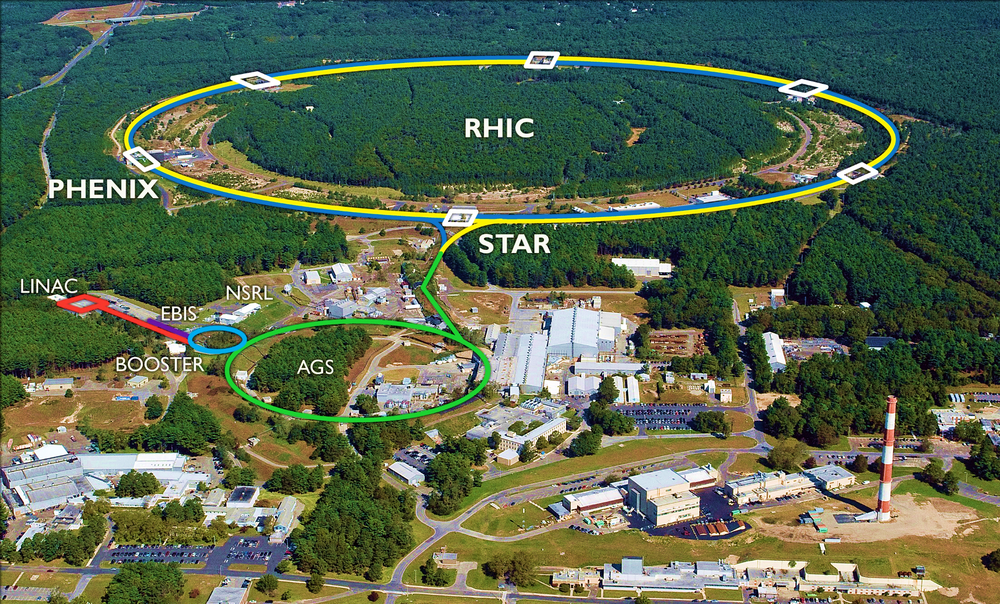
Areal Photo of RHIC

Slide 18
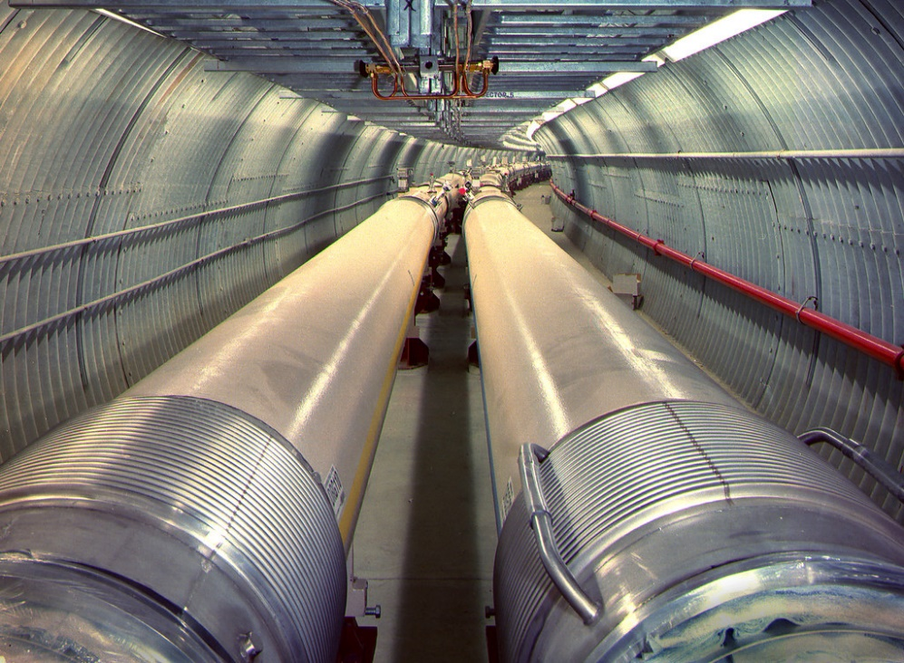
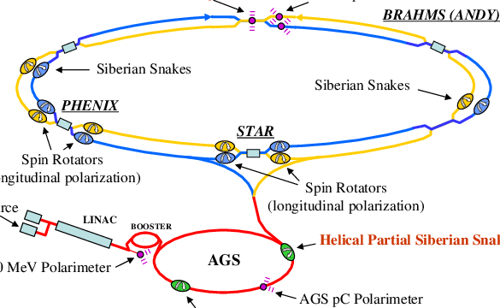
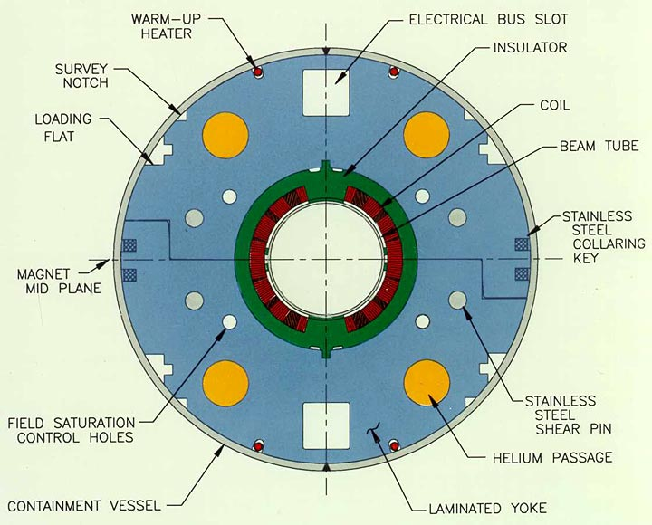
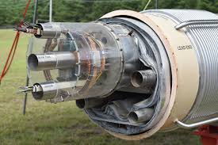
RHIC in Numbers
Two rings, 4 km each
99.995% speed of light
111 bunches
80 000 rounds/sec
Thousands of collisions/sec
1740 superconducting magnets
21 000 km superconducting wires
25 tons of liquid He
0.00005 mg gold/year

Slide 19
Rhic runs, 2001-2022

Slide 20
STAR Recorded data

Slide 21
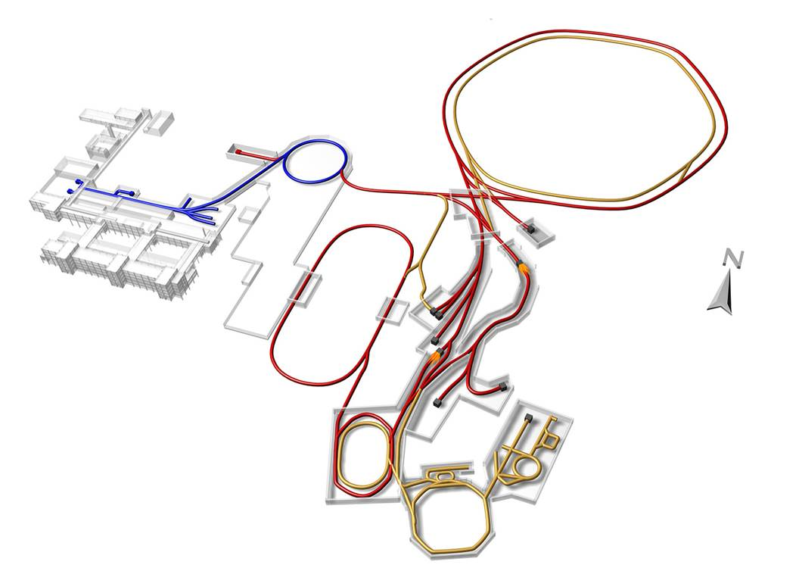
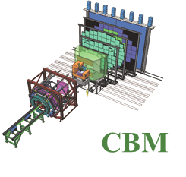
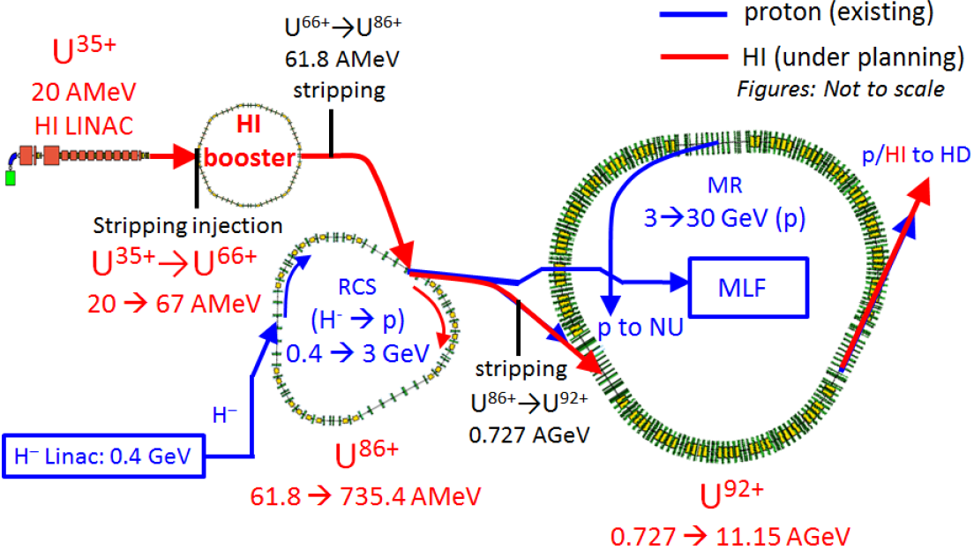
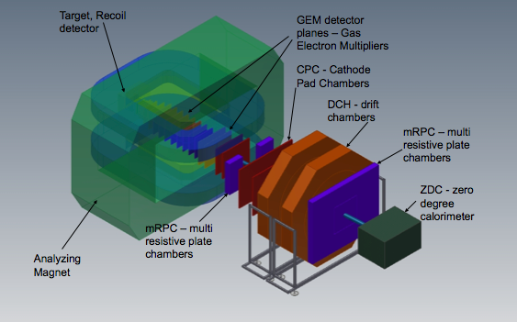
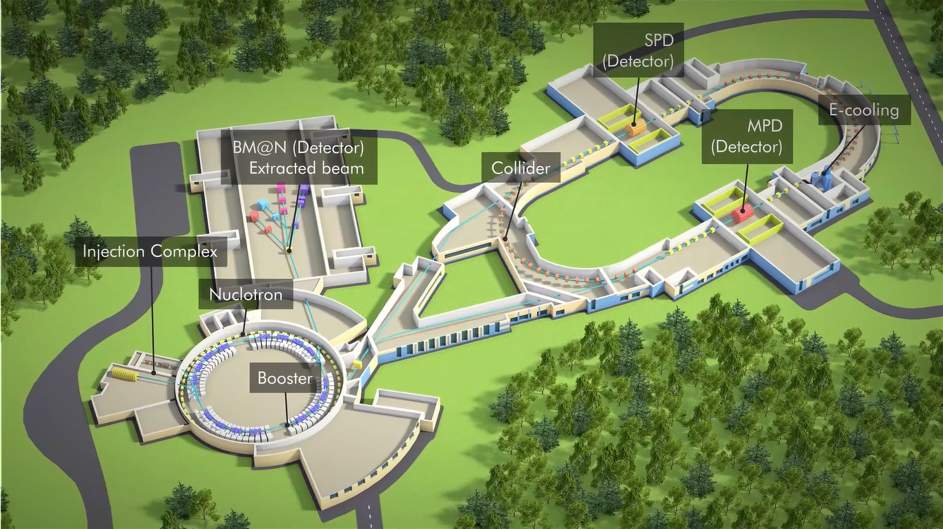
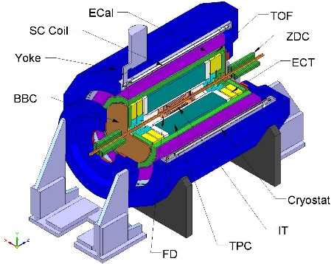
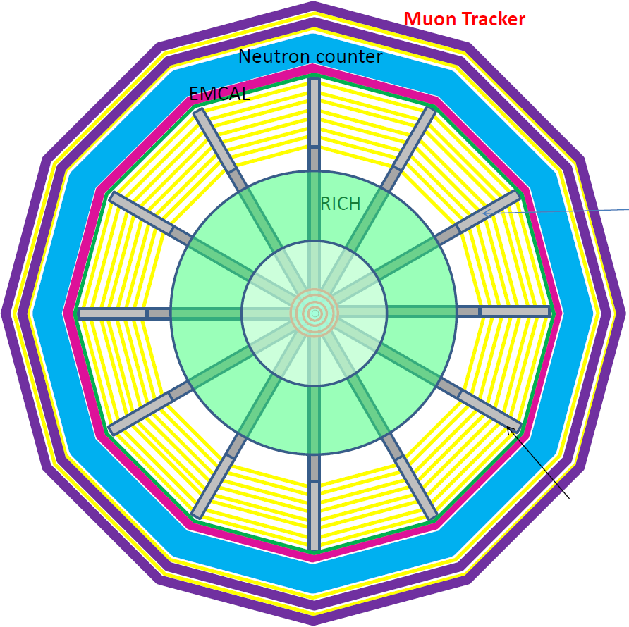
Future facilities: NICA, FAIR, J-PARC HI
New facilities planned/built
NICA: 2020, MPD&BM@N
FAIR: 2022, CBM
J-PARC HI: 2025, JHITS
SIS100/300
FAIR phase 1
FAIR phase 2
J-PARC HI
NICA

Slide 22
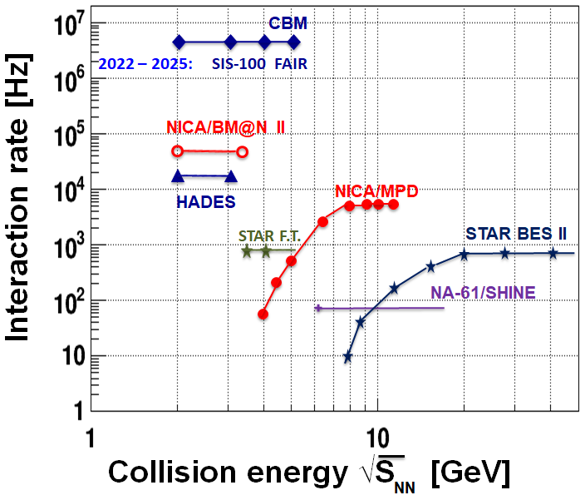
(FUTURE) FacilitIES comparison
Many future facilities and experiments, SPS and RHIC already running
RHIC, NICA: Collider and fixed target
SPS, FAIR, J-PARC: fixed target
Energy ranges from 2 to 20 GeV in $\sqrt{s_{NN}}$
Compilation from Daniel Cebra and Olga Evkidomiv:
Facility | RHIC BES-II & Fixed Target | SPS | NICA | FAIR | J-PARC HI
Experiment | STAR | NA61 | MPD & BM@N | CBM | JHITS
Start | 2019 | 2009 | 2020-23 | 2025 | 2025
Energy ($\sqrt{s_{NN}}$, GeV) | 2.9-19.6 GeV | 4.9-17.3 | 2.0-11 | 2.7-8.2 | 2.0-6.2
Rate | 100-1000 Hz | 100 Hz | 10 kHz | 10 MHz | 10-100 MHz
Physics | Critical Point Onset of Deconf. | Critical Point Onset of Deconf. | Onset of Deconfinement Compr. Hadronic Matter | Onset of Deconfinement Compr. Hadronic Matter | Onset of Deconfinement Compr. Hadronic Matter

Slide 23
Contents
Accelerators in general
Details of SPS, RHIC, LHC
Detectors in general
Some examples: PHENIX, STAR, CMS, NA61

Slide 24
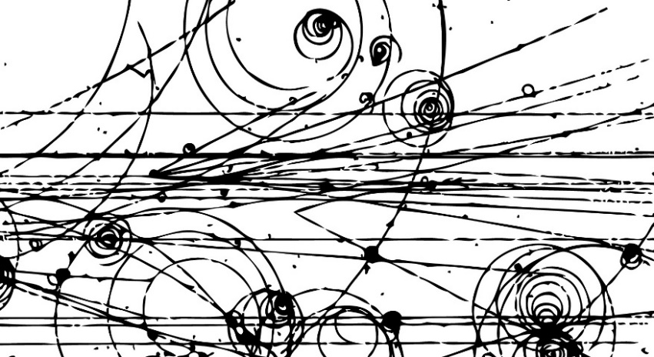
Particle detectors
Bubble chamber: overheated fluid, bubble creation
Cloud chamber: supersaturated gas, condensation
Ionization detector: traversing particle ionizes gas
Scintillator: luminescence, light detection
Semiconductor detectors: similar to CCD chip
Many Nobel prizes: Wilson, Glaser, Charpak

Slide 25
Event characterisation objectives
When (time zero) and where (vertex)
Overlap (centrality), number of participants (N_{part})
Orientation with respect to overlap (reaction plane)
Central Au+Au
N_{part}~300
Peripheral Au+Au
N_{part}~50
d+Au
p+p
Reality
Reaction Plane

Slide 26
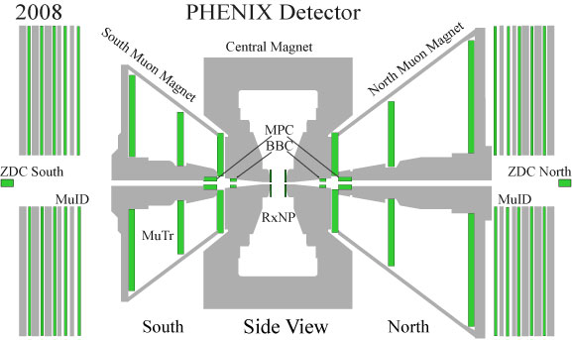
Time zero & vertex determination
BBC at $η≈3−4$, charged particles
Event activity
ZDC at $η≈∞$, evaporating neutrons
Spectator size
Time zero from $\left\langle T\right\rangle$
Vertex from $ΔT$
L
L
South
North
Vertex position: (T_{S}-T_{N}) × c/2
T_{S}
T_{N}
Time zero: (T_{N}+T_{S})/2 – L/c

Slide 27
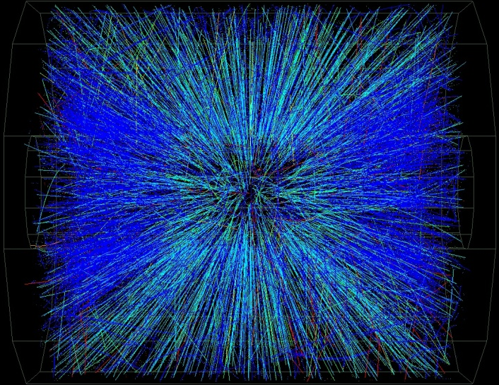
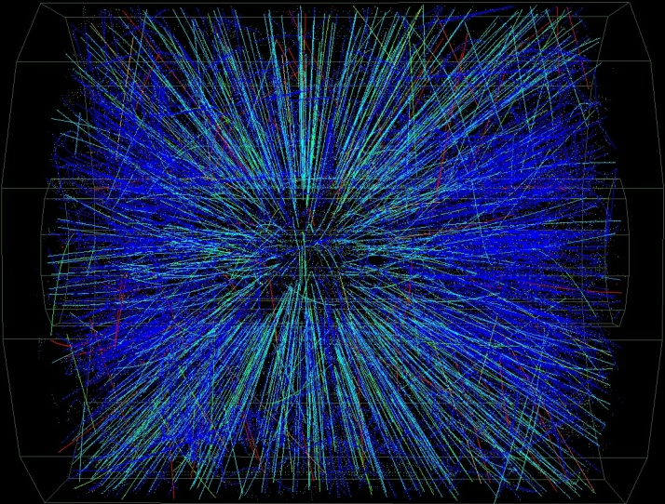
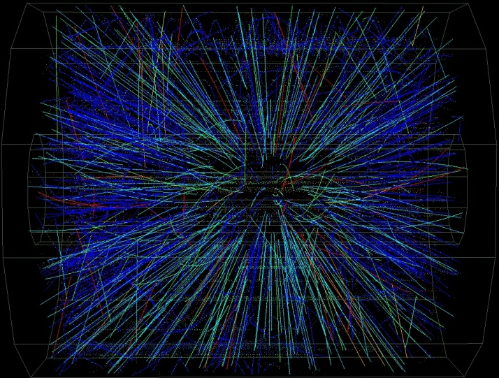
Collisions of different centrality
Centrality: how head-on the collision was
Measure: how many events are more central?
0%: most central collision; 0-5%: most central 1/20th of all; 90-100%: least central 1/10th of all
Central
Peripheral
INTRODUCTION EXPERIMENTS OBSERVATIONS

Slide 28
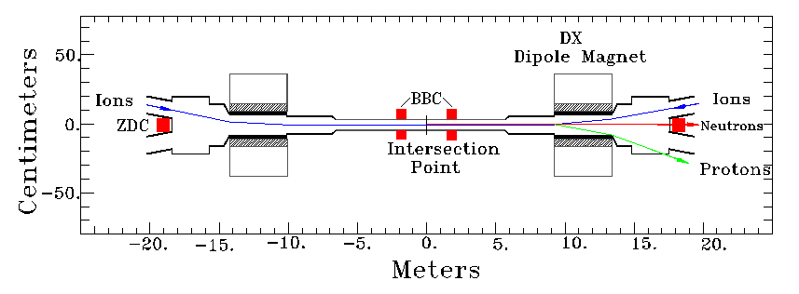
Centrality determination
Participants: new particles towards central detectors, including BBC
Spectators: deflected by DX magnet
Evaporated neutrons: not deflected („zero degree”), towards ZDC
Spectators
Towards ZDC
Participants
Spectators
Central detectors, incl. BBC

Slide 29
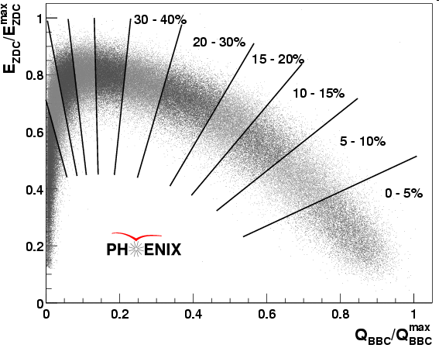
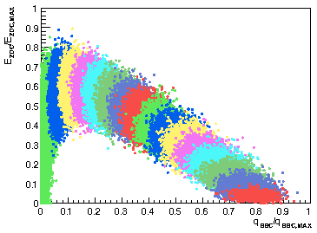
Centrality calibration
More central: more charge in BBC
Very central or very peripheral: no energy in ZDC
E_{ZDC} versus Q_{BBC}
Simulation via Glauber Monte Carlo model
Data
Simulation
10-15%
5-10%
0-5%

Slide 30
Glauber model
Nuclear density: $ρ\left(x,y,z\right)=\frac{ρ_{0}}{1+\exp{\frac{r−R}{a}}}$, $R$: radius, $a$: thickness, $∫ρ=1$
$T_{A}\left(b\right)=∫dzρ(z,b)$, surface density profile, with $b=(x,y)$
$T_{AB}\left(b\right)=∫d^{2}sT_{A}\left(s\right)T_{B}(s−b)$, nuclear overlap function
$N_{coll}=ABσ_{NN}T_{AB}\left(b\right)$, number of binary collisions
$σ_{AB}=∫d^{2}b\left\{1−{\left[1−σ_{NN}T_{AB}\left(b\right)\right]}^{AB}\right\}$, total cross section
$N_{part}=A∫d^{2}sT_{A}\left(s\right)\left\{1−{\left[1−σ_{NN}T_{AB}\left(s−b\right)\right]}^{B}\right\}+\left(A↔B\right)$
$ε=\frac{\left\langle x^{2}\right\rangle −\left\langle y^{2}\right\rangle }{\left\langle x^{2}\right\rangle +\left\langle y^{2}\right\rangle }$, initial excentricity
Monte Carlo: deposit nucleons according to $ρ$, collision probability, etc.

Slide 31
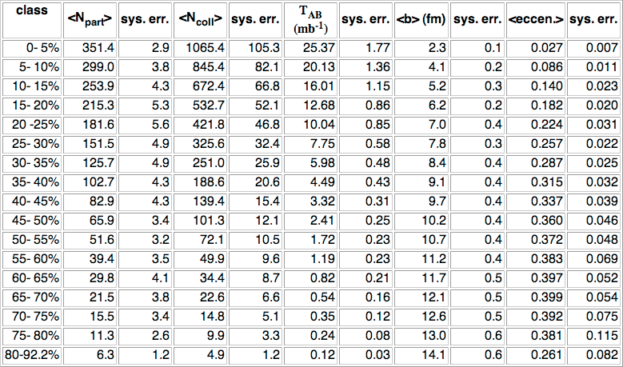
Results from a Glauber MC Calculation
$\sqrt{s_{NN}}=200$ GeV Au+Au simulation in varios centrality classes

Slide 32
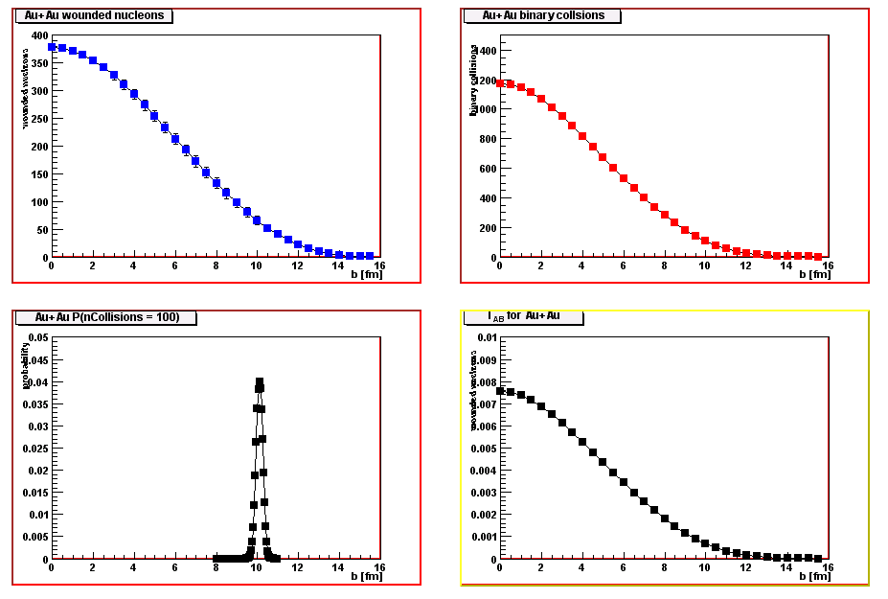
Results from a Glauber MC Calculation
$\sqrt{s_{NN}}=200$ GeV Au+Au simulation in varios centrality classes
N_{part} vs. b
N_{coll} vs. b
Prob(N_{coll}=100) vs. b
T_{AB} vs. b

Slide 33
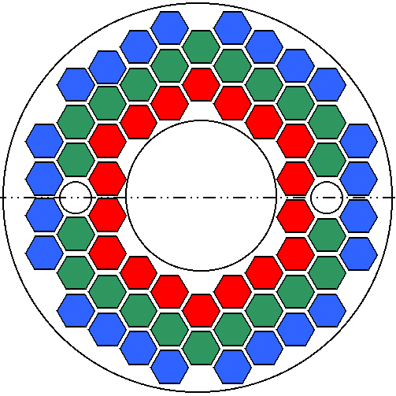
Reaction plane determination
Segmented detector, $Q_{i}$ charge in the $i$-th segment
Reaction Plane
$$Ψ$$
Reaction plane
$$\tan\left(nΨ\right)=\frac{\sum{Q_{i}\sin{nφ_{i}}}}{\sum{Q_{i}\cos{nφ_{i}}}}$$
b
impact parameter
BBC
RxNP

Slide 34
Particle properties
Particle = spatial track
Set of hits in several detectors measured
Momentum measured via curvature
Known magnetic field
Particle type determined via mass & charge
Charge: curvature again…
Mass: momentum & (velocity or energy)
Measure all this for hadrons, γ, leptons etc…
Quality assurance: matching of the above

Slide 35
Magnetic field to measure momentum
Momentum from curvature, precise tracking needed
CMS

Slide 36
Tracking with Kalman Filter
5D state vector: $x=\left(q/p,θ,φ,rφ,z\right)$, measurement vector: $m=\left(rφ,z\right)$
Describing the helical track of the particle
Adding more measurement points from detector layers
ATLAS
ALICE
CMS

Slide 37
Particle Identification via Time of flight
Time of Flight → velocity → mass → particle identity
$$t=\frac{L}{cβ}=\frac{L}{c}⋅\frac{\sqrt{p^{2}+m^{2}}}{p}↔m^{2}=p^{2}\left(\frac{t^{2}}{T^{2}}−1\right)$$

Slide 38
Particle id via energy deposition
Deposited energy: Bethe-Bloch formula
Depends on mass and medium
Example plot from STAR:

Slide 39
Electron ID: Cerenkov detectors
Čerenkov radiation: $β>1/n$, angle $\cos{θ}=1/nβ$
Example in PHENIX: Ring Imaginc CHerenkov counter (RICH)
Čerenkov light mirrored onto PMT plane
PMT array, ring size characteristic
$$β>1/n$$
$$e^{−}$$
$$θ$$

Slide 40
Data Aquisition (DAQ)
Central concept: triggering
Level-1: hardware trigger
Level-2: software trigger
All connected to global timing
Event building at the end

Slide 41
Event Builder
Event fragments come in from all detectors
Need to be assembled
One event
SEB
Gigabit
Switch
ATP
Buffer
Box
Final Storage
SEB
ATP
SEB
ATP
SEB
ATP
Buffer
Box
SEB
ATP
SEB
ATP
Buffer
Box
SEB
ATP
SEB
ATP
ATP
Buffer
Box
SEB
SEB
ATP
Sub-event buffers
Assembly & Trigger Processors

Slide 42
Contents
Accelerators in general
Details of SPS, RHIC, LHC
Detectors in general
Some examples: PHENIX, STAR, CMS, NA61

Slide 43
An example: the PHENIX Detector system
Charged hadrons (pion, kaon, etc.)
Photons, direct or decay (from $η$, $π^{0}$)
Light mesons $φ$, $ω$ and $η$
Single leptons → heavy flavor
Dileptons → heavy flavor, J/Ψ

Slide 44
Tracking in PHENIX
Track particles, measure momentum
Hit → Track → Curvature → Momentum
Wire chambers
Track reco: DC+PC1
Matching: PC2-3

Slide 45
Tracking in PHENIX, illustrated
Innermost layers, tracking
Outer layers: matching, reduces background, for example decays

Slide 46
Time of flight PID in PHENIX
Time Of Flight detector
time measurement
120 ps resolution
East and West arm
1472 PMTs
Measure hit position and time from PMT time
$$T_{0}+\frac{x}{v}=T_{1}$$
$$x$$
$$L−x$$
$$T_{2}=T_{0}+\frac{L−x}{v}$$
PMT
PMT

Slide 47
Lepton and Photon ID: EM Calorimeters
Energy + momentum → mass
Leptons and photons to deposit all their energy in EMCal
Lead Scintillator and Lead Glass: light ~ energy
Hadron ID via time of flight: additional recalibration needed (worse time resol.)
PbSc
Optical fiber
collects light
$$γ$$
PMT
Pb absorber
generates shower
Scintillator
generates light
PbGl
$$γ$$
PMT
Scintillator
generates Č-rad

Slide 48
further example: Silicon detectors @ CMS

Slide 49
Time projection chamber @ STAR
Heart of STAR: a large Time Projection Chamber for tracking and ID

Slide 50
A fixed-target detector system: NA61
TPCs for tracking and PID, TOF for more precise PID, PSD for centrality

Slide 51
What do we extract from the data?
p_{x}, p_{y}, p_{z} → η or y, ϕ, p_{t} or m_{t}
Transverse mom. spectrum for each particle
Rapidity distributions
Angular distributions
Elliptic flow
All kinds of ratios
Pair-correlations
Momentum, angle, etc
Fluctuations
Whatever tells us something…

Slide 52
BACKUP

