Slide 1

Soft Probes in high energy heavy ion physics
Máté Csanád
Eötvös University, Budapest, Hungary

Slide 2
Content of this talk
INTRODUCTION
  The Big Bang and the Little Bangs in the lab
  Phase map of QCD and the experimental control parameters
  High energy physics facilities, experiments
BASIC OBSERVATIONS
  Spectra, flow, thermal photons, femtoscopy, fluctuations
RECENT RESULTS FROM RHIC & LHC
  Freeze-out curve
  Flow in small systems, higher order and mixed flow
  Finite size scaling in HBT measurements
INTRODUCTION BASIC OBSERVATIONS RECENT RESULTS

Slide 3
INTRODUCTION
Universe history, Big Bang and Little Bangs
Time evolution of heavy ion collisions
Phase map of QCD
Experimental control parameters
Experiments, recorded data
INTRODUCTION BASIC OBSERVATIONS RECENT RESULTS

Slide 4
Time evolution of a heavy ion collision
γ, e±, μ±
γ, e±, μ±
π±, K±, p, ..
π±, K±, p, ..
Hadron gas
Initial stage:
  Hard scattering
  Jet formation
Leptons, photons:
  ”shine through”
Hadrons:
  Dissociation and coalescence
  ”Final” hadrons created at freeze-out
How do we know if sQGP
was there or not?
Freeze-out, hadrons
jets
sQGP
INTRODUCTION BASIC OBSERVATIONS RECENT RESULTS

Slide 5
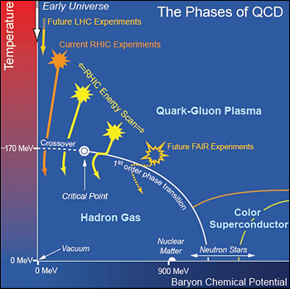

Exploring the Phase map of QCD
Phase map: temperature versus
matter excess (baryochem. pot. μ_{B})
1st order quark-hadron
phase transition at high μ_{B}
Crossover at low μ_{B} and T$≅$170 MeV
Critical EndPoint inbetween?
Control parameters:
  Collision energy
  Collision system
  Collision geometry
High μ_{B}: nuclear matter, neutron stars, color superconductors…
SPS
NICA
J-PARC HI
T
μ_{B}
INTRODUCTION BASIC OBSERVATIONS RECENT RESULTS

Slide 6
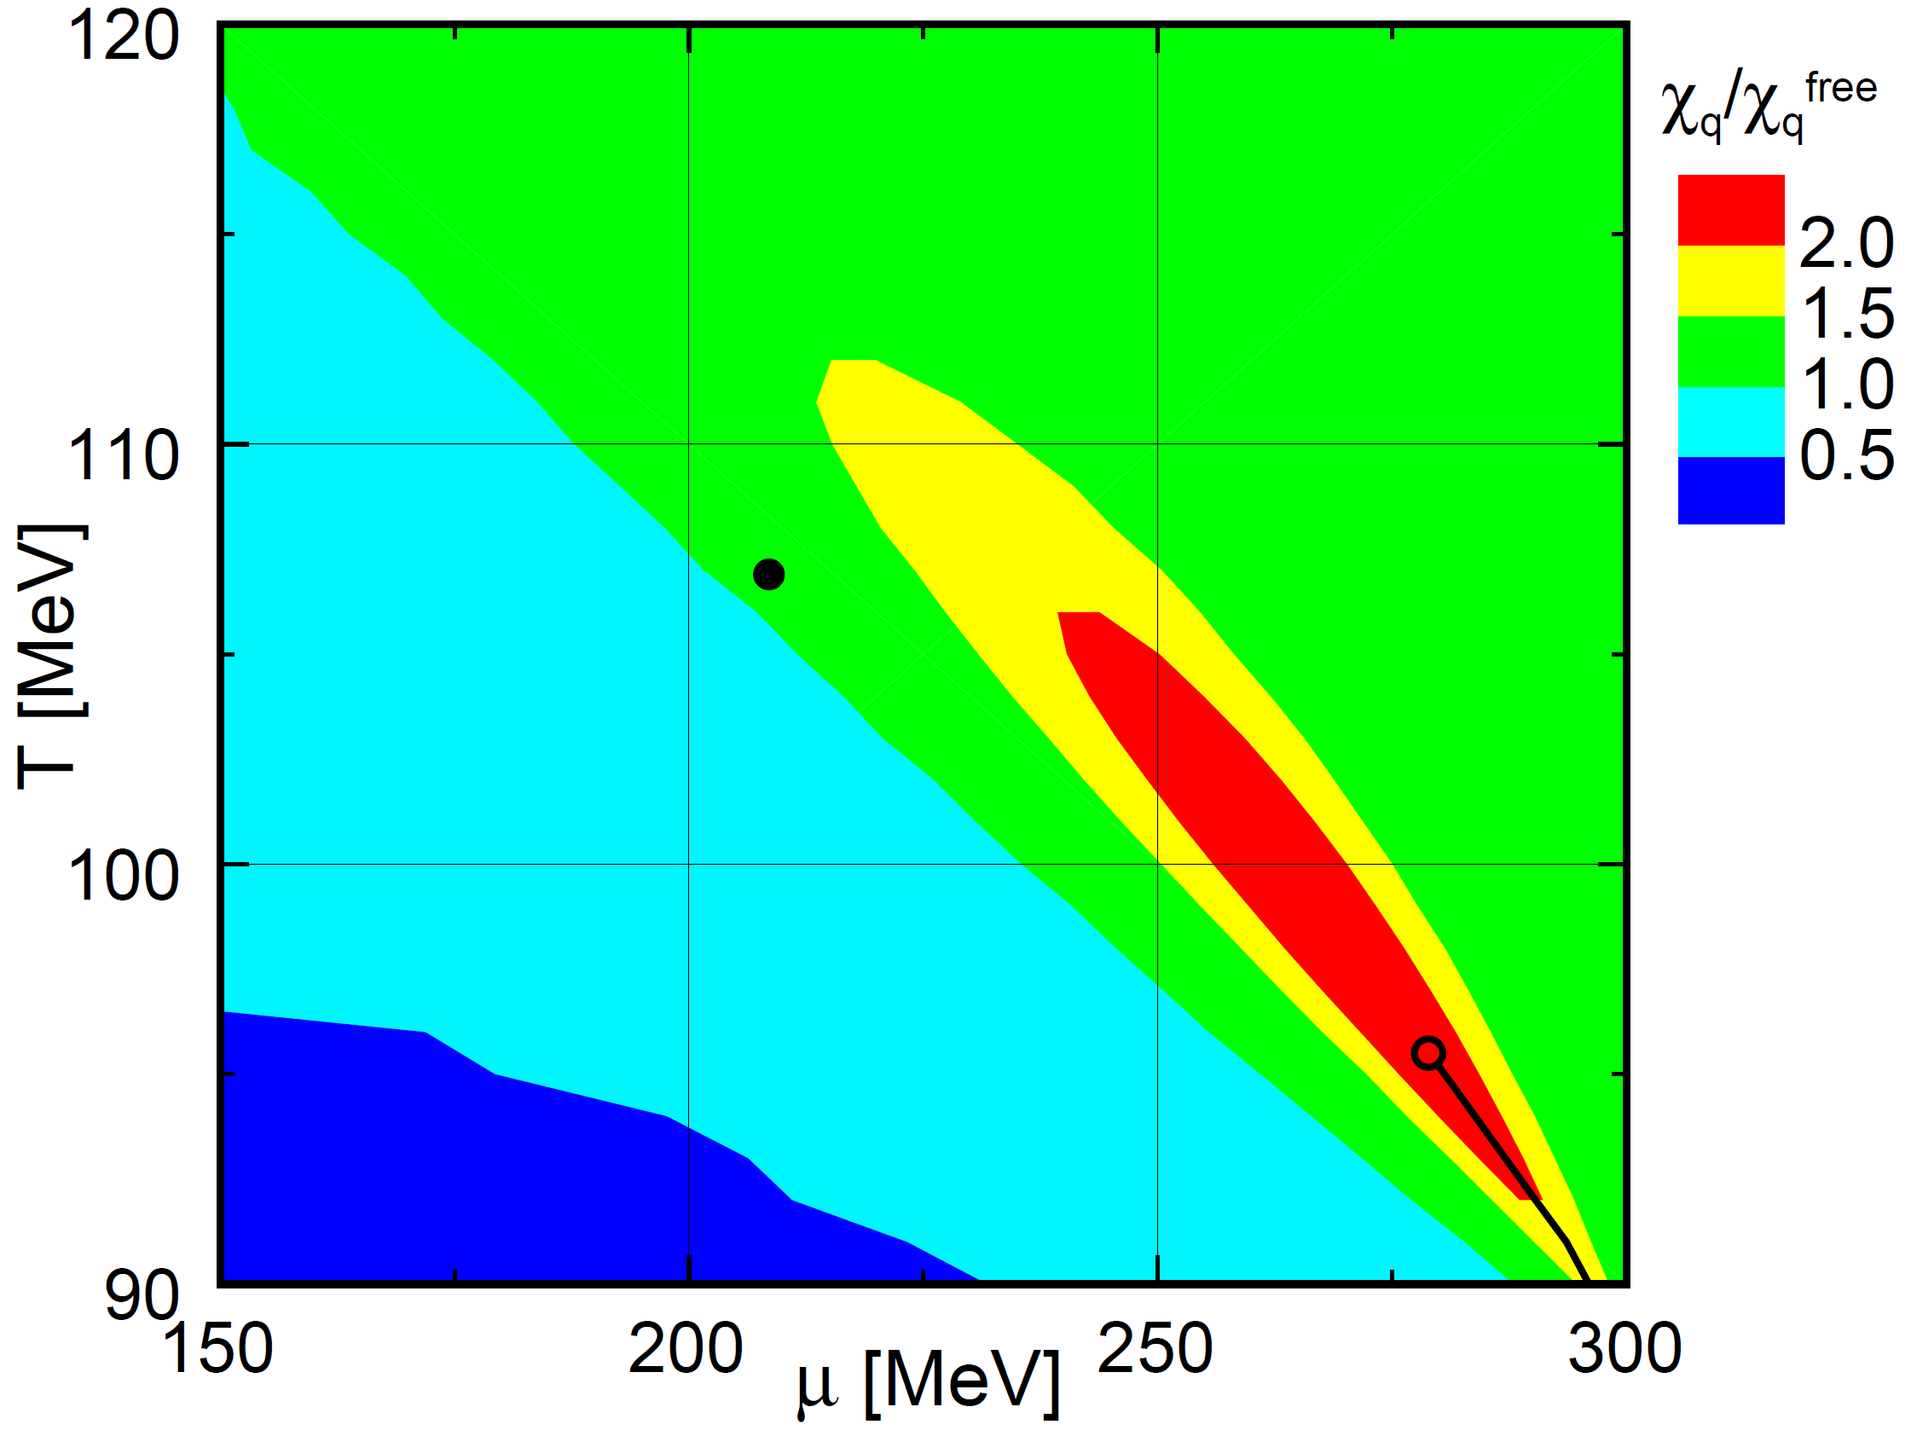
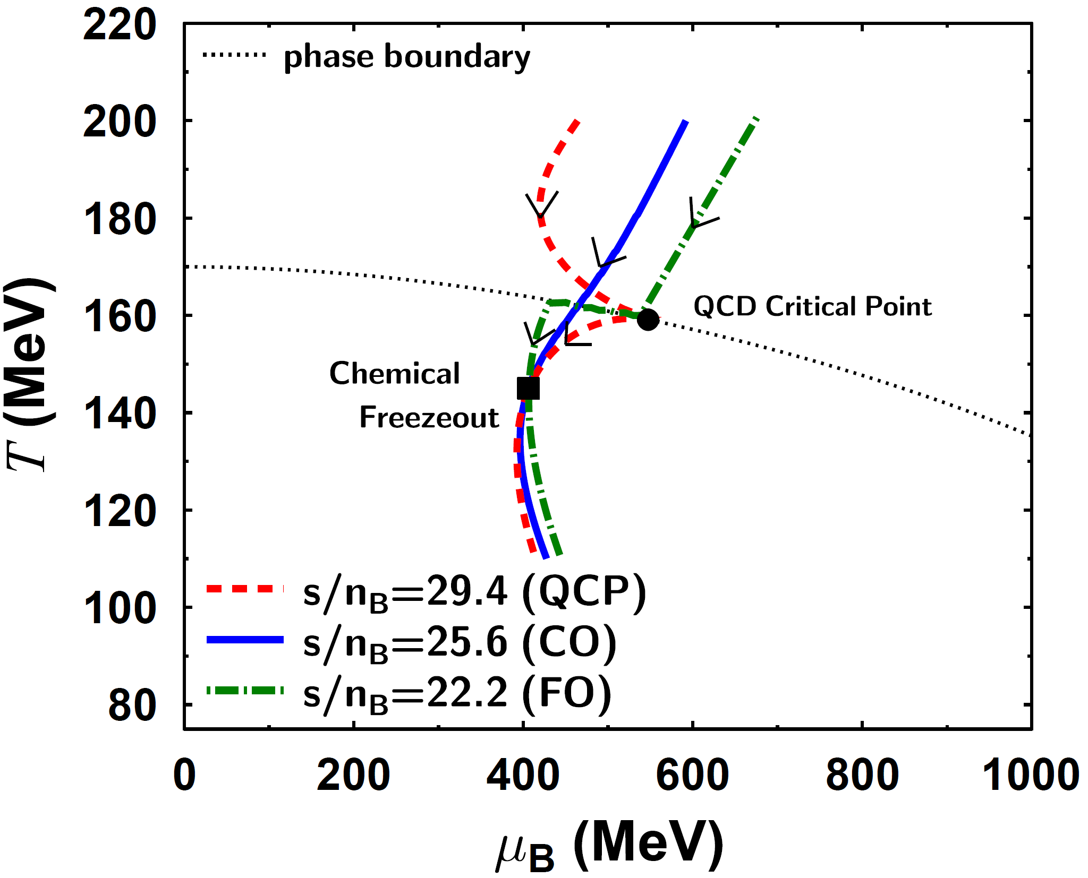

Search for the Critical Point
Evolution attracted to the critical point
  M. Asakawa et al., PRL101,122302(2008) [arXiv:0803.2449]
Effects of critical point in a broad region
  Y. Hatta and T. Ikeda, PRD67,014028(2003) [hep-ph/0210284]
$→$ Critical Point
$→$ Cross-Over
$→$ First Order
INTRODUCTION BASIC OBSERVATIONS RECENT RESULTS

Slide 7
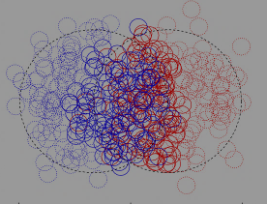
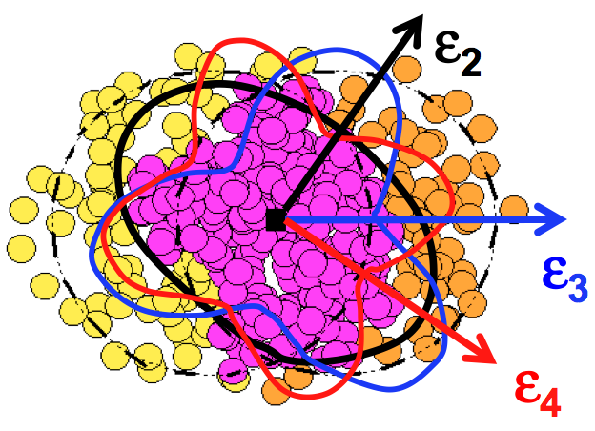
Experimental Control parameters
Collision energy: controls initial temperature, initial μ_{B}
Collision system & centrality: controls available volume
Event geometry: reaction plane, event plane, fluctuations
Important parameters: N_{part} (system size), N_{coll} (x-sect)
Central Au+Au
N_{part}~300
Peripheral Au+Au
N_{part}~50
d+Au
p+p
Reality
Multipole event planes
Reaction Plane
INTRODUCTION BASIC OBSERVATIONS RECENT RESULTS

Slide 8
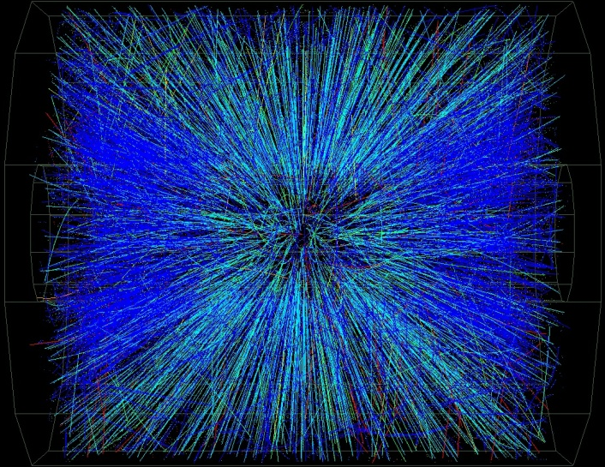
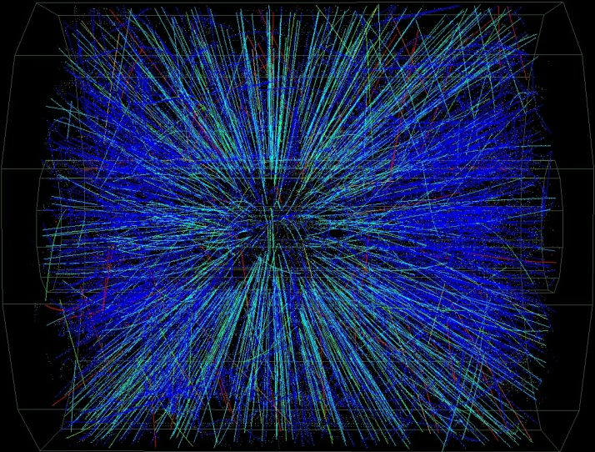
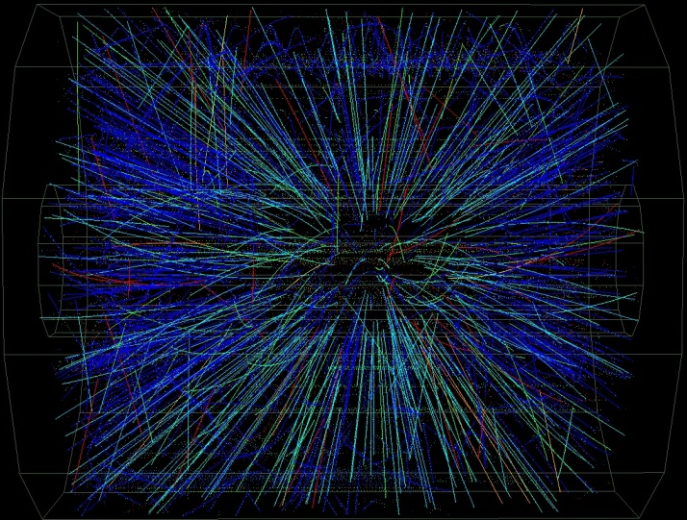
Collisions of different centrality
Centrality in percentage (%): how many events are more head-on?
  0%: most central collision; 0-5%: most central 1/20th of all; 90-100%: least central 1/10th of all
  Minimum Bias sample: all observable centrality, least possible bias (when triggering)
Central
Peripheral
INTRODUCTION BASIC OBSERVATIONS RECENT RESULTS

Slide 9
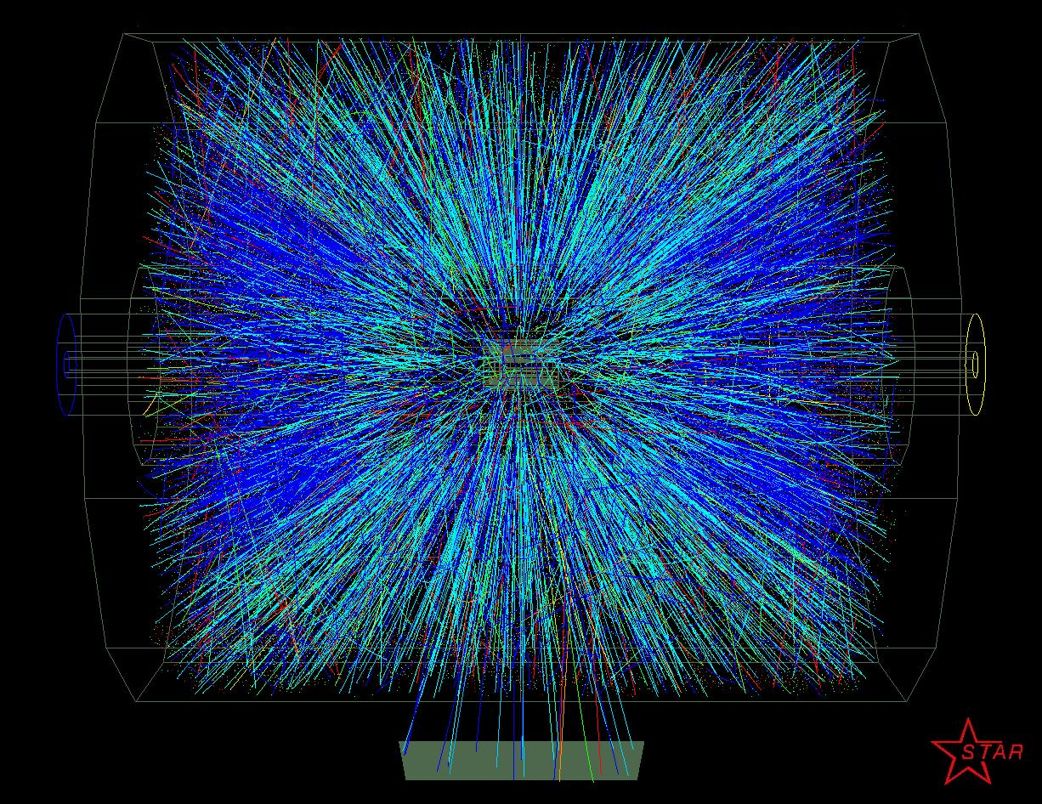




Important kinematic quantities
Particle four-momentum: $p=(E,p_{x},p_{y},p_{z})$
Beam direction: z; transverse plane: perpendicular to z: (x,y) coordinates
Transverse momentum: $p_{T}=\sqrt{p_{x}^{2}+p_{y}^{2}}$; transverse mass: $m_{T}=\sqrt{m^{2}+p_{T}^{2}}$
Spherical coordinates:
$p_{x}=p_{T}\cos{φ}$, $p_{y}=p_{T}\sin{φ}{}_{z}$
$p_{T}=\left|p\right|\sin{θ}$, $p_{z}=\left|p\right|\cos{θ}$
Rapidity:
$y=0.5\ln{\frac{E+p_{z}}{E−p_{z}}}=\operatorname{atanh}{\frac{p_{z}}{E}}$
Pseudorapidity:
$η=0.5\ln{\frac{\left|p\right|+p_{z}}{\left|p\right|−p_{z}}}=−\ln{\operatorname{tg}{\frac{θ}{2}}}$
$$p_{T}$$
$$θ$$
beam: z axis
transverse plane
$$p_{z}$$
INTRODUCTION BASIC OBSERVATIONS RECENT RESULTS

Slide 10
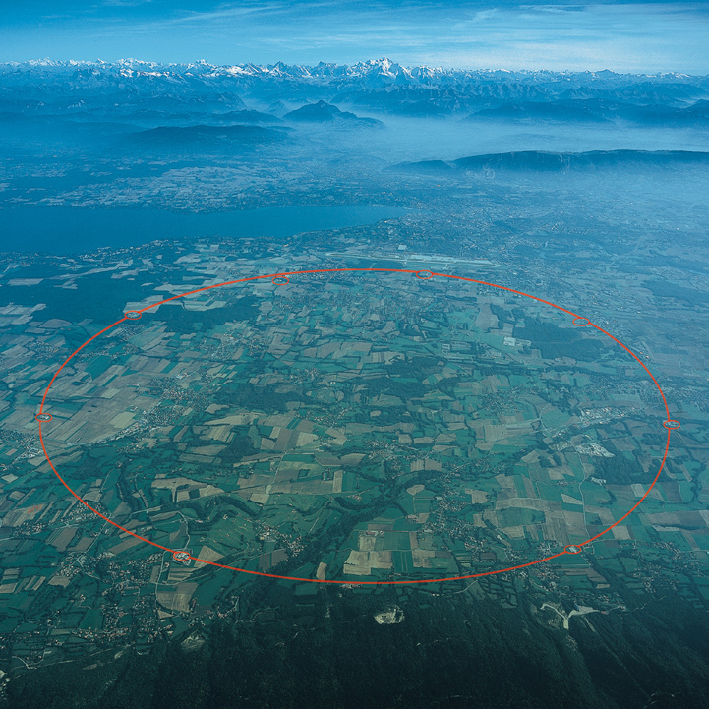
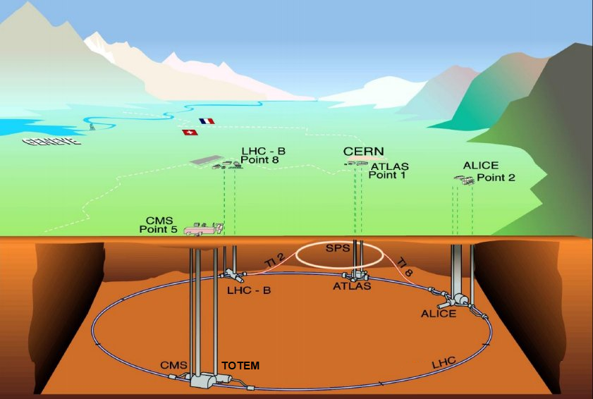
Facilities: Large Hadron Collider
Past high energy physics facilities: LEP, SPS (also currently in use)
LHC collisions: p+p, p+Pb and Pb+Pb
Energies: from 2.76 TeV/nucleon to 13 TeV (p+p only)
Experiments: ALICE, ATLAS, CMS, LHCb, LHCf, MoEDAL, TOTEM
INTRODUCTION BASIC OBSERVATIONS RECENT RESULTS

Slide 11
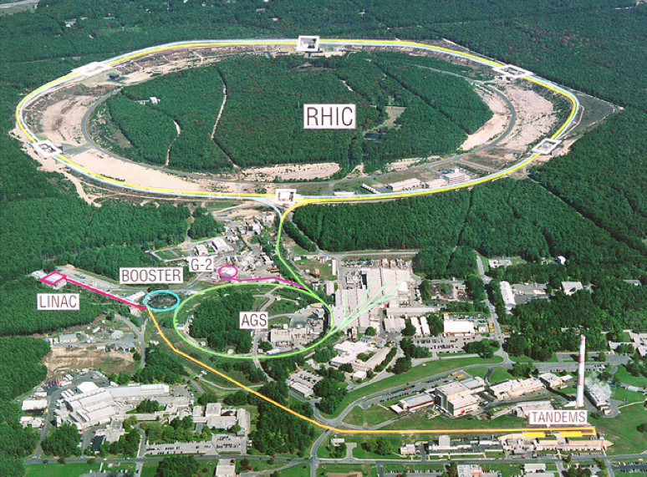


The Relativistic Heavy Ion Collider
At the Brookhaven National Laboratory, Long Island, New York, USA
Collisions of: $\vec{\text{p}}$, d, ³He, Al, Cu, Zr, Ru, Au, U
Collision energies: 7-200 GeV/nucleon, even 0.51 TeV for $\vec{\text{p}}$
Experiments: STAR; future: sPHENIX; past: BRAHMS, PHENIX, PHOBOS
INTRODUCTION BASIC OBSERVATIONS RECENT RESULTS

Slide 12
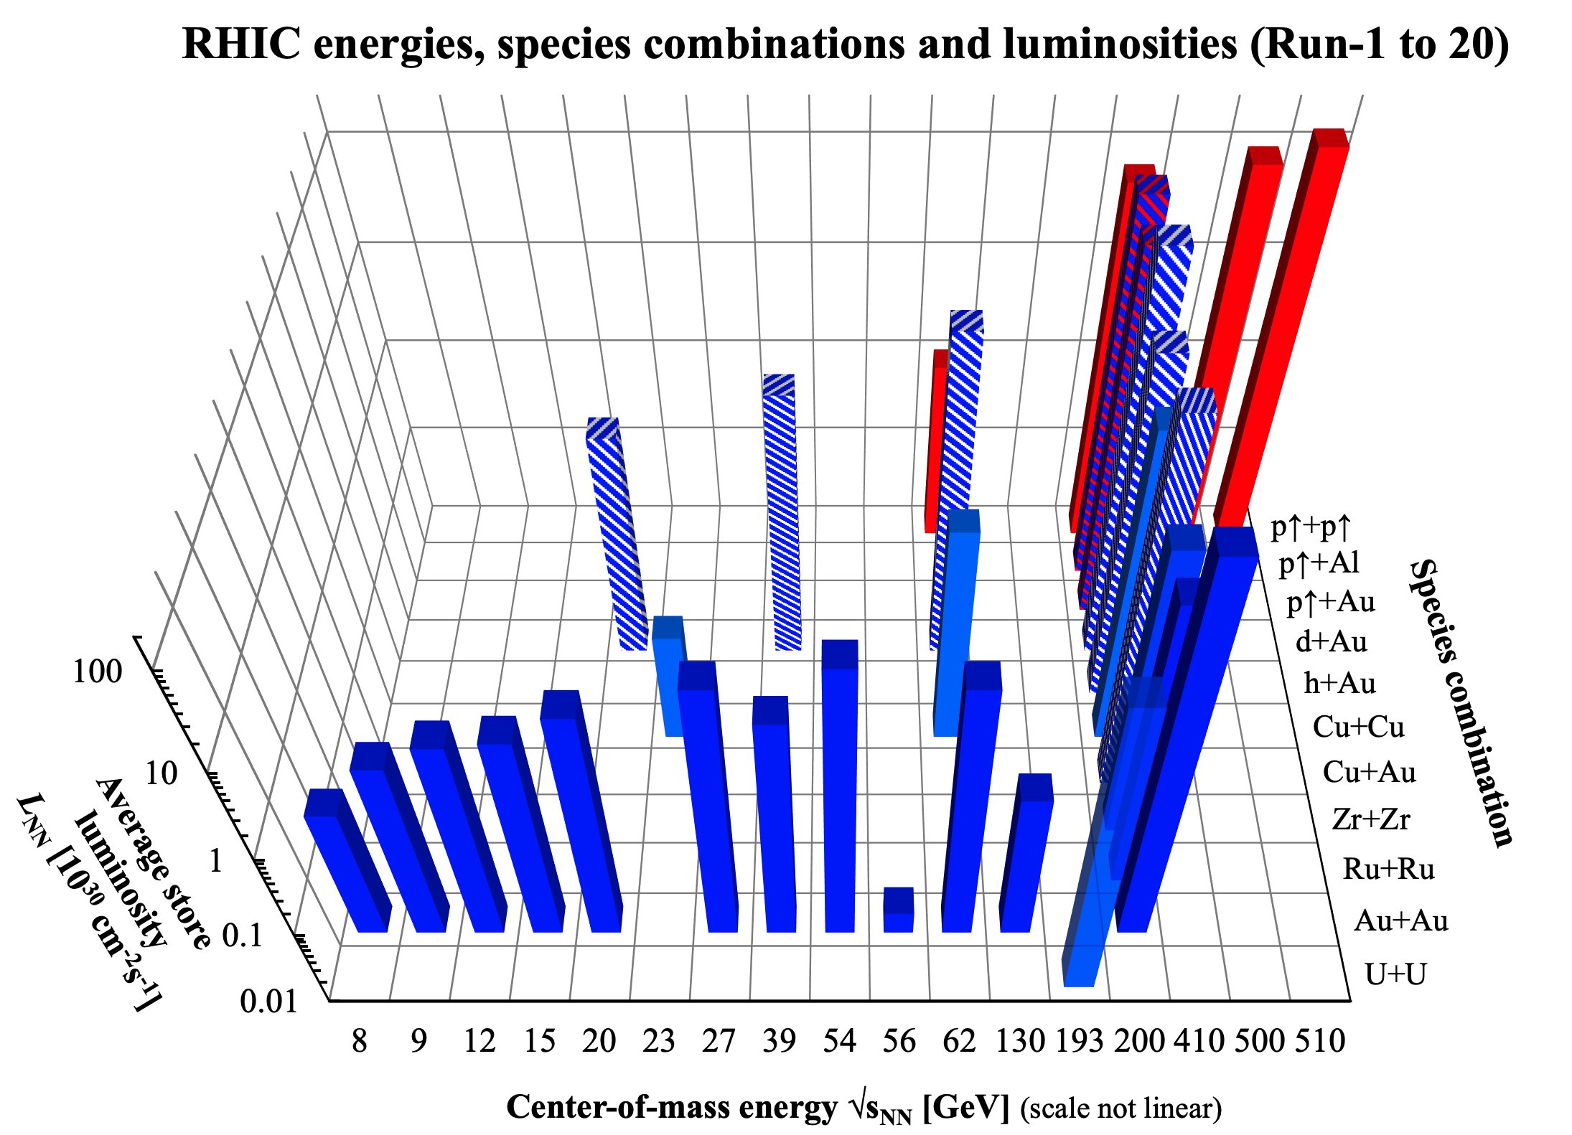
RHIC recorded runs and Luminosity
INTRODUCTION BASIC OBSERVATIONS RECENT RESULTS

Slide 13
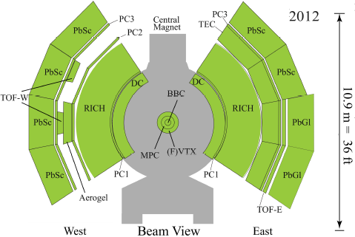
PHENIX and sPHENIX
PHENIX: versatile detector identifying many different particles, recording large amount of collisions. Dismantled in 2016, to give way to sPHENIX
sPHENIX: to take data in 2022-2023
  Jets, jet correlations, Upsilon states
  EM+Hadronic calorimetry, high resolution tracking, fast (~100 kHz) data aquisition
PHENIX
2012
sPHENIX
2022
INTRODUCTION BASIC OBSERVATIONS RECENT RESULTS

Slide 14
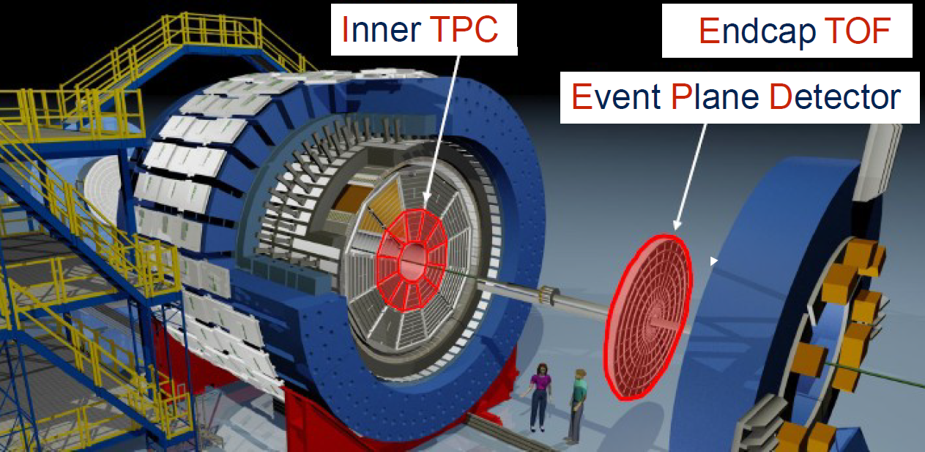
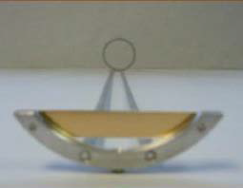
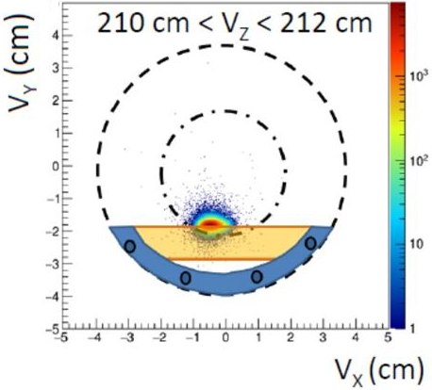
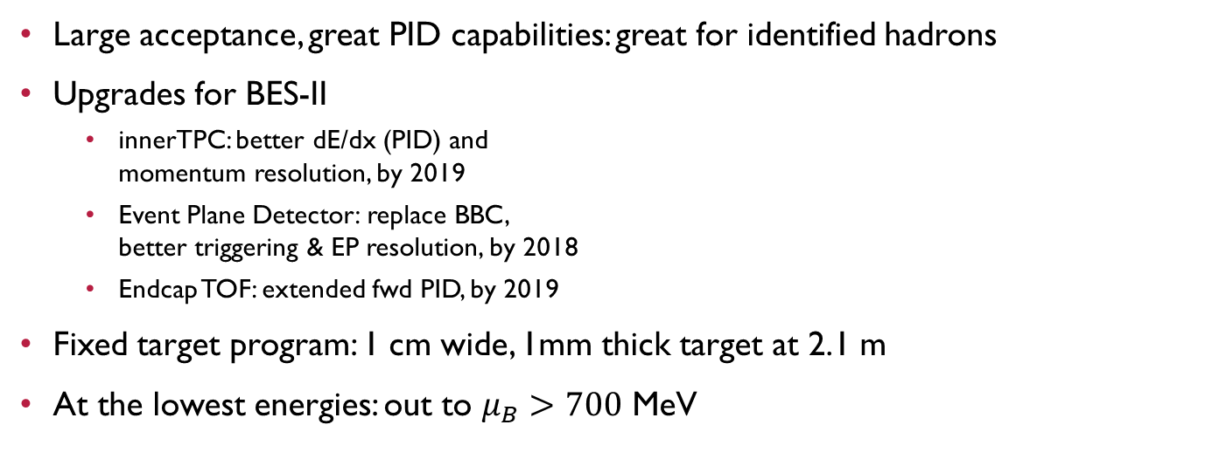
STAR: upgrades and fixed target program
Large acceptance, great PID capabilities: great for identified hadrons
Upgrades for BES-II
  innerTPC: better dE/dx (PID) and
  momentum resolution, by 2019
  Event Plane Detector: replace BBC,
  better triggering & EP resolution, by 2018
  Endcap TOF: extended fwd PID, by 2019
Fixed target program: 1 cm wide, 1mm thick target at 2.1 m
At the lowest energies: out to $μ_{B}>700$ MeV
a 3.9 GeV event
INTRODUCTION BASIC OBSERVATIONS RECENT RESULTS

Slide 15
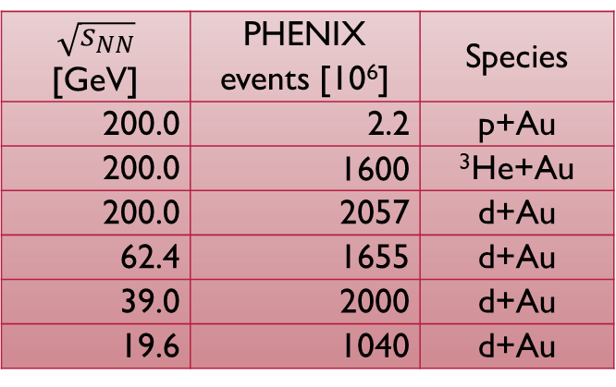
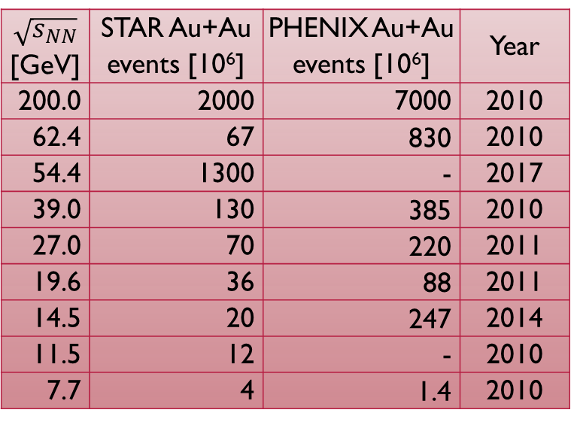
the RHIC Beam Energy/SPECIES scan
Collision experiments: acceptance independent of energy
BES-I: 7.7-200 GeV; BES-II: 7.7-19.9 GeV, increased luminosity
Small system scan: x+Au, 19.6-200 GeV
STAR fixed target mode: down to 3 GeV
$\sqrt{s_{NN}}$ [GeV] | STAR Au+Au events [10⁶] | PHENIX Au+Au events [10⁶] | Year
200.0 | 2000 | 7000 | 2010
62.4 | 67 | 830 | 2010
54.4 | 1300 | - | 2017
39.0 | 130 | 385 | 2010
27.0 | 70 | 220 | 2011
19.6 | 36 | 88 | 2011
14.5 | 20 | 247 | 2014
11.5 | 12 | - | 2010
7.7 | 4 | 1.4 | 2010
$\sqrt{s_{NN}}$ [GeV] | PHENIX events [10⁶] | Species
200.0 | 2.2 | p+Au
200.0 | 1600 | ³He+Au
200.0 | 2057 | d+Au
62.4 | 1655 | d+Au
39.0 | 2000 | d+Au
19.6 | 1040 | d+Au
INTRODUCTION BASIC OBSERVATIONS RECENT RESULTS

Slide 16
Fixed target Baryochemical Potentials
Collider: $\sqrt{s_{NN}}=E_{beam}+E_{beam}$ Fixed target: $\sqrt{s_{NN}}=\sqrt{2⋅M_{p}⋅E_{beam}}$
Energies unreachable in collider mode
Chemical potentials reachable by RHIC in collider mode: 20-420 MeV
Chemical potentials in fixed target mode: 420-721 MeV
LHC: ~0.5-1 MeV
Collider Energy [GeV] | Single beam energy [GeV] | Fixed target c.m. energy[GeV] | Beam rapidity | μ_{B} (MeV)
200.0 | 100.00 | 13.71 | 2.10 | 260
62.4 | 31.20 | 7.74 | 2.10 | 420
39.0 | 19.50 | 6.17 | 1.87 | 487
27.0 | 13.50 | 5.19 | 1.68 | 541
19.6 | 9.80 | 4.47 | 1.52 | 589
11.5 | 5.75 | 3.53 | 1.25 | 666
9.1 | 4.59 | 3.20 | 1.13 | 699
7.7 | 3.85 | 2.98 | 1.05 | 721
INTRODUCTION BASIC OBSERVATIONS RECENT RESULTS

Slide 17

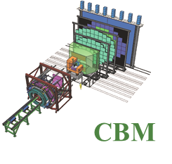
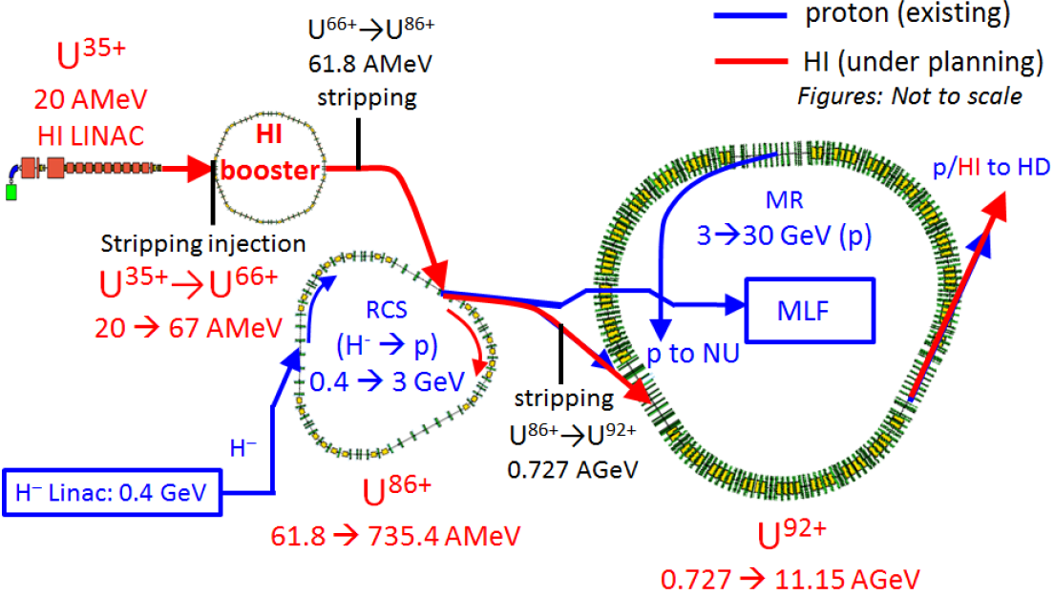
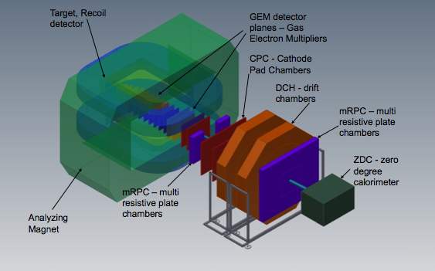


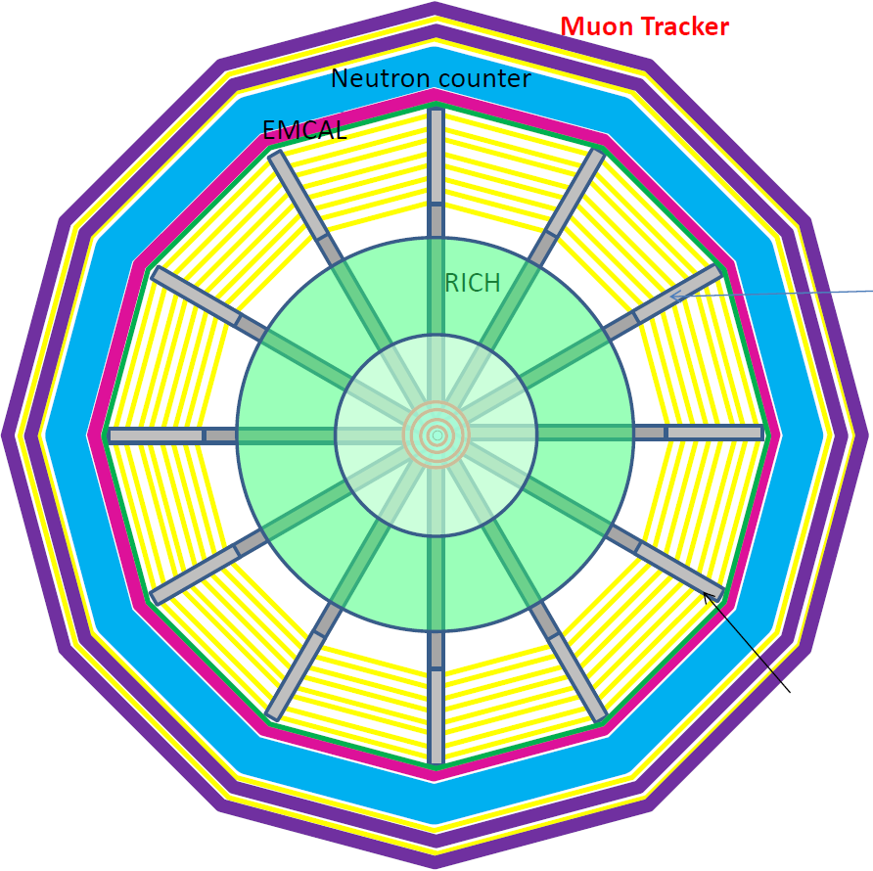
Future facilities: NICA, FAIR, J-PARC HI
New facilities planned/built
NICA: 2020, MPD&BM@N
FAIR: 2022, CBM
J-PARC HI: 2025, JHITS
SIS100/300
FAIR phase 1
FAIR phase 2
J-PARC HI
NICA
INTRODUCTION BASIC OBSERVATIONS RECENT RESULTS

Slide 18
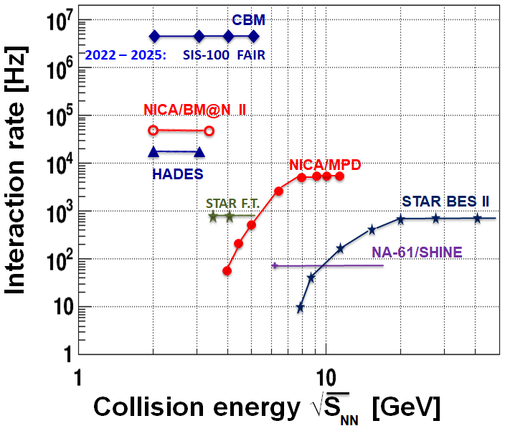
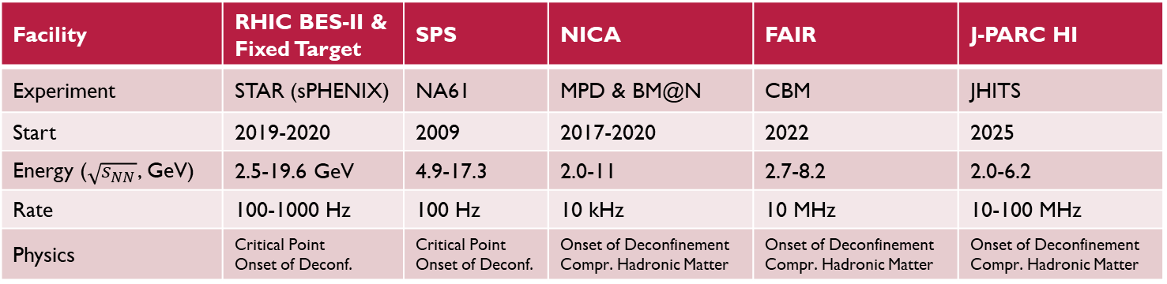
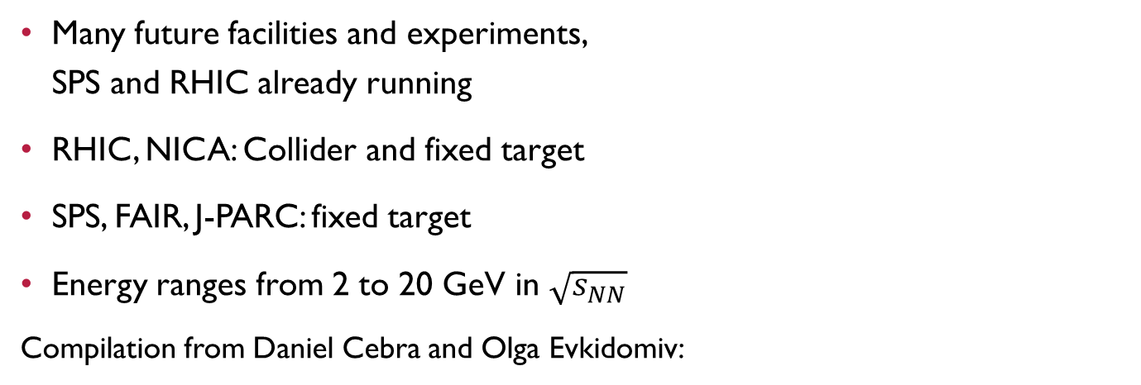
(FUTURE) FacilitIES comparison
Many future facilities and experiments,
SPS and RHIC already running
RHIC, NICA: Collider and fixed target
SPS, FAIR, J-PARC: fixed target
Energy ranges from 2 to 20 GeV in $\sqrt{s_{NN}}$
Compilation from Daniel Cebra and Olga Evkidomiv:
Facility | RHIC BES-II & Fixed Target | SPS | NICA | FAIR | J-PARC HI
Experiment | STAR (sPHENIX) | NA61 | MPD & BM@N | CBM | JHITS
Start | 2019-2020 | 2009 | 2017-2020 | 2022 | 2025
Energy ($\sqrt{s_{NN}}$, GeV) | 2.5-19.6 GeV | 4.9-17.3 | 2.0-11 | 2.7-8.2 | 2.0-6.2
Rate | 100-1000 Hz | 100 Hz | 10 kHz | 10 MHz | 10-100 MHz
Physics | Critical Point Onset of Deconf. | Critical Point Onset of Deconf. | Onset of Deconfinement Compr. Hadronic Matter | Onset of Deconfinement Compr. Hadronic Matter | Onset of Deconfinement Compr. Hadronic Matter
INTRODUCTION BASIC OBSERVATIONS RECENT RESULTS

Slide 19
Soft probes of sQGP
Spectra
Elliptic flow
Direct photons
Bose-Einstein correlations
INTRODUCTION BASIC OBSERVATIONS RECENT RESULTS

Slide 20
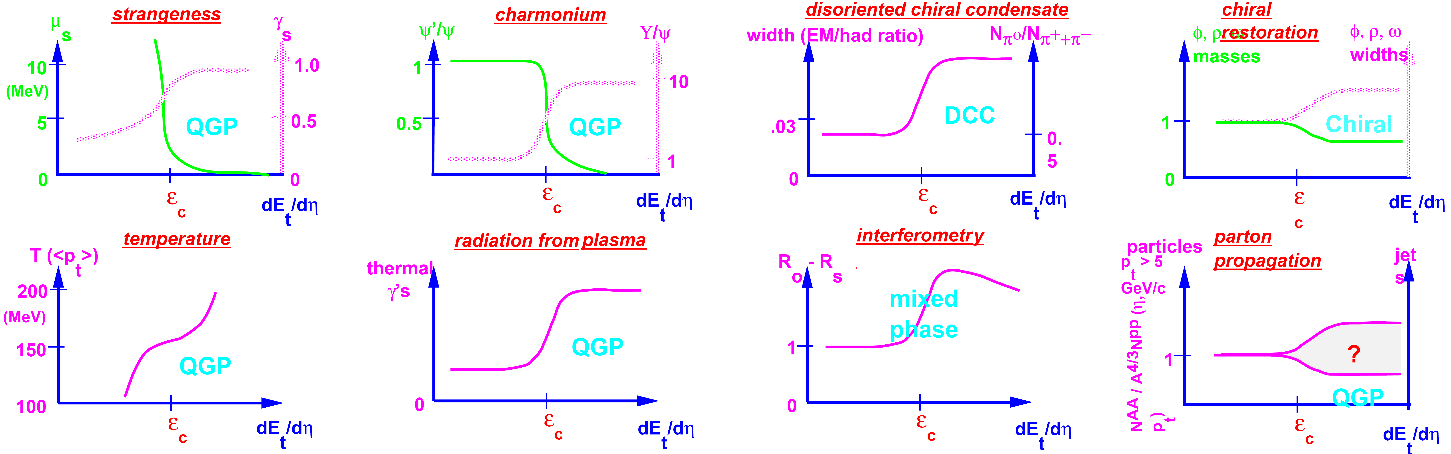

QGP signatures Expectations, 1996
Critical energy density: $ε_{c}≈1 \text{GeV}/{\text{fm}}^{3}$, temperature $T_{c}≈170 MeV$
Some observed, some not…
J. Harris & B. Mueller, „The Search for the QGP”, Ann.Rev.Nucl.Part.Sci. 46 (1996) 71 [hep-ph/9602235]
INTRODUCTION BASIC OBSERVATIONS RECENT RESULTS

Slide 21
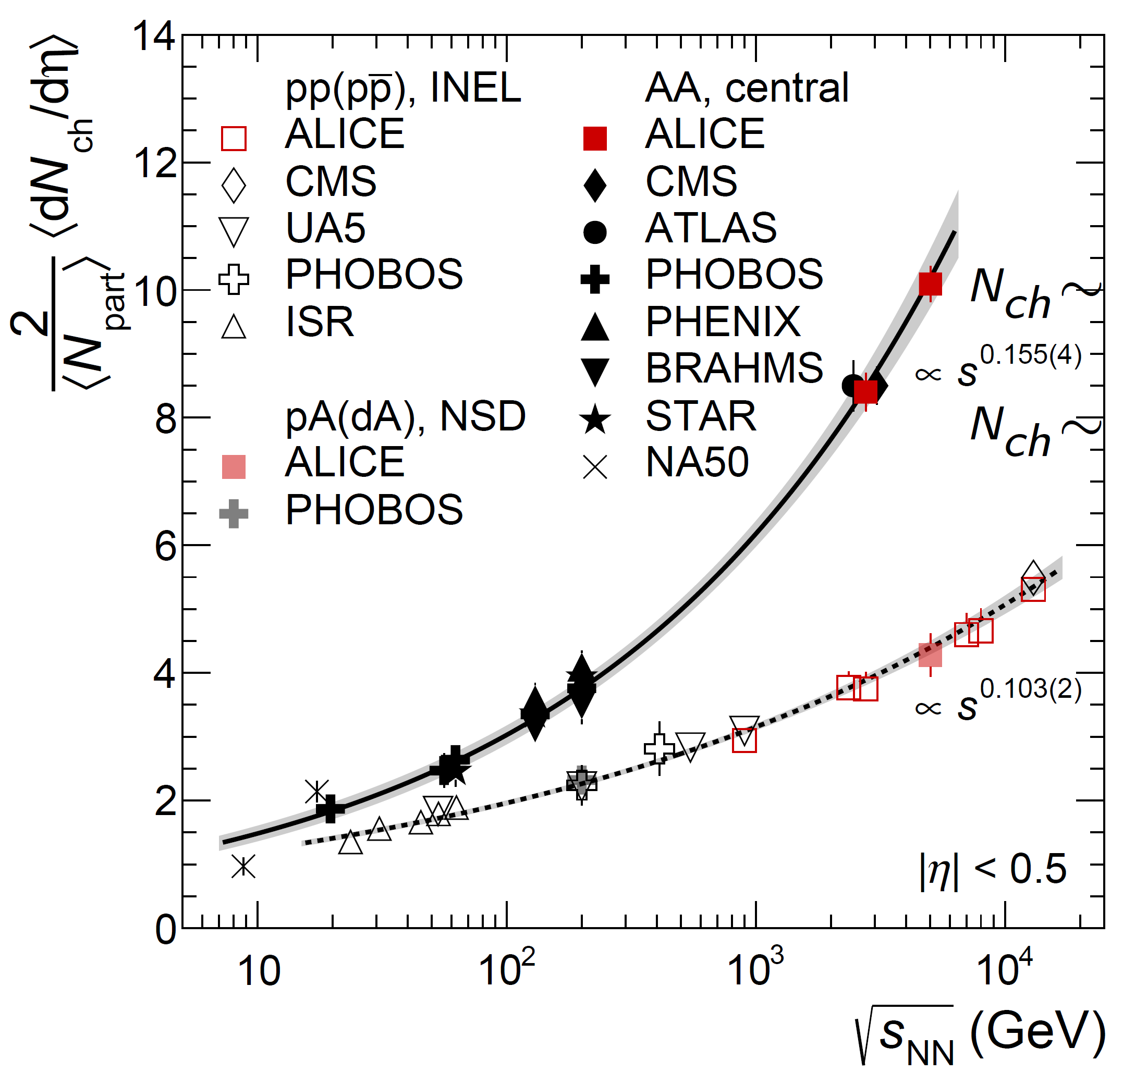
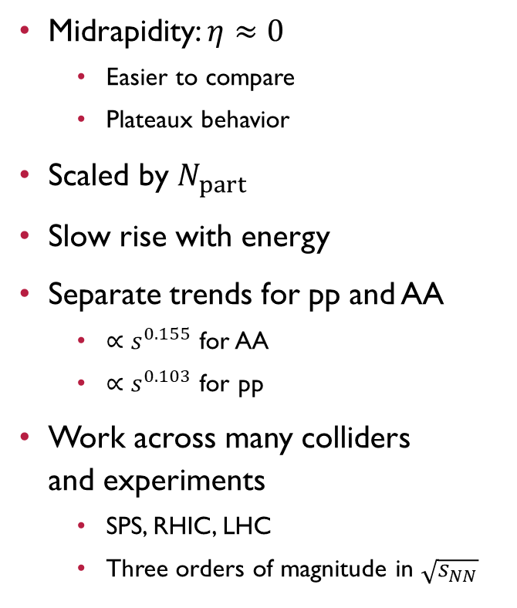
Charged particle Multiplicity evolution
Midrapidity: $η≈0$
  Easier to compare
  Plateaux behavior
Scaled by $N_{part}$
Slow rise with energy
Separate trends for pp and AA
  $∝s^{0.155}$ for AA
  $∝s^{0.103}$ for pp
Work across many colliders
and experiments
  SPS, RHIC, LHC
  Three orders of magnitude in $\sqrt{s_{NN}}$
ALICE, PRL116 (2016) 222302
INTRODUCTION BASIC OBSERVATIONS RECENT RESULTS

Slide 22
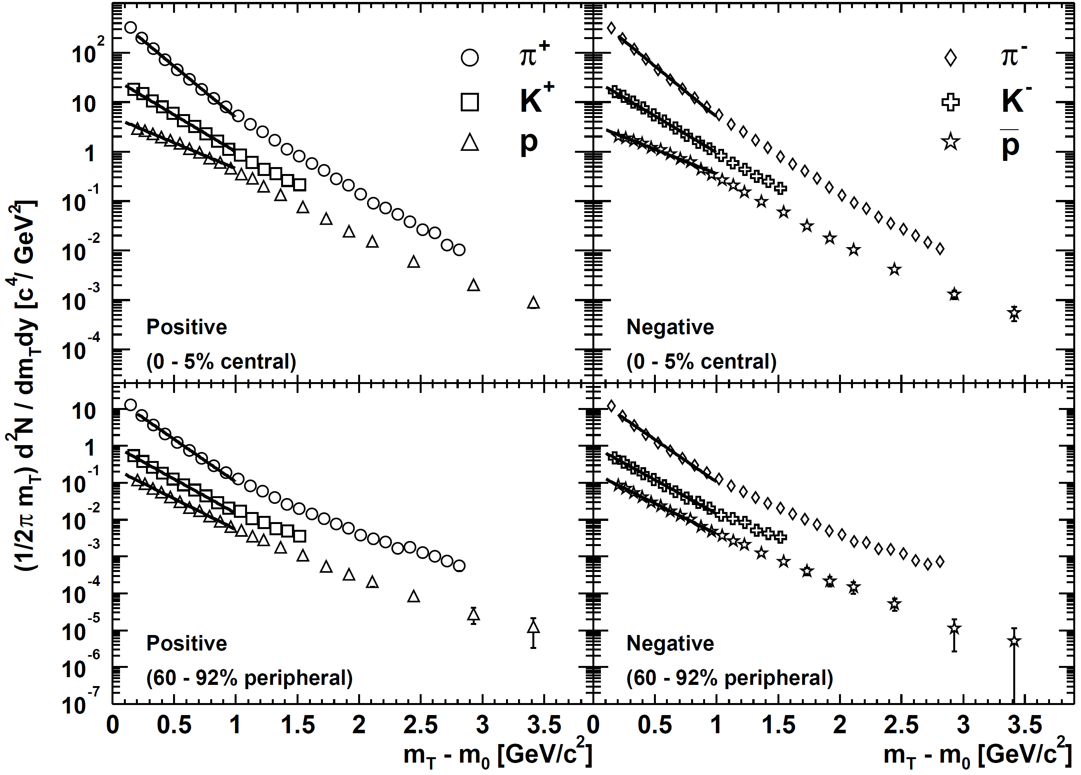
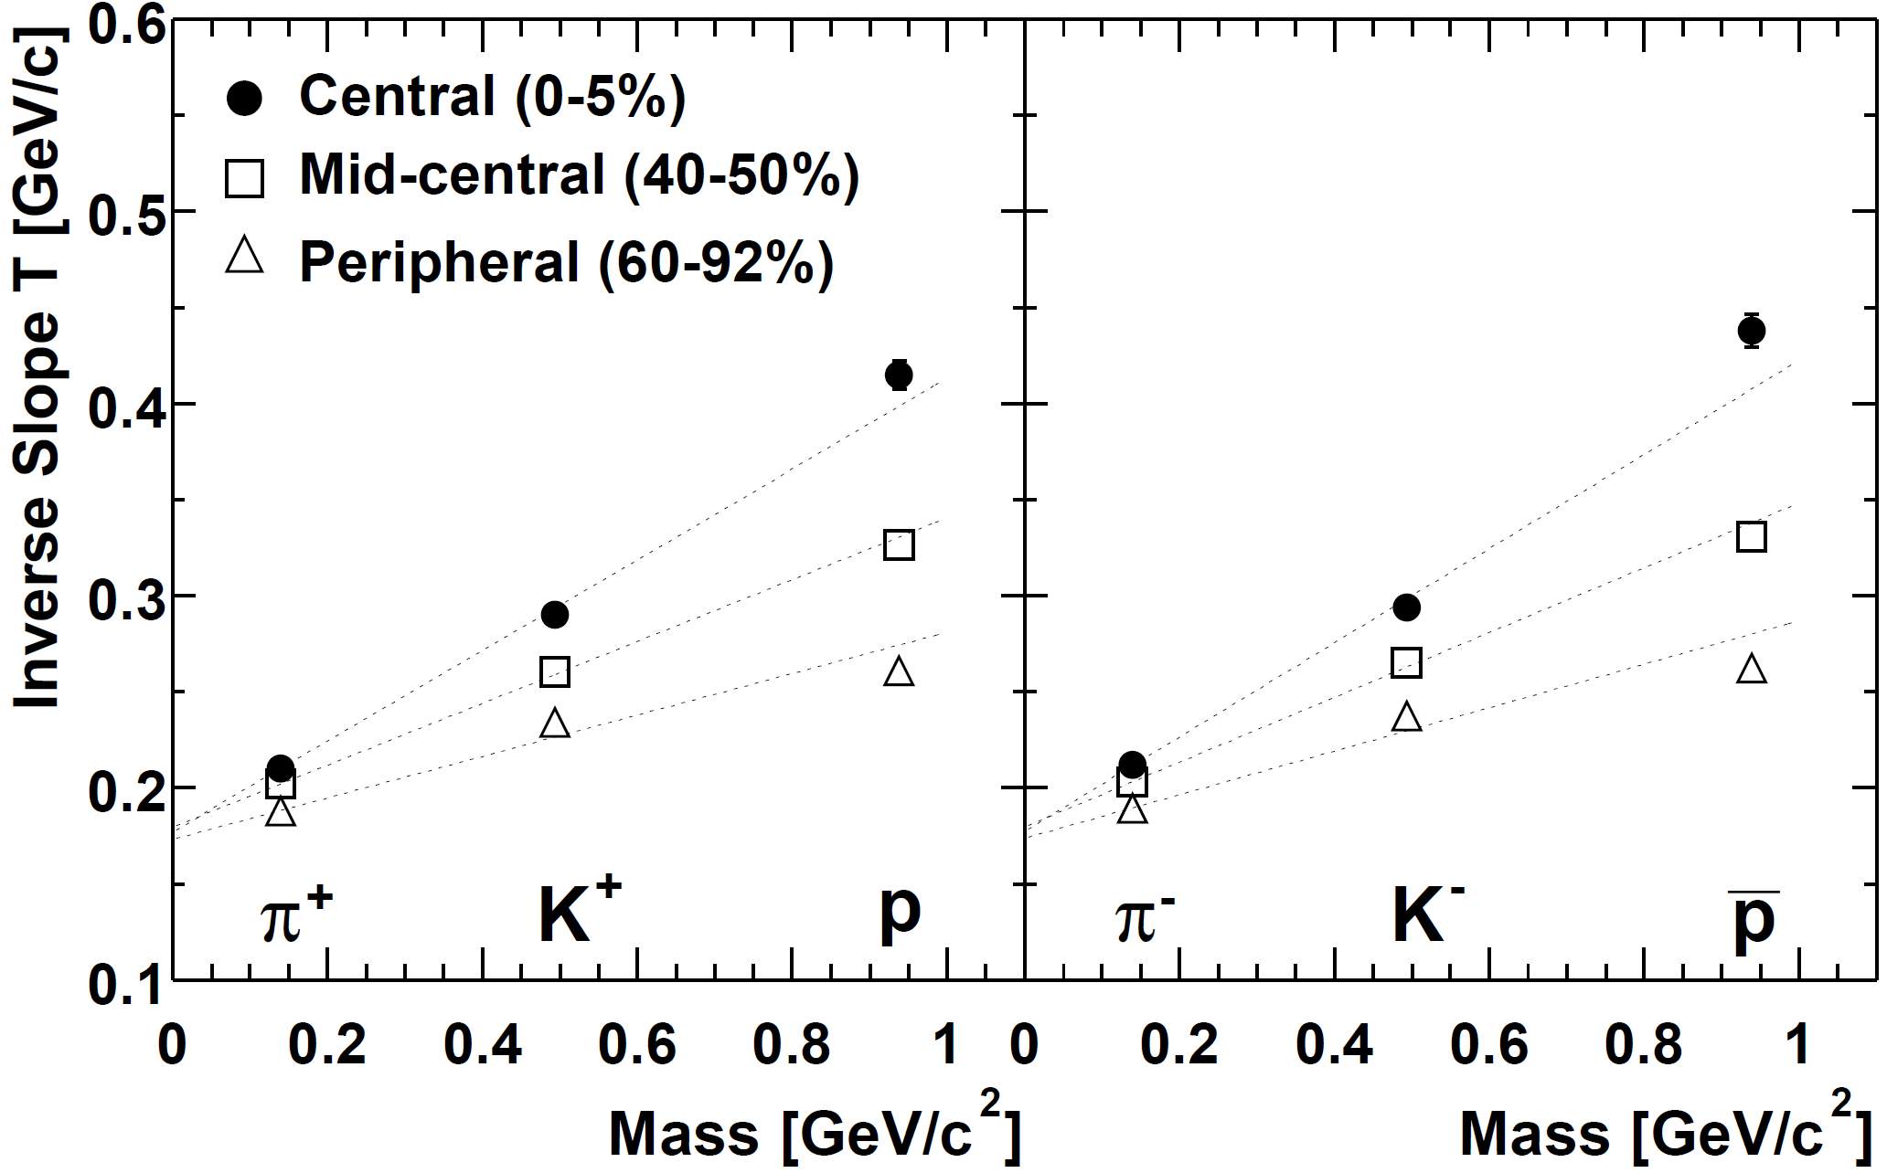

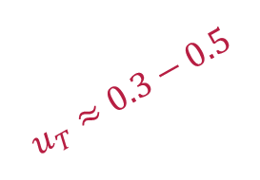

Signs of collective dynamics
Transverse momentum spectra: one of the first measurements usually
  Azimuthally integrated (on $φ$), invariant: $\frac{1}{2πp_{T}}\frac{d^{2}N}{dp_{T}dy}$ or $\frac{1}{2πm_{T}}\frac{d^{2}N}{dm_{T}dy}$
  Boltzmann-like distribution $∝exp{−\frac{m_{T}−m}{T_{eff}}}$, slope: effective temperature
  Simple nonrel. hydro: $T_{eff}=T_{0}+m⋅u_{T}^{2}$, $T_{0}:$ temperature, $u_{T}$: transverse flow velocity
$T_{0}≈175$ MeV
$$u_{T}≈0.3−0.5$$
INTRODUCTION BASIC OBSERVATIONS RECENT RESULTS

Slide 23
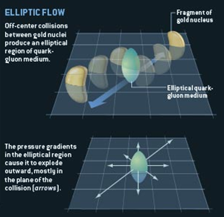
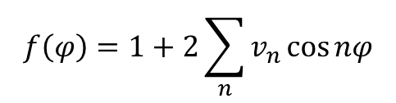
Observation of the elliptic flow
Spatial anisotropy creates
momentum-space anisotropy!
Quantified via
anisotropy
parameters
Zajc, Riordan, Scientific American
φ
$$f\left(φ\right)=1+2\sum_{n}{v_{n}\cos{nφ}}$$
ϕ
0 π 2π
INTRODUCTION BASIC OBSERVATIONS RECENT RESULTS

Slide 24
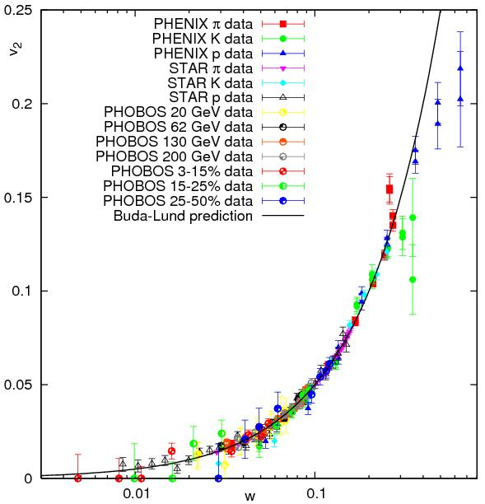
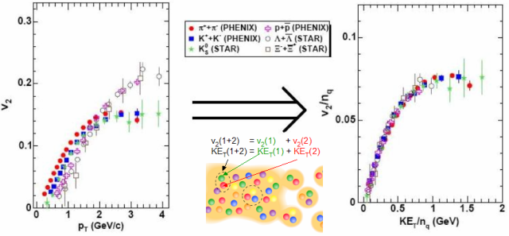

Elliptic flow scaling
Hydro predicts kinetic energy scaling
Coalescence predicts quark number scaling
$$E_{K}^{hadron}=n_{q}E_{K}^{quark}$$
$$v_{n}^{hadron}\left(E_{K}^{hadron}\right)≅n_{q}v_{n}^{quark}\left(E_{K}^{quark}\right)$$
Csörgő, Akkelin, Hama, Lukács, Sinyukov (PRC67, 034904, 2003)
Csanád, Csörgő, Lörstad, Ster (NPA742:80-94,2004)
Csanád, Csörgő, Lörstad, Ster et al. (EPJA38:363-368,2008)
PHENIX Collaboration, Phys.Rev.Lett. 98:162301, 2007
INTRODUCTION BASIC OBSERVATIONS RECENT RESULTS

Slide 25
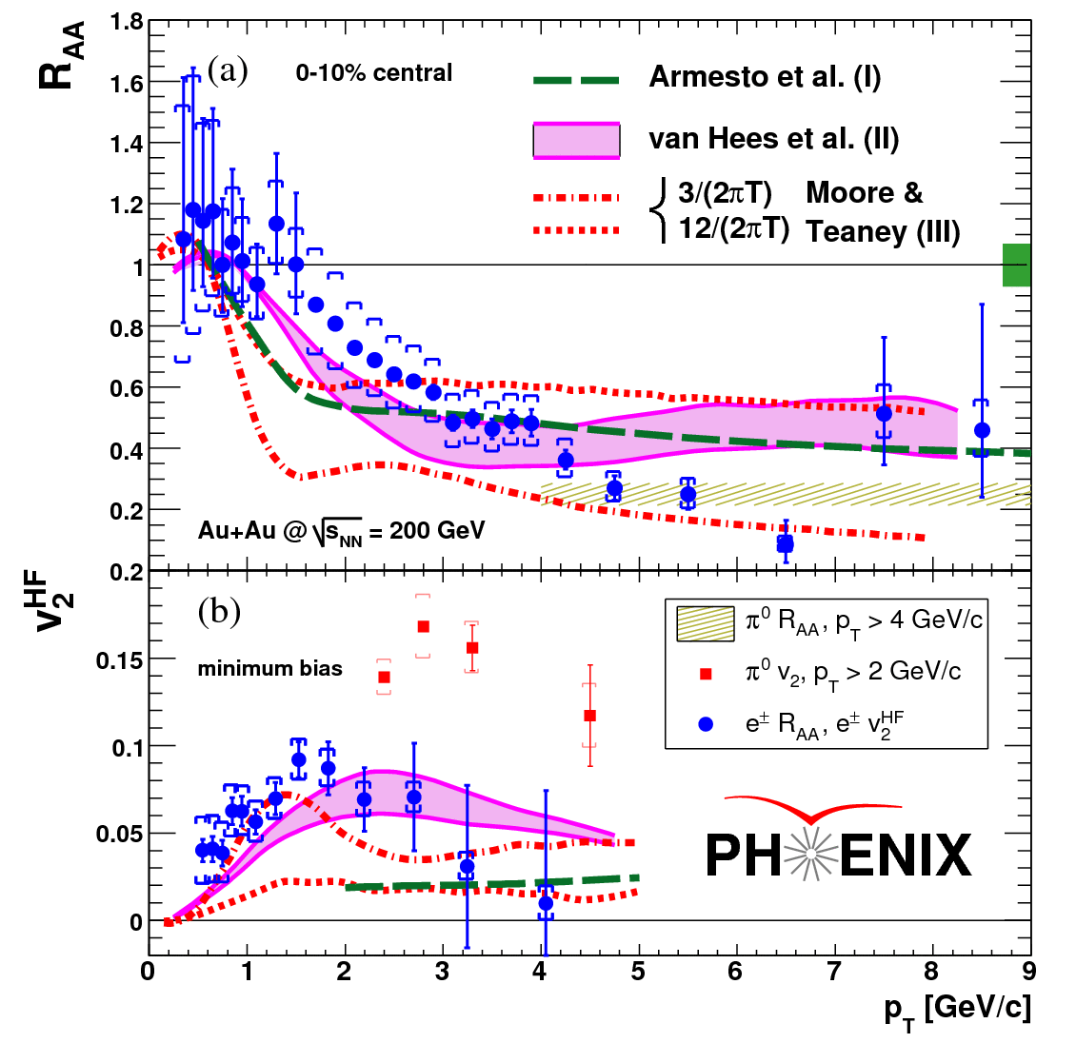
Even heavy flavor flows!
Electrons from heavy flavor measured
Even heavy flavor is suppressed
Even heavy flavor flows
Strong coupling of charm&bottom to the medium
Small charm&bottom relaxation time in medium and small viscosity
INTRODUCTION BASIC OBSERVATIONS RECENT RESULTS

Slide 26
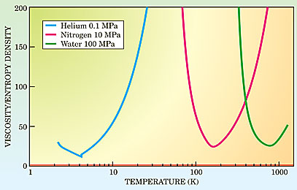
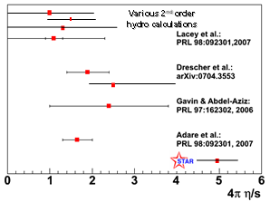
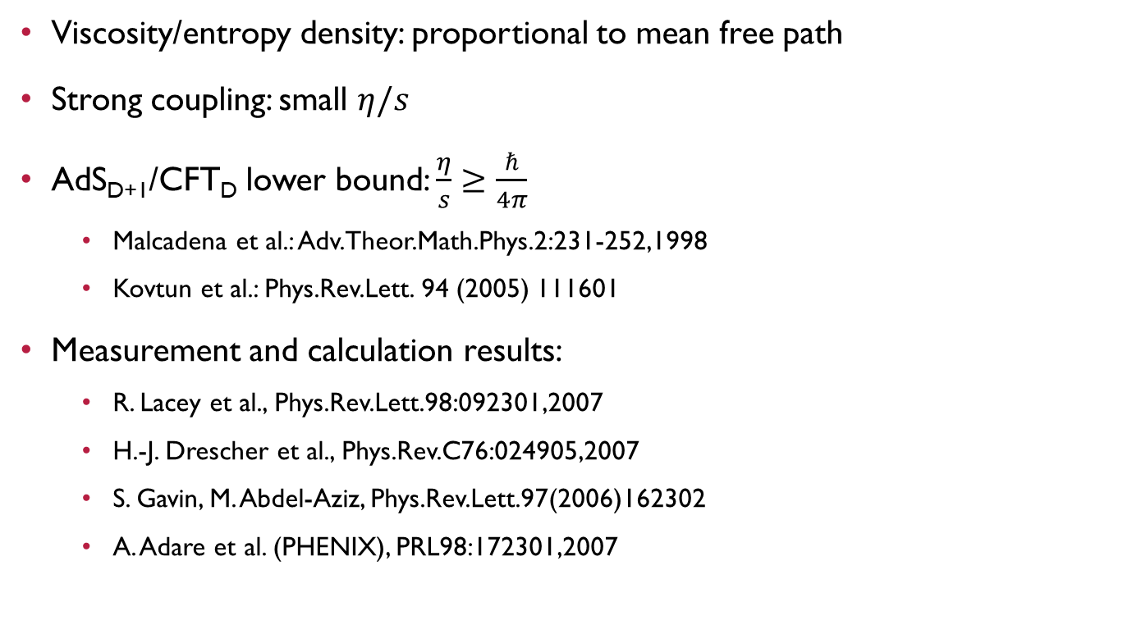
VISCOSITY
Viscosity/entropy density: proportional to mean free path
Strong coupling: small $η/s$
AdS_{D+1}/CFT_{D} lower bound: $\frac{η}{s}≥\frac{ℏ}{4π}$
  Malcadena et al.: Adv.Theor.Math.Phys.2:231-252,1998
  Kovtun et al.: Phys.Rev.Lett. 94 (2005) 111601
Measurement and calculation results:
  R. Lacey et al., Phys.Rev.Lett.98:092301,2007
  H.-J. Drescher et al., Phys.Rev.C76:024905,2007
  S. Gavin, M. Abdel-Aziz, Phys.Rev.Lett.97(2006)162302
  A. Adare et al. (PHENIX), PRL98:172301,2007
INTRODUCTION BASIC OBSERVATIONS RECENT RESULTS

Slide 27
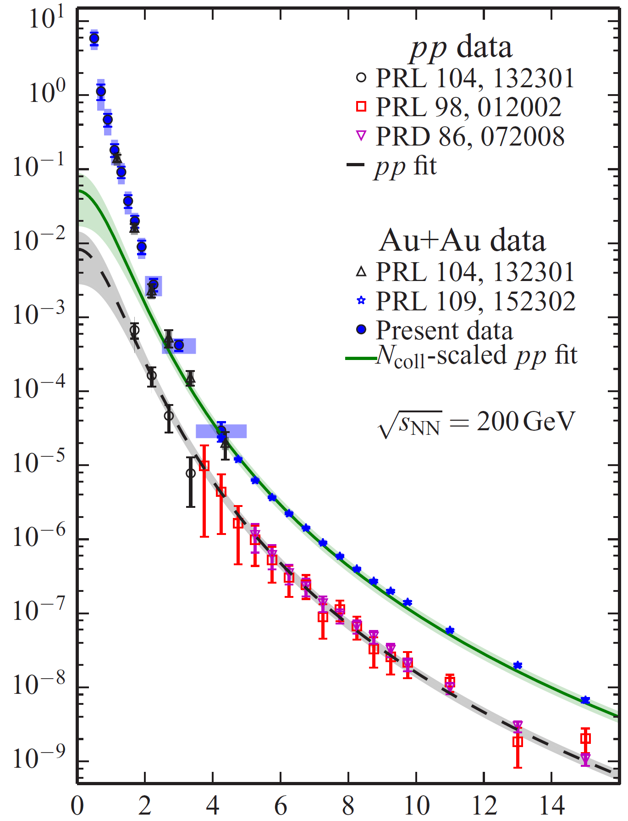
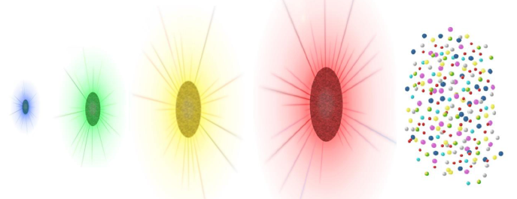
Thermal photons
Thermal photons
Hadron creation: after freeze-out
Direct vs decay photons measured
Soft component in direct photon spectra:
compared to p+p extrapolation
These are thermal photons!
Large initial temperature, 3-600 MeV!
Direct photon spectrum
Prediction based on pp
photons
hadrons
nucleon-nucleon
proton-proton
PRC 91,064904
Transverse momentum [GeV]
INTRODUCTION BASIC OBSERVATIONS RECENT RESULTS

Slide 28
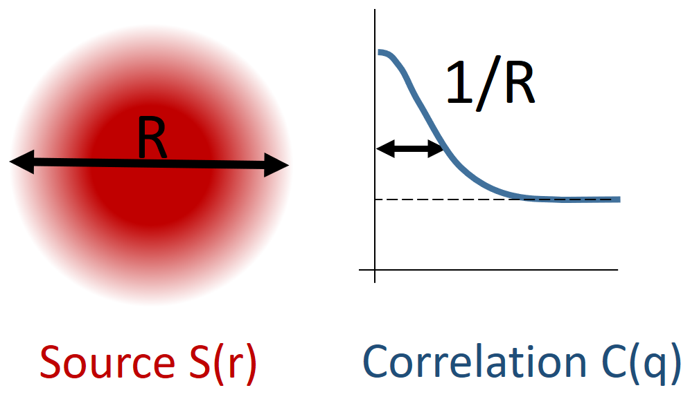

Femtoscopy in heavy ion physics
All particles have a wave nature, are indistinguishable
Hence two-particle wave function is symmetric (on interchange)
${\left|Ψ_{p_{1},p_{2}}\left(x_{1},x_{2}\right)\right|}^{2}=1+\cos{qx}$, where $q=p_{1}−p_{2}$, $x=x_{1}−x_{2}$
Correlation function $C_{2}\left(q\right)={\left\langle {\left|Ψ\right|}^{2}\right\rangle }_{S}$: averaging weighted by source $S(x)$
Result: $C_{2}\left(q\right)≅1+{\left|\tilde{S}\left(q\right)\right|}^{2}$, where $\tilde{S}\left(q\right)=∫S\left(x\right)e^{iqx}d^{4}x$
Correlation radii
measure source geometry!
Effect of flow:
radius R connected to
homogeneity length
INTRODUCTION BASIC OBSERVATIONS RECENT BES RESULTS LÉVY HBT

Slide 29


HBT and the phase transition
C(q) usually measured in the Bertsch-Pratt pair coordinate-system
  out: direction of the average transverse momentum
  long: beam direction
  side: orthogonal to the latter two
R_{out}, R_{side}, R_{long} : HBT radii
Out-side difference → ∆τ emission duration
From a simple hydro calculation:
$R_{out}^{2}=\frac{R^{2}}{1+u_{T}^{2}m_{T}/T_{0}}+β_{T}^{2}Δτ^{2}$, $R_{side}^{2}=\frac{R^{2}}{1+u_{T}^{2}m_{T}/T_{0}}$
RHIC, 200 GeV: $R_{out}≈R_{side}$→ no strong 1st order phase trans.
Plus lots of other details: pre-equilibrium flow, initial state, EoS, ...)
S. Chapman, P. Scotto, U. Heinz, Phys.Rev.Lett. 74 (1995) 4400
T. Csörgő and B. Lörstad, Phys.Rev. C54 (1996) 1390
S. Pratt, Nucl.Phys. A830 (2009) 51C
INTRODUCTION BASIC OBSERVATIONS RECENT RESULTS

Slide 30





Search for the CEp: Fluctuations
Static universality class: 3D Ising (or random field 3D Ising?)
Dynamic universality class? 1 or 3 slow modes? Finite size/time effects?
Look at cumulants: $C_{n}=\left\langle {\left(n−\left\langle n\right\rangle \right)}^{n}\right\rangle$, function of corr. length $ξ\sim {\left|T−T_{c}\right|}^{−ν}$
$C_{n}\sim ξ^{2.5n−3}$ $\left(C_{2}\sim ξ^{2},C_{3}\sim ξ^{4.5},C_{4}\sim ξ^{7}\right)$
Non-monotonicity at CEP:
Usual observables:
$$\frac{M}{σ^{2}}=\frac{C_{1}}{C_{2}}, Sσ=\frac{C_{3}}{C_{2}}, κσ^{2}=\frac{C_{4}}{C_{2}}$$
Finite size effects dampen
divergencies in $ξ$!
Stephanov, IJMPA20,4387(2005)
Stephanov, PRL102, 032301(2009)
Stephanov, PRL107, 052301(2011)
Asakawa et al., PRL103, 262301(2009)
Hatta et al., PRL91,102003(2003)
$$\frac{C_{4}}{C_{2}}$$
$$T$$
STAR, PRL113(2014)092301
STAR, PRL112(2014)032302
INTRODUCTION BASIC OBSERVATIONS RECENT RESULTS

Slide 31

Search for the CEP, finite size/time effects
Finite size limits correlation length: $ξ\sim {\left|T−T_{c}\right|}^{−ν}$ but $ξ<L$!
Only a pseudocritical point can be observed
Clear influence on the phase diagram
Convenient situation: finite size scaling
discloses CEP location
and universality class
  Shift: $\sim L^{−1/ν}$
  Broadening: $\sim L^{−1/ν}$
  Dampening: $\sim L^{−γ/ν}$
T>T_{c}
T near T_{c}
INTRODUCTION BASIC OBSERVATIONS RECENT RESULTS

Slide 32
Summary of the status quo
Jet suppression in A+A
Lack of suppression in d+A
Photons shine through, thermal photons prevail at low momenta
Scaling of the elliptic flow: hydrodynamic medium, quark degrees of freedom
Heavy flavour suppression appears
Bose-Einstein correlations: no 1st order phase transition; 2nd order?
Correlations and fluctuations to search for the CEP
Finite size and time effects important!
INTRODUCTION BASIC OBSERVATIONS RECENT RESULTS

Slide 33
(not so) Recent results
Spectra and yields
Thermal photons
Elliptic flow
Bose-Einstein correlations
Finite size scaling
INTRODUCTION BASIC OBSERVATIONS RECENT RESULTS

Slide 34



Freeze-out
Chemical and kinetic freeze-out parameters via THERMUS and BlastWave
Thermal multiplicity assumption valid
Systematics investigated (parameter constraints, included species)
Separation of T_{ch} and T_{kin} around $\sqrt{s_{NN}}=$4-5 GeV, T_{ch} flattens at ~10 GeV
STAR Collaboration, arXiv:1701.07065
INTRODUCTION BASIC OBSERVATIONS RECENT RESULTS

Slide 35



Particle ratios
AGS, SPS, RHIC, LHC data included
The K/π „horn” still there:
phase transition?
$π^{−}>π^{+}$: baryon decays
Baryon stopping at small $\sqrt{s}$
Proton, kaon pair-prod. at high $\sqrt{s}$
STAR Collaboration
arXiv:1701.07065
INTRODUCTION BASIC OBSERVATIONS RECENT RESULTS

Slide 36




Direct photons
Clear direct $γ$ signal at lower energies as well (yield scaling shown in backup)
T_{eff}(62.4 GeV) = 211±24±24 MeV T_{eff}(39 GeV) = 177±31±68 MeV
INTRODUCTION BASIC OBSERVATIONS RECENT RESULTS

Slide 37


Direct photons universal scaling
3 methods: calorimeter, virtual γ, external conversion
Universal scaling in all AA systems
(PRL123, 022301)
N_{coll} scaled pp: same trend at 10% yield
p+Au and d+Au interpolate between p+p and A+A
Onset of low p_{T} photon radiation at multiplicity of 10?
Wenqing Fan, Zimanyi 2020
INTRODUCTION BASIC OBSERVATIONS RECENT RESULTS

Slide 38

Elliptic flow in the beam energy scan
With Blast-Wave fits
Predictions for not fitted
particles agree well
Flow in all sytems!
STAR Collaboration,
PRC93, 014907 (2016)
INTRODUCTION BASIC OBSERVATIONS RECENT RESULTS

Slide 39

Elliptic flow scaling in the bes
STAR data on mesons from π to φ, baryons from p to Ω
Scaling everywhere, except φ below 11.5 GeV, but little statistics
Phys. Rev. C 88 (2013) 14902
Phys. Rev. C 93 (2016) 014907
Phys. Rev. Lett. 116 (2016) 062301
INTRODUCTION BASIC OBSERVATIONS RECENT RESULTS

Slide 40


Elliptic flow in small systems
Deuteron-gold energy scan (19.6-200 GeV), PHENIX, arXiv:1708.06983
superSONIC in good agreement at 62.4 GeV and 200 GeV
Underpredicts data at 19.6 GeV and 39 GeV
Data still contains nonflow effects: AMPT(EventPlane) w/ nonflow matches
INTRODUCTION BASIC OBSERVATIONS RECENT RESULTS

Slide 41

Origin OF Final state collectivity?
Is it due to the appearance of the sQGP (i.e. a strongly coupled fluid)?
  If yes, how much time is needed to spend in QGP phase?
  Test: d+Au collisions from 20 to 200 GeV
Is it due to initial geometry and hydro?
  Hydrodynamics: initial spatial correlations
  Alternative: initial momentum correlations
  Test: p+Au, d+Au, ³He+Au
  How do v₂ and v₃ evolve with initial state geometry?
INTRODUCTION BASIC OBSERVATIONS RECENT RESULTS

Slide 42


Initial state and hydro evolution
Evolution from SONIC
Initial stage:
  $$ε_{2}^{p+Au}<ε_{2}^{d+Au}≈ε_{2}^{3He+Au}$$
  $$ε_{3}^{p+Au}≈ε_{3}^{d+Au}<ε_{3}^{3He+Au}$$
INTRODUCTION BASIC OBSERVATIONS RECENT RESULTS

Slide 43

Flow in small systems: geometric ordering
Flow ordered similarly as initial state:
  $v_{2}^{p+Au}<v_{2}^{d+Au}≈v_{2}^{3He+Au}$ $v_{3}^{p+Au}≈v_{3}^{d+Au}<v_{3}^{3He+Au}$
Nature Physics 15, 214-220 (2019)
INTRODUCTION BASIC OBSERVATIONS RECENT RESULTS

Slide 44


Comparison to hydro calculations
Hydro calculations
Both 2+1D, $η/s$ = 0.08, MCGlauber initial cond.
Different hadronic rescattering
Nature Physics 15, 214-220 (2019)
p+Au
d+Au
³He+Au
INTRODUCTION BASIC OBSERVATIONS RECENT RESULTS

Slide 45


Is there an alternative explanation?
Hydro: initial state spatial correlations a.k.a. geometry
Final state momentum
correlations
Alternative: initial state momentum correlations
Mace et al. Phys. Rev. Lett. 121, 052301 (2018)
INTRODUCTION BASIC OBSERVATIONS RECENT RESULTS

Slide 46

Alternative model vs Data
MSTV postdiction (Mace, Skokov, Tribedy, Venugopalan, PRL121, 052301)
  Official PRL Erratum: Phys. Rev. Lett. 123,039901(E) (2019)
Before erratum: reasonable v₂ description, misses v₃ ordering
d+Au
³He+Au
p+Au
INTRODUCTION BASIC OBSERVATIONS RECENT RESULTS

Slide 47



All models vs data
Hydro description much better already „by eye”
Tools for discrmination: confidence level
MSTV: multiplicity dependence; test v₂ at same dN/dη
p+Au
d+Au
³He+Au
Nature Physics 15,
214-220 (2019)
INTRODUCTION BASIC OBSERVATIONS RECENT RESULTS

Slide 48


Elliptic flow in p+Pb at the LHC
Identified particle elliptic flow, ALICE pPb @ 5.02 TeV, from pions to Λ’s
Quark number scaling works well; LHC pPb not so small system though…
V. Pacik (ALICE), Quark Matter 2018
INTRODUCTION BASIC OBSERVATIONS RECENT RESULTS

Slide 49


Flow in 13 TeV p+p At CMS
No mass ordering in low multiplicity p+p (v₂ due to jets)
Mass ordering, quark number scaling in high multiplicity pp
CMS, Phys. Lett. B 765 (2017) 193
Note: initial energy density may reach 1 GeV/fm³ already around N_{ch}=10
Csanád et al., Universe 3 (2017) no.1, 9
INTRODUCTION BASIC OBSERVATIONS RECENT RESULTS

Slide 50


Higher order flow coefficients
Nowadays measured up to $v_{9}$
ALICE, JHEP05(2020)085
Most flow in mid-central
Least flow in central:
axial symmetry
Smaller flow in very peripheral:
fluctuations distort geometry
Hydro descriptions work
Role of viscosity: „washes out” higher order anisotropies
Very small viscosity!
INTRODUCTION BASIC OBSERVATIONS RECENT RESULTS

Slide 51


Mixed flow coefficients
Mixed flows: respectively to different event planes
Scalar product method: $Q_{n}={\left\langle e^{inφ}\right\rangle }_{tracks}$, e.g. $v_{4}\left(Ψ_{22}\right)$: two pairs, $Q_{4}$ and $Q_{2}$
CMS, Eur. Phys. J. C 80 (2020) 534
INTRODUCTION BASIC OBSERVATIONS RECENT RESULTS

Slide 52


Directed flow
Pion and kaon $v_{1}$ similar for $+/−$
Rapidity-odd proton $v_{1}$ results
Slope at $y=0$ shows minumum
Hydro with 1st order phase trans: OK
e.g. Petersen et al. PRC78,044901(2008)
Hadronic transport & UrQMD fail
e.g. Isse et al. PRC72,064908(2005)
Softest point collapse at 1st order PT?
STAR Coll., PRL112 (2014)162301
More recently arXiv:1708.07132,
coalescence assumptions invalid
at the lowest energy?
INTRODUCTION BASIC OBSERVATIONS RECENT RESULTS

Slide 53



Search for the CEP: FluCtuations
Changing trend for net-protons at $\sqrt{s_{NN}}$ ~ 20 GeV for p_{T} up to 2 GeV
No such trend for kaons (for p_{T} up to 1.6 GeV)
Kaons less
sensitive than
protons
More data
to be collected
in BES-II
Roli Esha, STAR, QM17
STAR Collaboration, 1709.00773
INTRODUCTION BASIC OBSERVATIONS RECENT RESULTS

Slide 54


HBT radii and the search for the CEP
Signals of QCD CEP: softest point, long emission
$R_{out}^{2}−R_{side}^{2}$: related to emission duration
$(R_{side}−\sqrt{2}\overline{R})/R_{long}$: related to expansion velocity, $\overline{R}$: initial transverse size
Non-monotonic patterns
Indication of the CEP?
Further details in
Roy Lacey, arXiv:1606.08071 &
arXiv:1411.7931 (PRL114)
How about finite size scaling?
INTRODUCTION BASIC OBSERVATIONS RECENT RESULTS

Slide 55






Finite size effects and the CEP search
Finite size scaling analysis with $L=\overline{R}$, peak position and height tell $ν$ and $γ$
Critical EndPoint location for $L→∞$: $\sqrt{s_{NN}}≈47.5$ GeV
Scaling vs $t_{T}=\frac{T−T_{c}}{T_{c}},$ $t_{μ_{B}}=\frac{μ_{B}−μ_{B,c}}{μ_{B,c}}$: $T_{c}=165$ MeV & $μ_{B}=95$ MeV
Peak position [TeV]
$$\sim L^{−1/ν}→ν≈0.66$$
Peak height [fm²]
$$\sim L^{γ/ν}→ γ≈1.3$$
Roy Lacey, PRL114 (2015),142301
INTRODUCTION BASIC OBSERVATIONS RECENT RESULTS

Slide 56

Summary of the Recent results
Freeze-out curve mostly known down to $μ_{B}=400$ MeV
No very clear change in some usual observables down to 7.7 GeV
  Even small size and energy systems exhibit flow features
  Thermal photons appear also down to $\sqrt{s_{NN}}=39$ GeV
  Heavy flavor suppression similar over broad range
  No clearly apparent fluctuation in cumulant ratios
Note however:
  Lack of suppression for $\sqrt{s_{NN}}<20−30$ GeV
  Directed net-proton flow shows minimum: softest point?
  Non-monotonicity in the HBT radii
  Finite size scaling relations tested
INTRODUCTION BASIC OBSERVATIONS RECENT RESULTS

Slide 57


Summary
Clear consensus on a list of QGP signs
Some appear also at low energies, for small systems
Note however finite size scaling for HBT radii and cumulant ratios
Strong efforts and plans at SPS, RHIC, NICA, FAIR, J-PARC
SPS
J-PARC HI
INTRODUCTION BASIC OBSERVATIONS RECENT RESULTS

Slide 58

Thank you for your attention
SPS
J-PARC HI
If you are interested in these subjects, come to our
Zimányi School 2021
December 6-10, Budapest, Hungary
http://zimanyischool.kfki.hu/21

Slide 59
BACKUP

Slide 60





heavy flavor suppression & regeneration
Timeline: quarkonium ($\text{q}\overline{\text{q}}$) formation $→$ QGP evolution $→$ $\text{q}\overline{\text{q}}$ decay
Quarkonia experience the whole QGP evolution, competing processes
Suppression due to color-screening: temperature and size/mass dependence
Statistical
regeneration
in time:
Images from J Castillo, SQM17 and A Mócsy, HardProbes2009
INTRODUCTION BASIC OBSERVATIONS RECENT BES RESULTS LÉVY HBT

